Slide 1
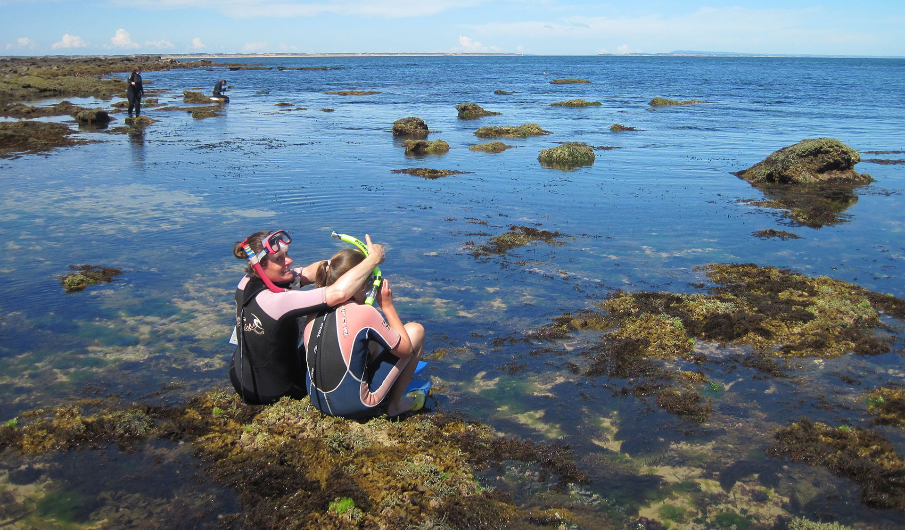


Coastal Custodians, Citizens and Scientists
Science Communicators &
Citizen Scientist
Profiles
Parks Victoria

Slide 2

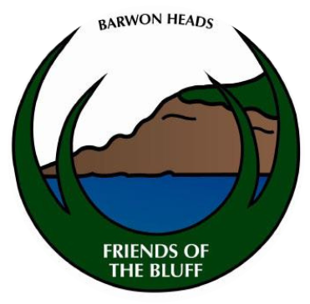
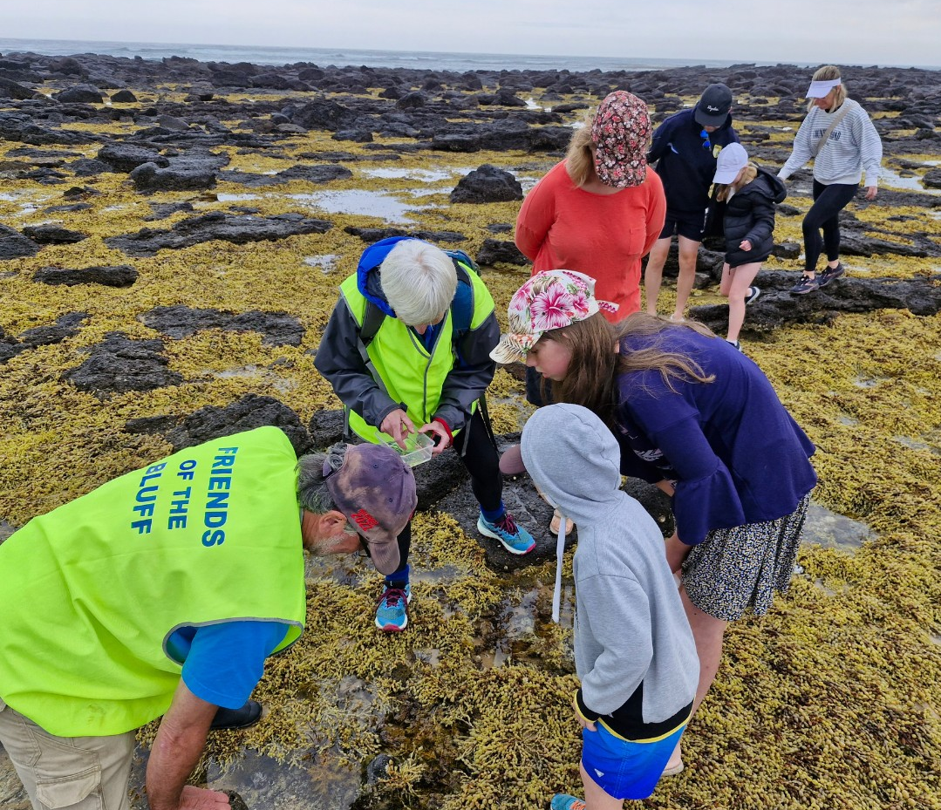
Friends of the Bluff
Community Volunteer Group
- “Our aim is to care for and maintain the remnant natural habitat of the Barwon Heads area, ensuring that something is left for future generations.”
Volunteers & Citizen Science Communicators
Friends of the Bluff create all kinds of science communication tools;
Local weed brochures,
Guided walks & booklets for self-guided walks,
Website, educational CD & digital app,
Festival of the Sea event: seminars, forums & interactivities activities,
The ‘Lobster Pot’ – a community centre promoting environmental, cultural and social heritage of the Barwon Heads.

Slide 3
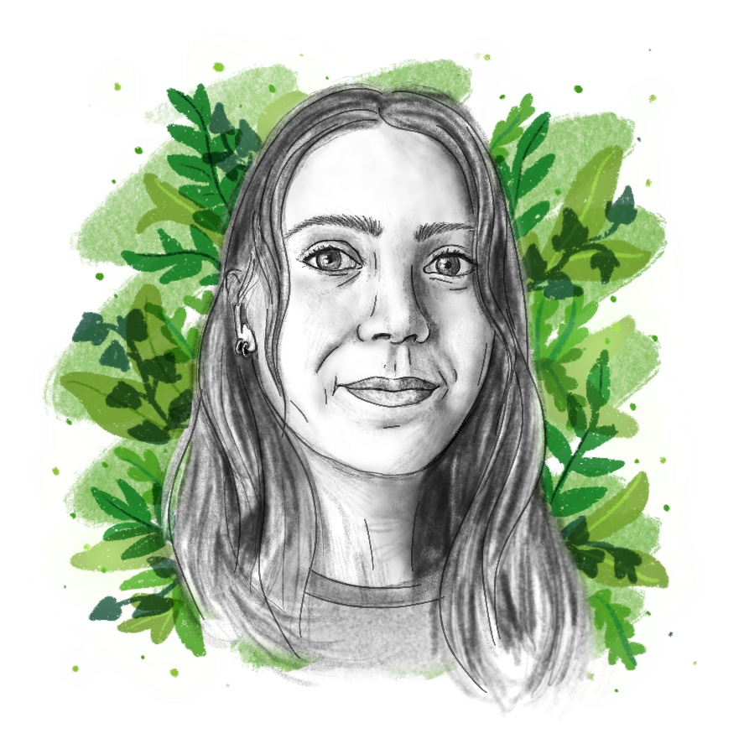
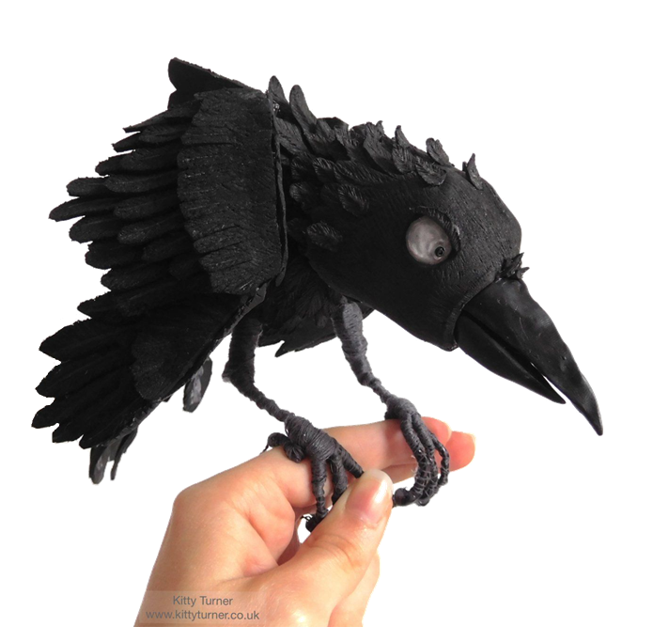
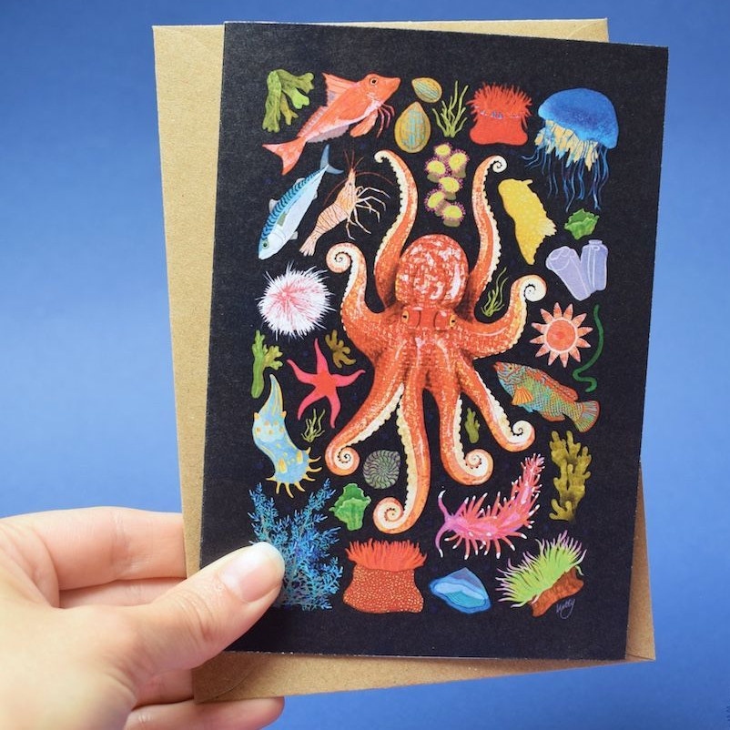
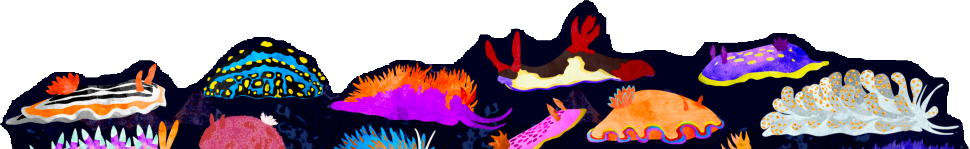
Kitty Turner
Illustrator & Maker
- “My artwork is primarily inspired by nature and often explores the amazing variety of colours, species and patterns found around us. I explore these themes through illustration, model making, puppetry and animation to connect with people in different ways.”
@kturnerillustration
www.kittyturner.com
Artist & Citizen Science Communicator
Based on her fascination with sea slugs - Kitty decided to create an illustrated informational book so children (and adults) can learn more about them in a fun and interesting way.

Slide 4
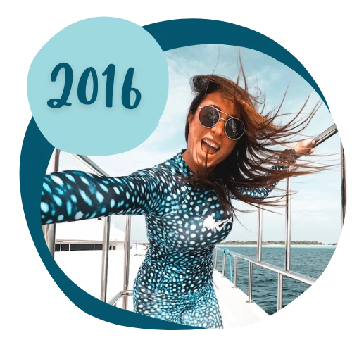

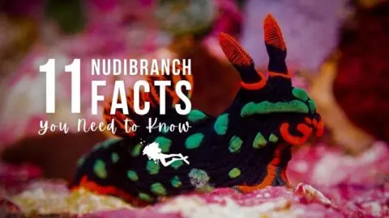
Sarah Richard
Dive Master
- “I was the only woman divemaster working on a boat in Micronesia and I wanted more women to talk to about diving. There was a lack of spaces online, I made my own.”
https://www.girlsthatscuba.com/
Scuba & Citizen Science Communicators
Girls that Scuba is the largest women’s diving community
online!
They share equipment reviews, and dive advice, as well as educational articles based on their observations and experiences with marine life.

Slide 5
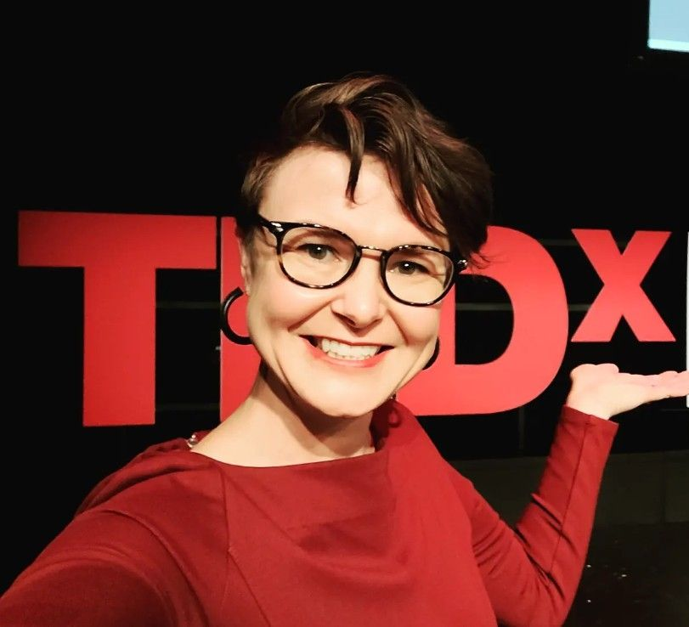
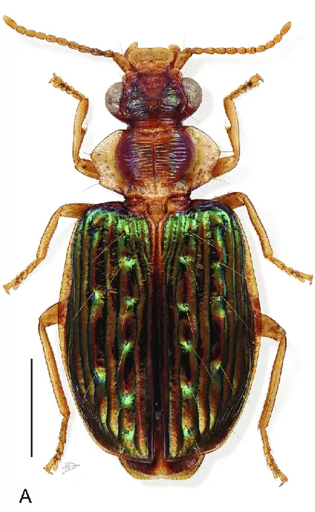
Shasta Henry aka the Bug Dr
Ecologist, PhD
      “I made this Schools Kit!
I have had several jobs in communication. I worked in eco-tourism, where my first tour went along the coast introducing people to crustaceans. I didn’t know
I wanted to be a scientist until I began studying my
favourite subject at university, bugs. Now I even have a
species of beetle named after me.”
Hyboptera shasta
@hybopterashasta
Scientist & Science Communicator
With help from my colleagues at Coastcare Victoria and Ecolinc, I used my research skills and my interest in ecology to design this Schools Kit. I have written lots of boring papers about interesting things. So, I hope you’re learning lots but having fun too.
I believe that - No science is complete until it is communicated.

