Slide 1



Sanctuaries and Sea Creatures: Ricketts Point

Slide 2

Lesson outline
Ricketts Point video
Activity: Marine life bingo game
Activity: Quiz
Activity: Habitats and adaptations
Activity: Biotic and abiotic factors
Activity: Classification
Investigation: Marine sanctuaries

Slide 3
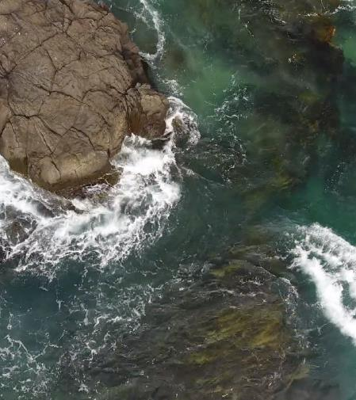
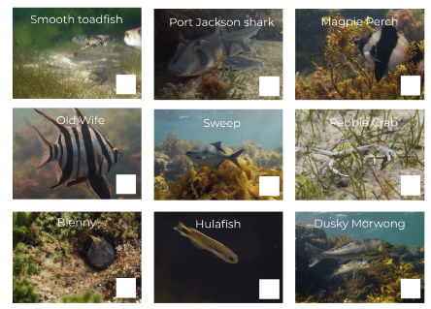


Marine life bingo
Each bingo card is unique
Tick off species as they are mentioned
Call ‘BINGO’ once all your species have been ticked off
First to call ‘BINGO’ wins
Keep going until the end of the video
Try and work out which three species are missing from your card.

Slide 4
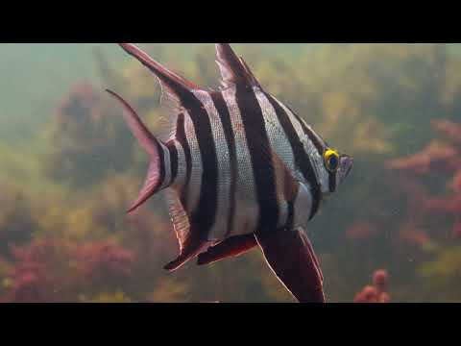
Video: Beneath the Waves at Ricketts Point
Join Jack Breedon for this calming journey underwater at Ricketts Point, to discover the beautiful marine life that is just on the doorstep of Melbourne's CBD.

Slide 5

Quiz
It’s time for a quick quiz to see what you can remember from the video!
There are a total of 10 multiple choice questions

Slide 6
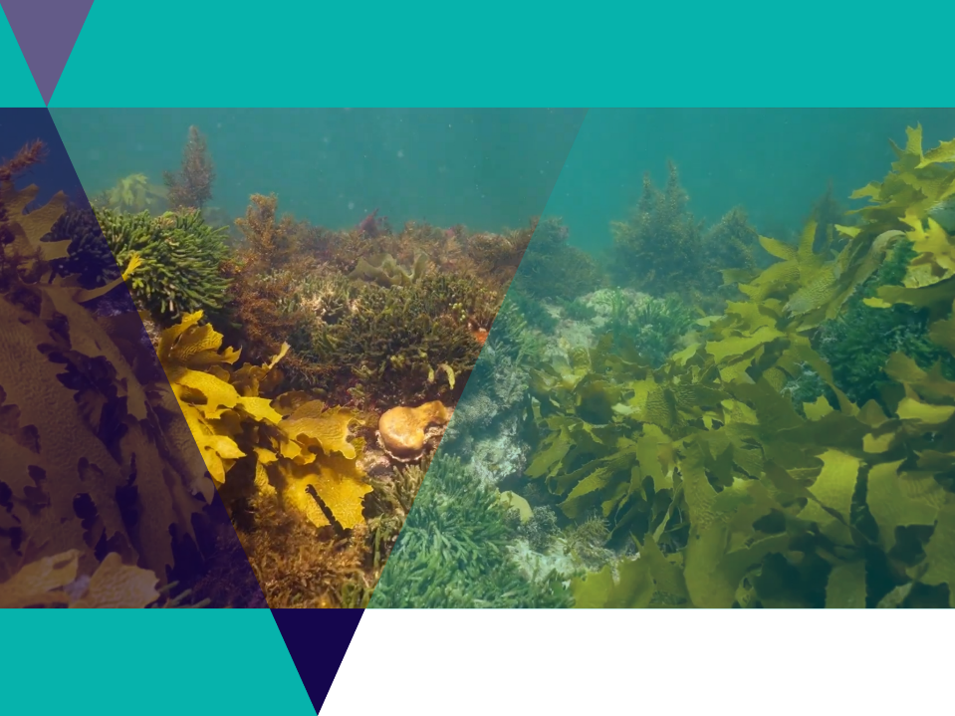
Habitats
Ricketts Point Marine Sanctuary offers a diverse range of habitats.
A habitat is the place where an organism makes its home.

Slide 7
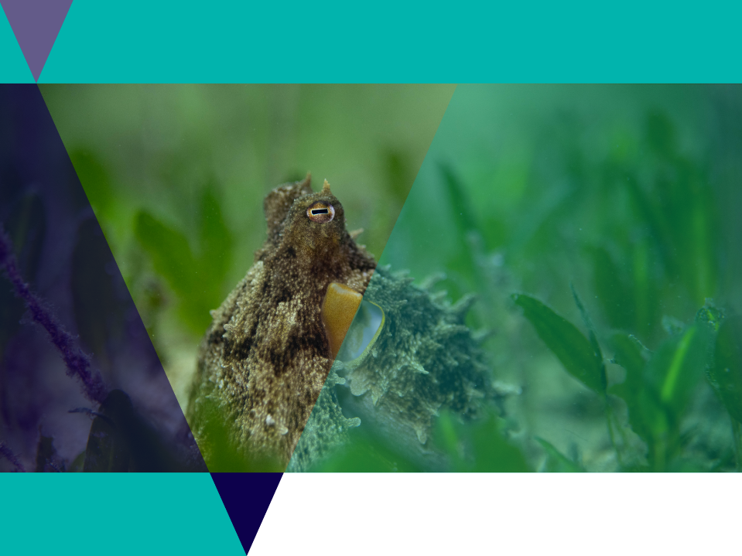
Adaptations
An adaptation is a special skill which helps an organism (a living thing) to survive and do everything it needs to do.
Adaptations help and organism to survive / reproduce.
For example an octopus has excellent eyesight for hunting and highly advanced skin cells called chromatophores used for camouflage.

Slide 8
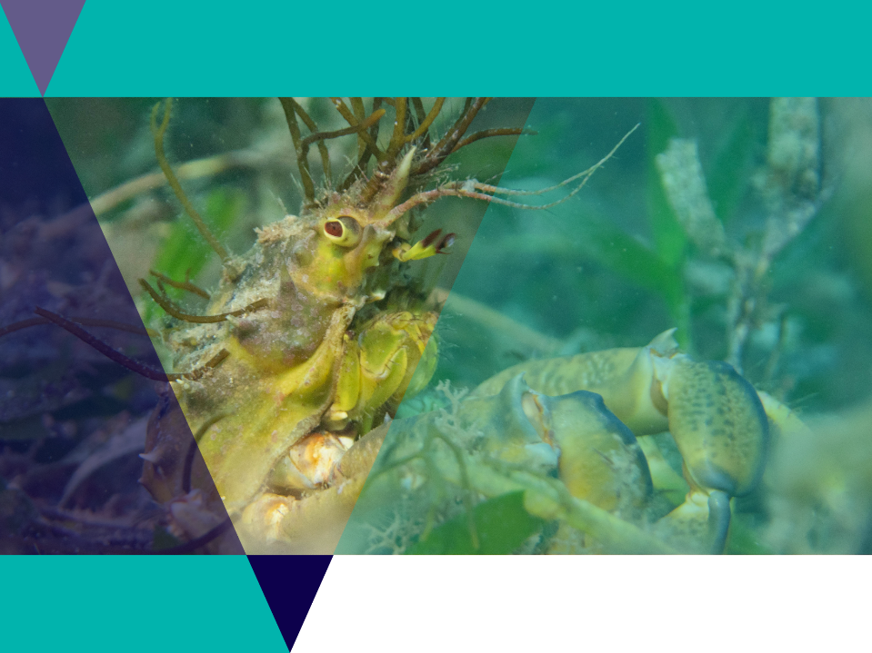
Adaptations
There are three main types of adaptations:
  Behavioural
  Physiological
  Structural

Slide 9
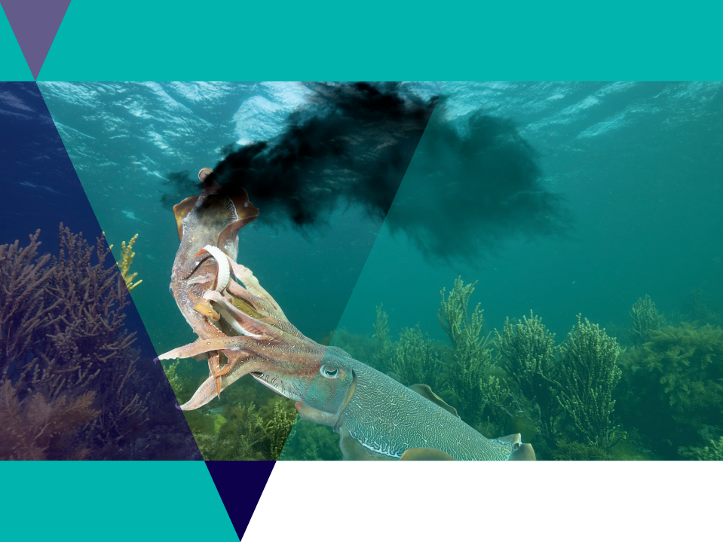
Adaptations
Behavioural adaptations are things organisms do to survive or reproduce.
For example - a cuttlefish may release a cloud of ink to escape from a predator.

Slide 10
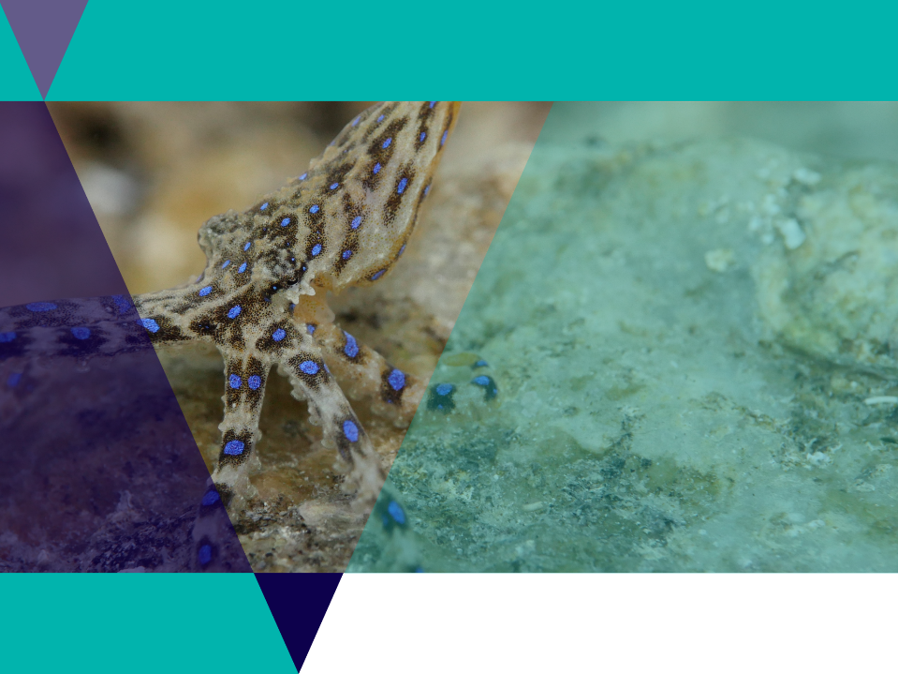
Adaptations
A physiological adaptation is a body process that helps an organism survive / reproduce.
For example - a blue ringed octopus makes venom.

Slide 11
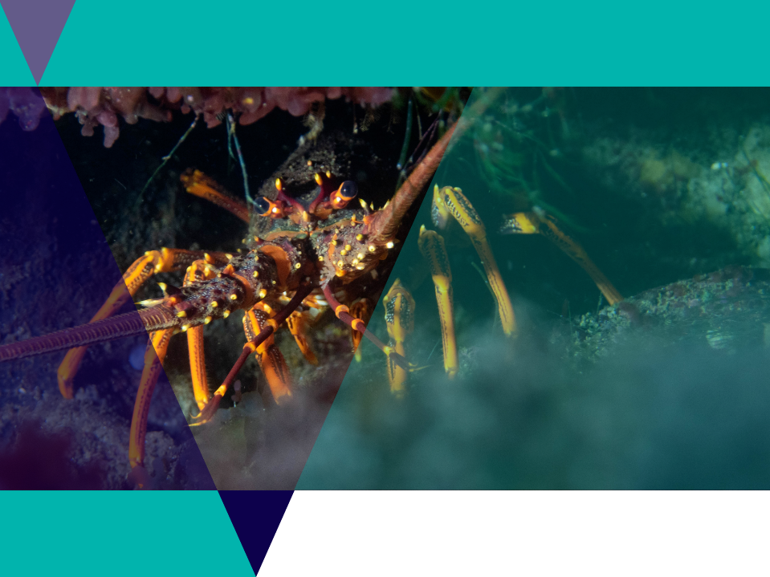
Adaptations
A structural adaptation is a physical feature that helps an organism survive / reproduce.
For example - a rock lobster has a hard exoskeleton and long antenna for protection.

Slide 12
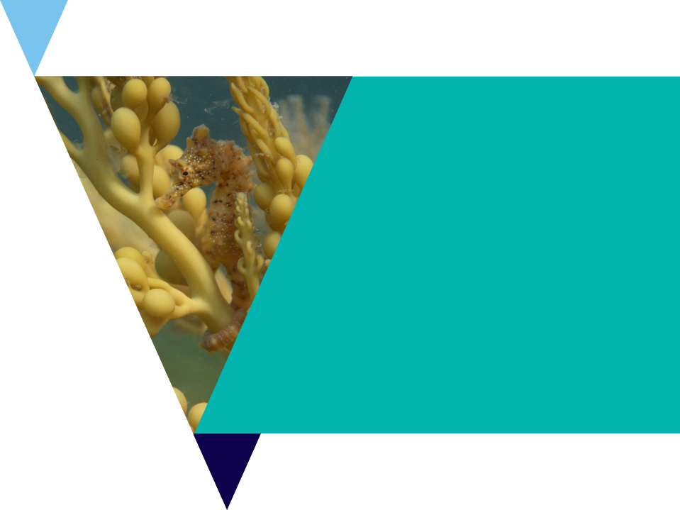
Design challenge
Design and draw the “ideal creature” best adapted to the kelp forest habitat.
Describe in a paragraph how this make the organism well suited to the kelp forest?

Slide 13
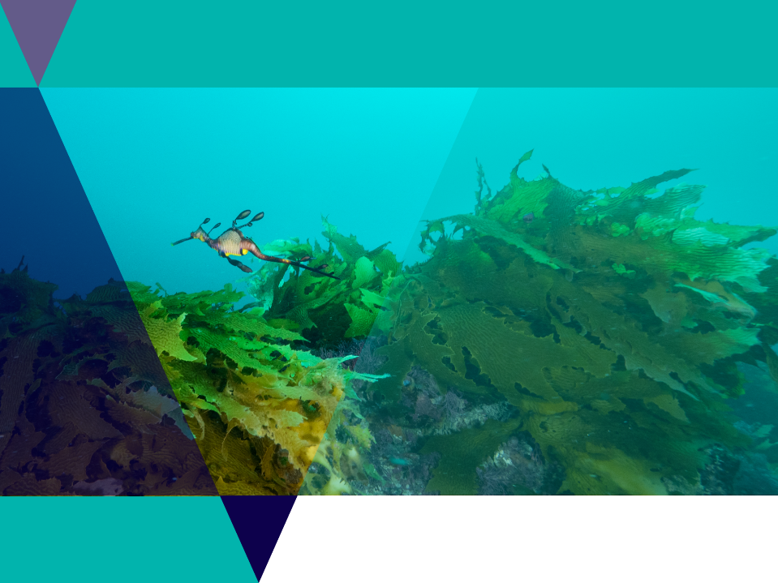
Biotic factors
An environment is made up of both living and nonliving things.
The biotic (living) factors consist of organisms and their products and wastes.
Biotic is anything living and can include plants, algae and microorganisms.

Slide 14

Abiotic factors
An abiotic factor is a non-living part of an ecosystem that shapes its environment.
Examples could be salinity, temperature and ocean currents.

Slide 15
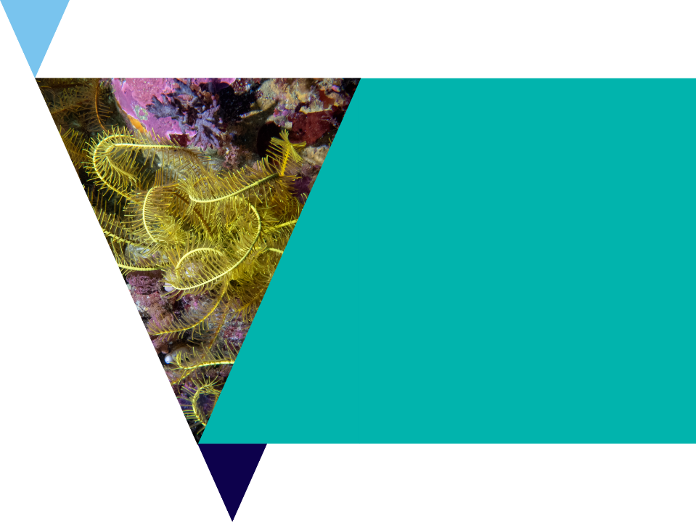
Class game
All students must start the game standing up
One ‘factor’ will be read out at a time by the teacher.
Stand up with arms up means your guess is the factor is biotic (living)
Standing up with arms by your side means your guessing the factor is abiotic (non-living).
You must sit down if you guess incorrectly.
Last one standing wins.

Slide 16
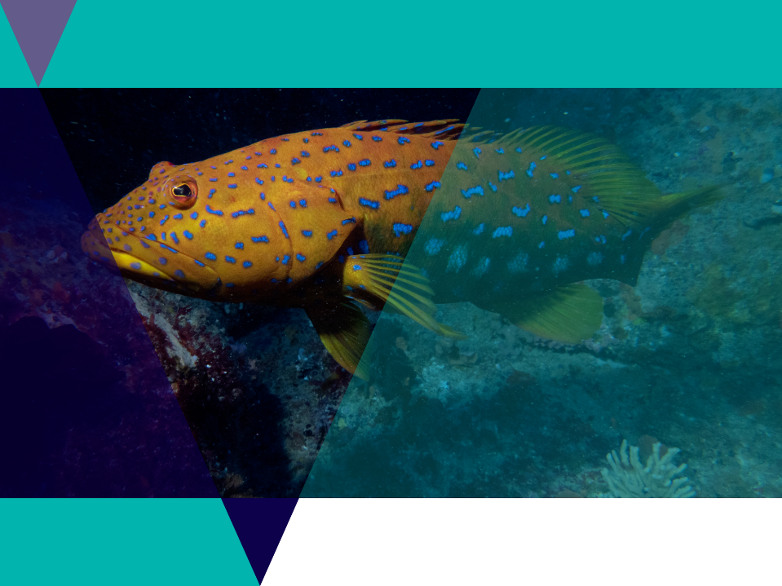
Classification
Classification is a system used by scientists to describe organisms.
To classify things means to place them in different categories, or groups.
Can you think of any ways to group your bingo cards? Compare your grouping with a partner.

Slide 17
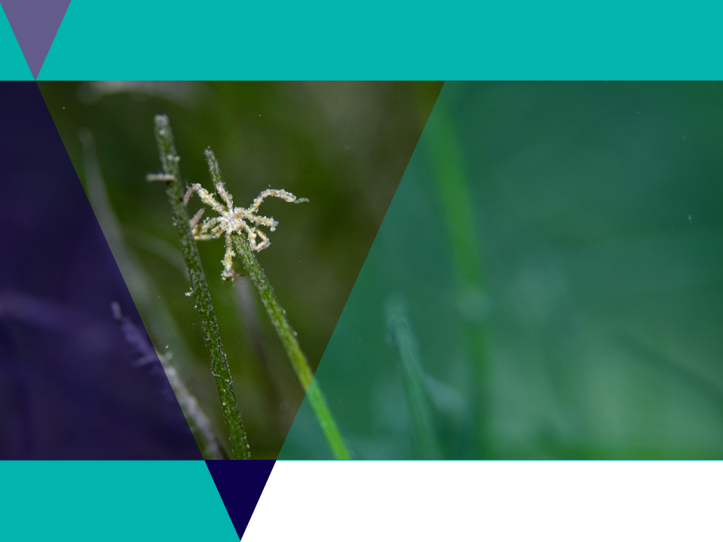
Classification
A classification key is a series of questions that determine an organism's physical characteristics.
When you answer one question, it either branches off to another question or identifies the organism.
Classification keys help to identify an unknown organism, or work out how to categorise groups of similar organisms.

Slide 18
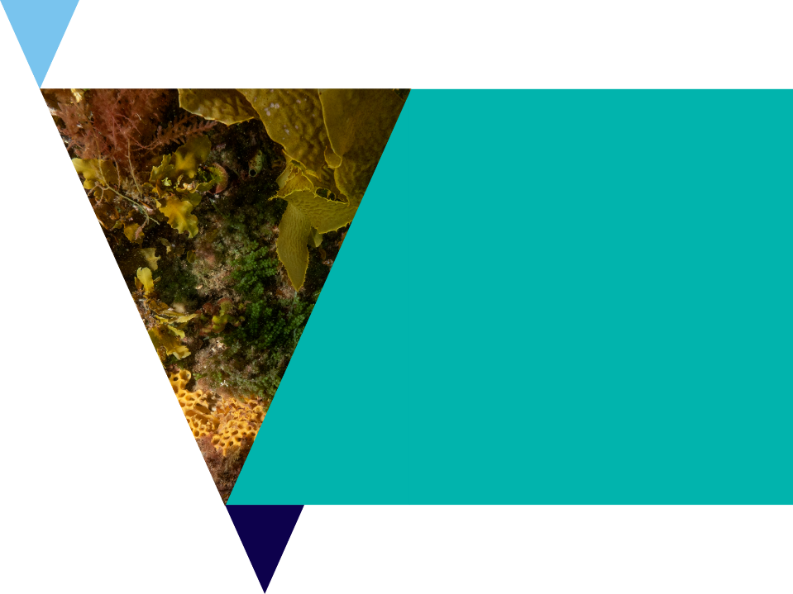
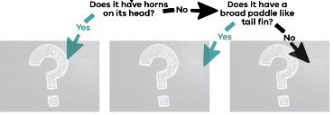
Classification activity
Neatly cut out your bingo cards.
In pairs, randomly choose one card and place it in front of you without showing your partner.
Pose questions to try and guess the species on your partners card.
If the answer is ‘yes’ you can ask another question. If the answer is ‘no’ it is the other person’s turn.
Continue until you choose the correct organism.
Work out places for all of the cards on your worksheet.

Slide 19
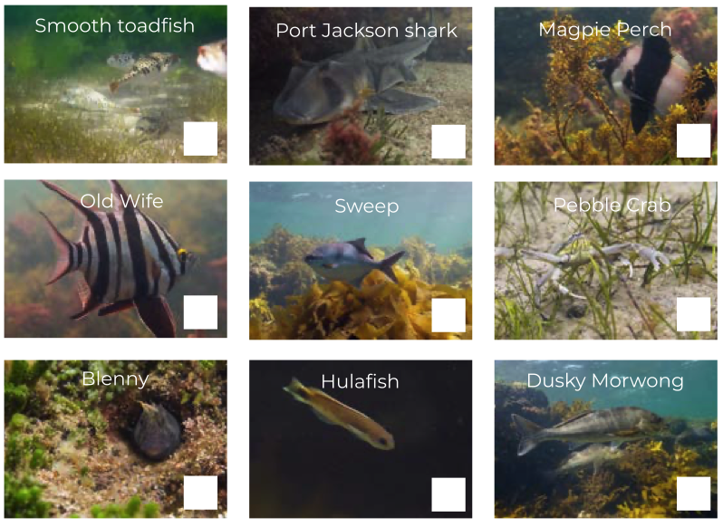
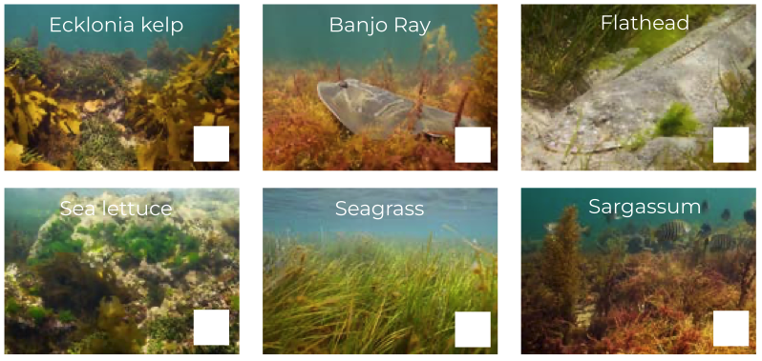
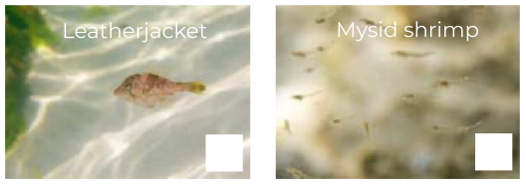
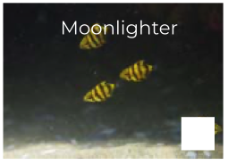
Marine life
bingo cards

Slide 20
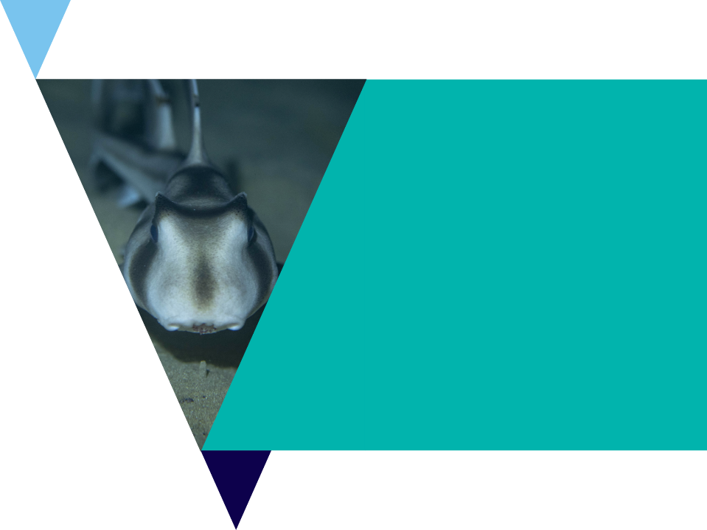
Classification activity
Now it’s time to create your own classification key using the marine life bingo cards.
Test your classification key with a partner.

Slide 21

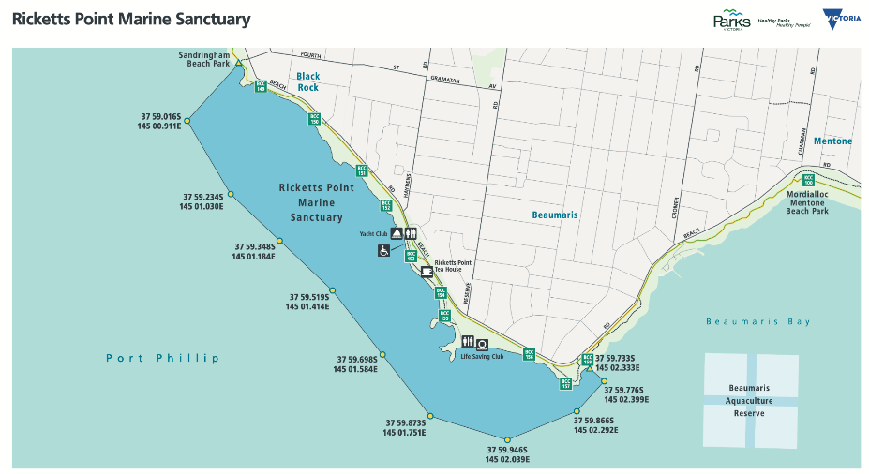
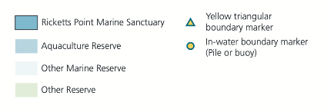
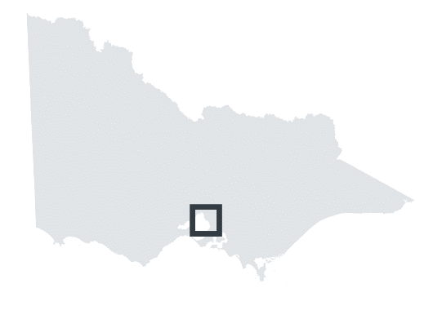

Slide 22

Marine Sanctuaries
Research Task
Research the following questions:
What activities are not permitted in a marine sanctuary?
What activities are permitted in a marine sanctuary?
Why are marine sanctuaries important areas?
What is the difference between a marine park and a marine sanctuary?
How many other marine parks and sanctuaries are in Victoria?

Slide 23

Marine Sanctuaries
Research Task
Your task is to create a pamphlet to promote one of Victoria’s marine sanctuaries.
The pamphlet must include a map and may use information from questions answered on the previous slide but should also focus on the following:
What is unique about this marine sanctuary?
How big is it?
What does this size compare to?
What facilities are in the area and what are good activities to do here?
Are there any ecotourism operators / opportunities?
What are the local threats to this area?

