Slide 1


Action and Innovation: Litter Stopper

Slide 2

Lesson outline
Video
Quiz
Activity: Litter alert
Activity: Compare the catch
Activity: Plastic free alternatives
Investigation: Pinpointing the problem
Investigation: Local action

Slide 3
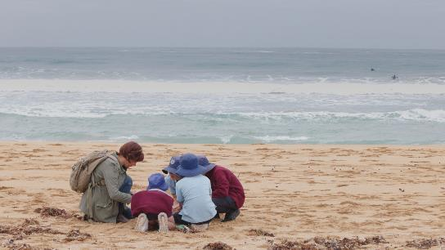


Video: Action and Innovation: Litter Stopper
Video Link: https://www.marineandcoasts.vic.gov.au/coastal-programs/coastcare-victoria/coastcare-victoria-school-kit

Slide 4

Quiz
It’s time for a quick quiz to see what you can remember from the video!
There are a total of 10 multiple choice questions.

Slide 5
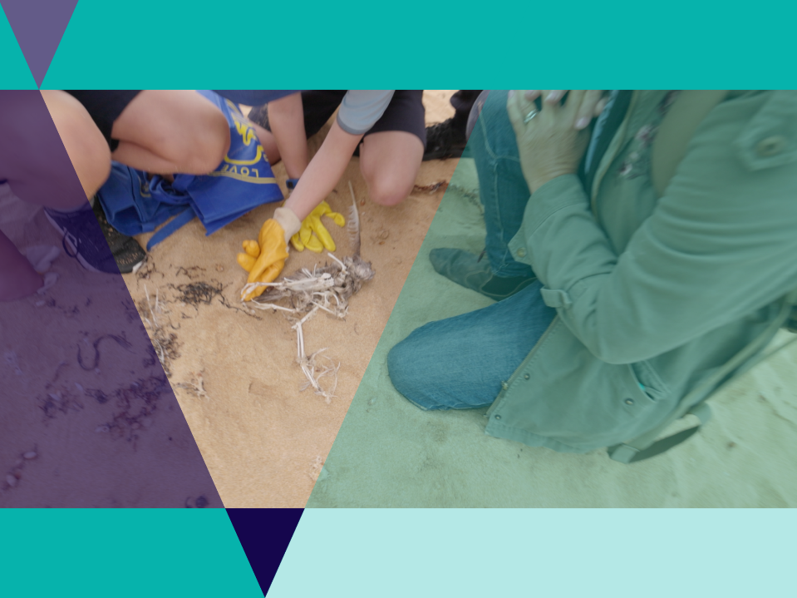
Plastics
Animals can confuse plastic for food.
Plastics accumulate toxic.
Ingested plastics may suffocate animal.
Stomachs of animal may fill and they starve.
Plastics may cause entanglement.

Slide 6

Activity 2: Litter alert
Colleen and her team at Beach Patrol 3280 teamed up with the Victorian Fisheries Authority to clean up Tea Tree Bay.
In one day they removed 108kg of litter.
Use the list of litter in your Worksheet to create a poster that will alert people to plastic litter.
Form categories for the litter to help with the way that the items are visually presented.

Slide 7

Plastics
Large pieces of plastic don’t go away, they just break into smaller pieces of plastic.
These smaller pieces are harder to find and collect.
Smaller pieces can be a bigger problem than bigger pieces.

Slide 8

Activity 3: Compare the catch
Can you think up a good way to test if the plastic free pots were as effective at catching rock lobster as the plastic ones?

Slide 9

Activity 3: Compare the catch
Calculate if the plastic free pots caught as many rock lobster as the plastic ones?
In your worksheet: use Rock Lobster Experiment Visual Data.
Graph the results by colouring in your worksheet.
Is it easy to tell from your graph which trap worked best?
What final calculations do you need to know which trap worked best?

Slide 10
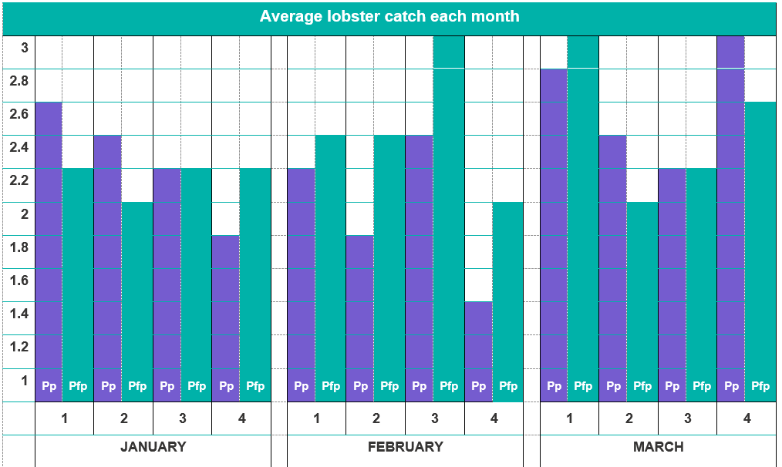
Activity 3: Compare the catch

Slide 11
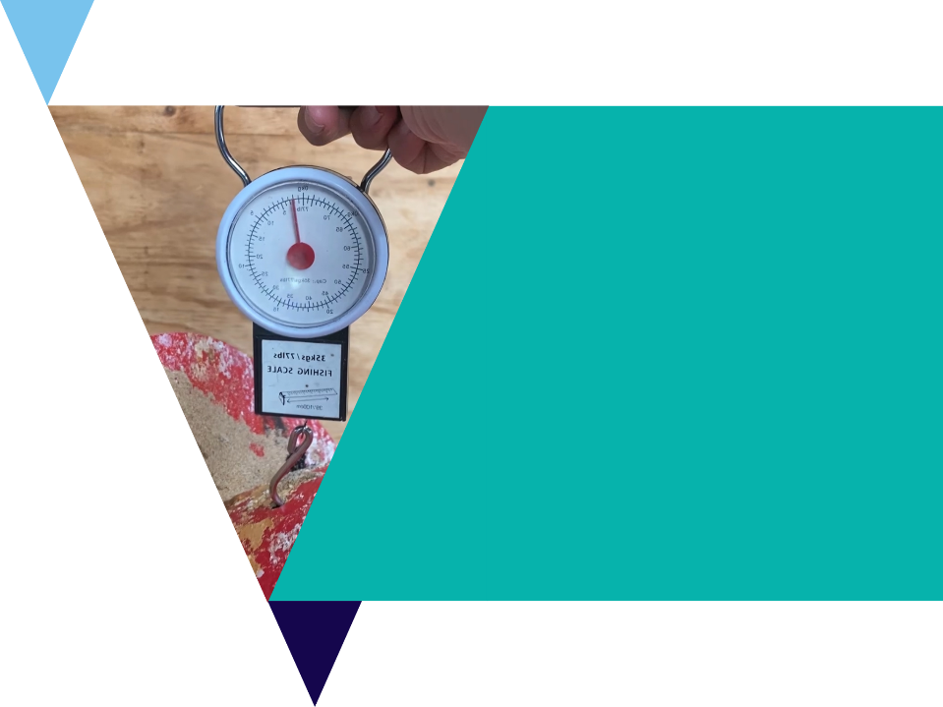
Activity 3: Compare the catch
Were any of the individual pots better or worse at catching rock lobster?
Were any of the reefs more productive than others?
Was any month of the year more productive than others?

Slide 12

Activity 4: Plastic free alternatives
Design your own plastic free product!
Choose one common piece of litter that you could replace.
We will use the Design Thinking Process called the 6 D’s to help with your investigation.
You could use the LitterStopper App to collect real data about common plastic litter around your school.

Slide 13
DEFINE
Choose a common piece of school litter you want to replace by redesigning it.
Record your design ideas as dot points on your worksheet.
DEBRIEF
DISCOVER
Design Thinking Process
DELIVER
DREAM
DESIGN

Slide 14
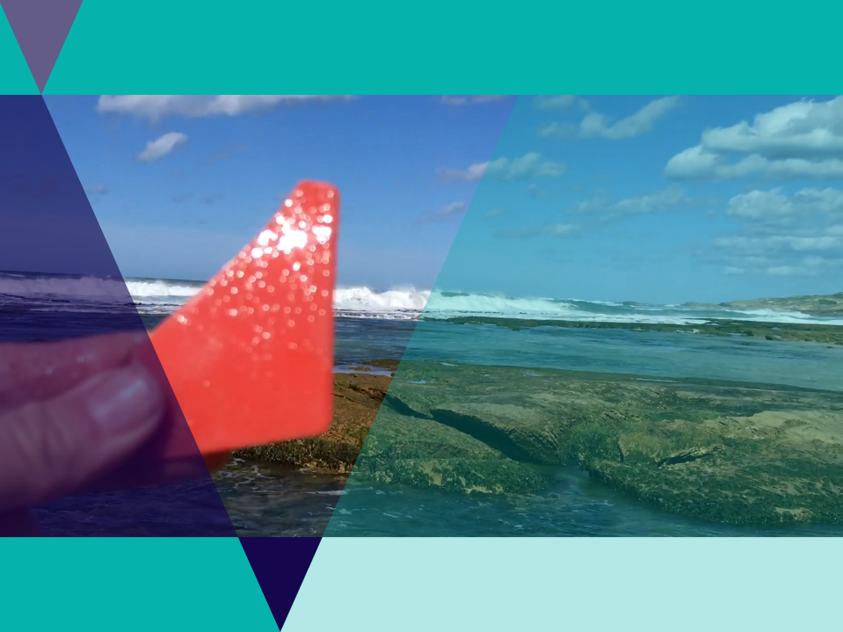
Define
What is your challenge?
Read your brief carefully and write a definition of the tasks and challenges.

Slide 15
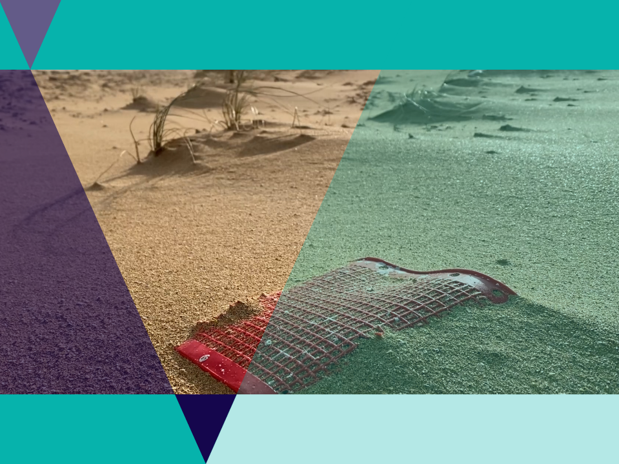
Discover
What makes a good plastic free alternative?
Which other good examples are out there?

Slide 16
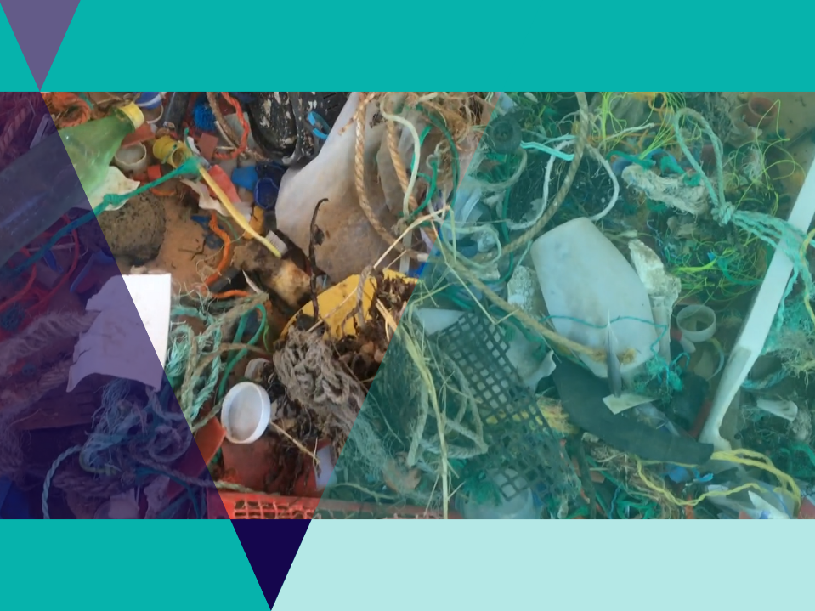
Dream
What items around the house or school could be designed better?

Slide 17

Design
How will the new product work?
What materials will you need?
How will it be cost effective?

Slide 18
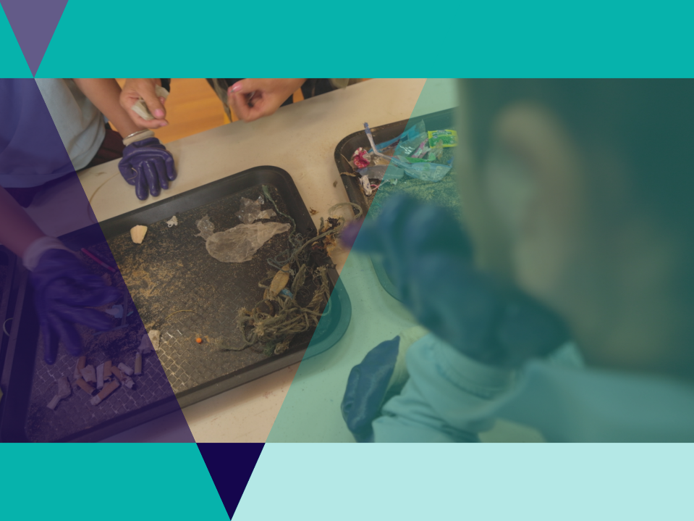
Deliver
Draw a plan for your design.
Label the sections.
Describe the features and benefits.
Pitch your product to a friend or your teacher.

Slide 19

Debrief
What have you learned from this task?
How did your creation compare to others?
How would you do this differently next time?

Slide 20

LitterStopper
Easy to use App that helps groups and individuals collect data about litter.
The data is shared accurately and effortlessly with other parties.
The data can help provide evidence to policy makers.
Data is stored on a public database at www.litterstopper.com

Slide 21

LitterStopper
Groups clean up an area.
Litter is sorted into categories.
The app counts data using the icon that best represents each category.
A photo is taken of the litter.
Details are added about how many people were involved how much distance covered, etc.

Slide 22

Investigation 1: Pinpointing the problem
In this Investigation you will use real Marine Debris Data collected from the Warrnambool area from July 2017 to April 2021.
Use the data to answer the questions in your worksheet: Pinpointing the problem.

Slide 23

Investigation 2: Local action
Use the following website links to research local groups and projects in your area.
Coastcare website with virtual map
Landcare Vic website with more groups
Conservation Volunteers Australia project search
Which one would you most like to join? Why?

Slide 24

Review questions
It’s time to check your understanding.
Fill out the review questions worksheet.

Slide 25
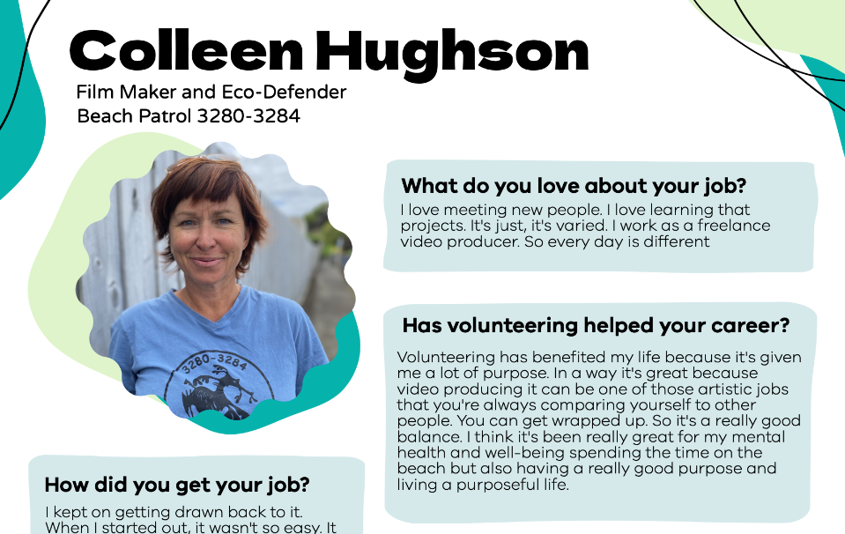


Slide 26

