Slide 1
Action and Innovation: Litter Stopper

Slide 2
Lesson Outline
Video
Game
Quiz
Illustrate the find Activity
Testing the solution Activity
Local groups Activity
Pinpointing the problem Investigation
Plastic Free Alternatives Investigation

Slide 3
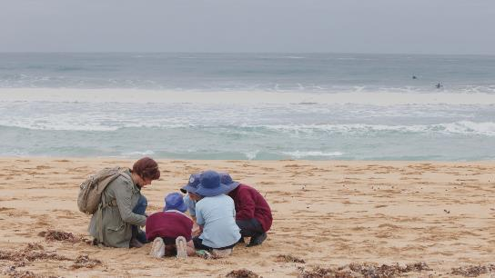
Video: Action and Innovation: Litter Stopper
Video Link: https://www.marineandcoasts.vic.gov.au/coastal-programs/coastcare-victoria/coastcare-victoria-school-kit

Slide 4
Quiz
It’s time for a quick quiz to see what you can remember from the video!
There are a total of 10 multiple choice questions

Slide 5
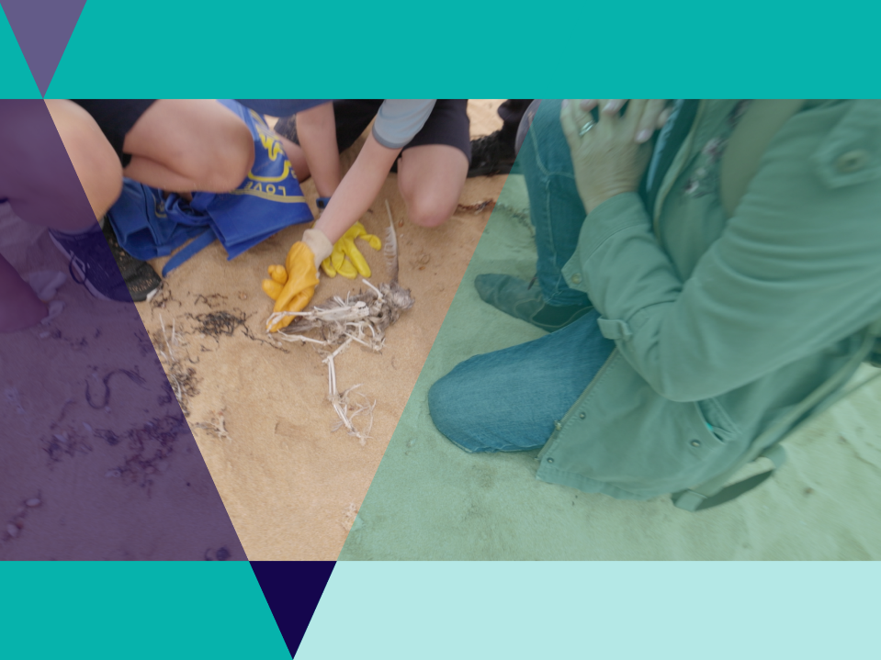
Plastics
Animals can confuse plastic for food
Plastics accumulate toxins
Ingested plastics may suffocate animal
Stomachs of animal may fill and they starve
Plastics may cause entanglement.

Slide 6
Plastics
Large pieces of plastic don’t go away, they just break into smaller pieces of plastic
These smaller pieces are harder to find and collect
Smaller pieces can be a bigger problem than bigger pieces.

Slide 7
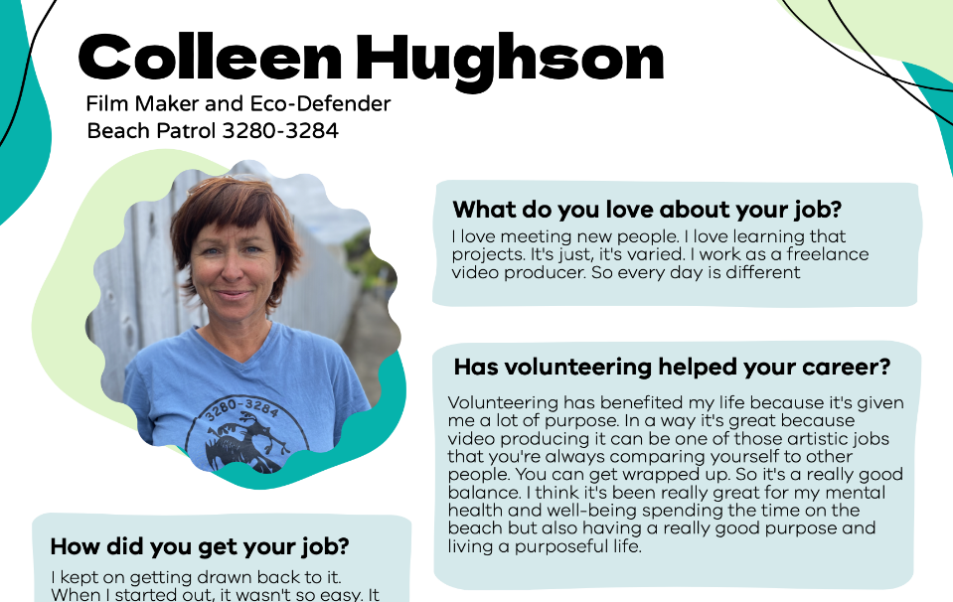
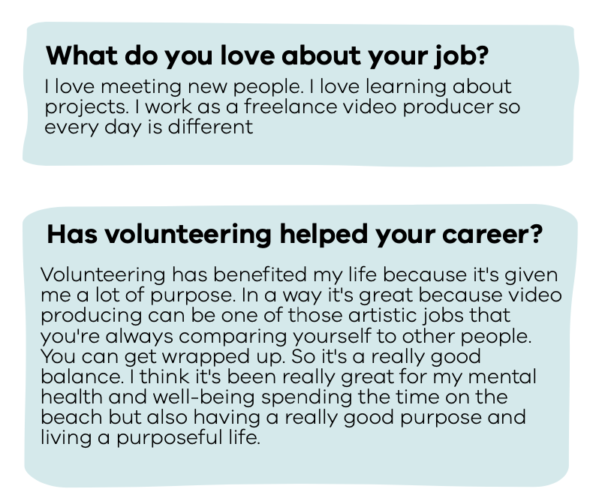

Slide 8
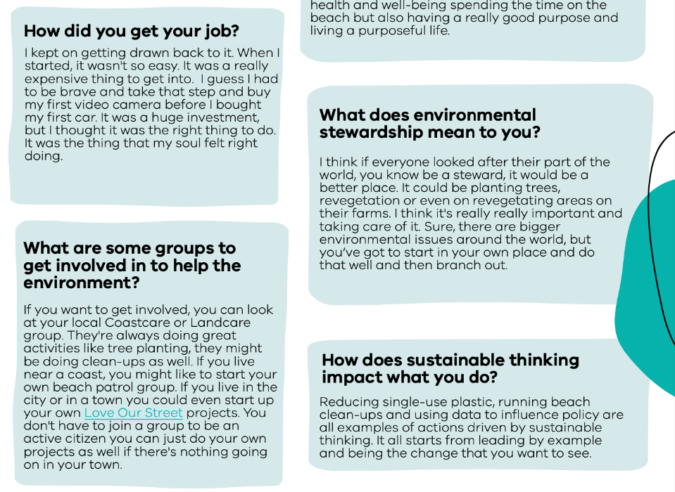
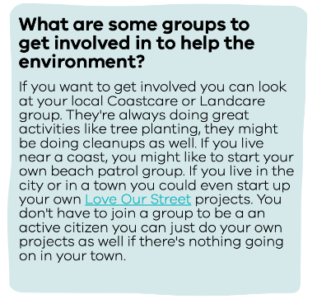

Slide 9
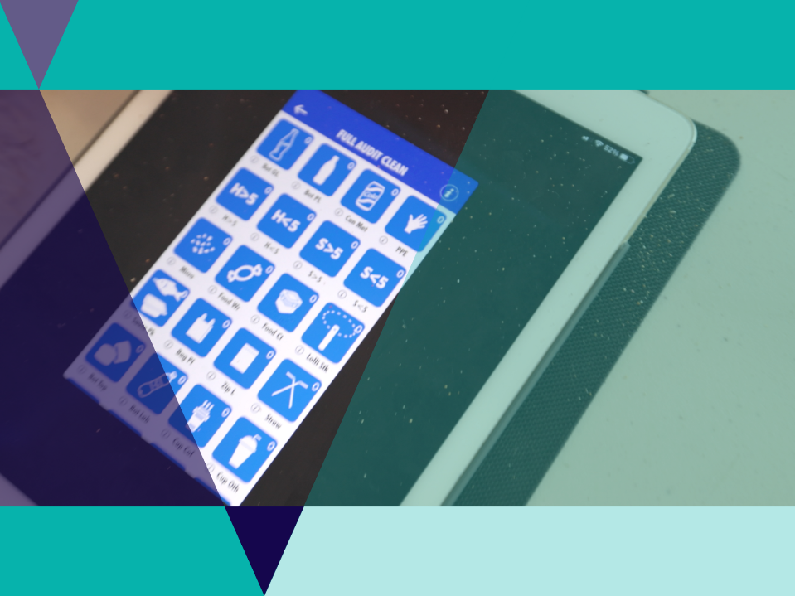
Litter Stopper
Easy to use App that helps groups and individuals collect data about litter
The data is shared accurately and effortlessly with other parties.
The data can help provide evidence to policy makers
Data is stored on a public database at www.litterstopper.com

Slide 10
Litter Stopper
Groups clean up an area.
Litter is sorted into categories
The app counts data using the icon that best represents each category
A photo is taken of the litter
Details are added about how many people were involved how much distance covered etc.

Slide 11
Illustrate the find
Activity
Colleen and her team at Beach Patrol 3280 teamed up with the Victorian Fisheries Authority to clean up Tea Tree Bay.
In one day they removed 108kg of litter.
Use this list of litter collected to create a poster that communicates what was found.
Form categories for the litter to help with the way that the items are visually presented.
This may be done as a digital poster or powerpoint presentation.

Slide 12
Testing the Solution
Activity
Can you think up a good way to test if the plastic free pots were as effective at catching rock lobster as the plastic ones?

Slide 13
Testing the Solution
Activity
Use the Rock Lobster Experiment Visual Data to test if the plastic free pots were as effective at catching rock lobster as the plastic ones.
You may like to design your own tables for collecting data, or use this pre-made excel data sheet.
Graph up the results either digitally or on graph paper.
Compare results with other groups.
Come up with a list of ways that the experiment could be improved.

Slide 14
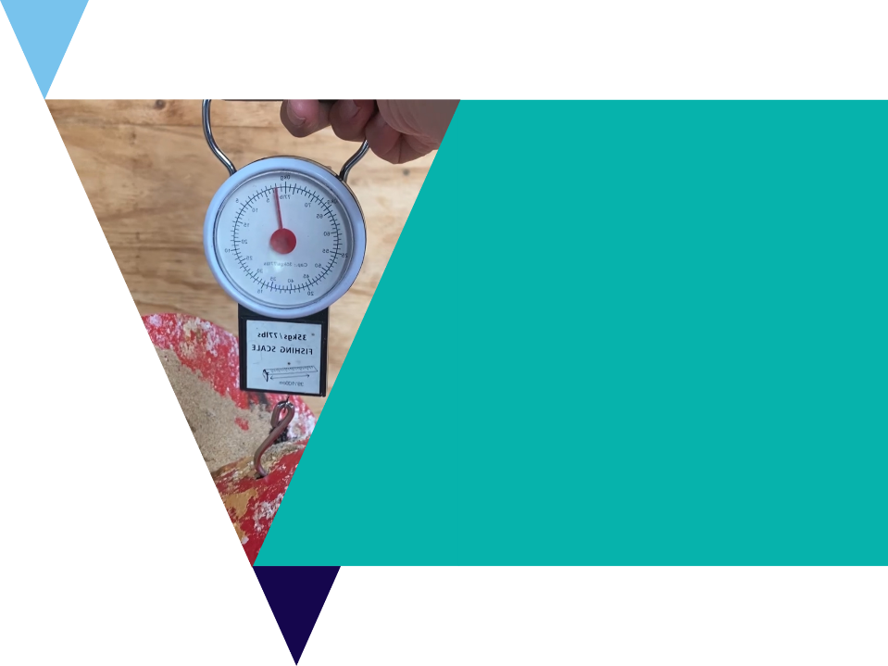
Testing the Solution
Activity extension
Were any of the individual pots better or worse at catching rock lobster?
Were any of the reefs more productive than others?
Was any month of the year more productive than others?

Slide 15
Local Groups
Activity
Use the following website links to research local groups and projects in their area.
Coastcare website with virtual map
Landcare vic website with more groups
Conservation Volunteers Australia project search

Slide 16
Pinpointing the Problem
Investigation
In this Investigation you will use the Collection Data Spreadsheet - a list of real data collected from the Warrnambool area from July 2017 to April 2021
Answer the questions from the Pinpointing the Problem Worksheet

Slide 17
Plastic Free Alternatives
Investigation
Use the Litter Stopper App to collect data around the school.
This could also be organised as an excursion to a local beach or park.
Choose one common piece of litter and try to work out the source.
If a collection is not possible, use data from the previous investigation for ideas about problem items that you may like to redesign
Use the 6 D’s (next slides) to help with your investigation

Slide 18
DEFINE
DEBRIEF
DISCOVER
Design Thinking Process
DELIVER
DREAM
DESIGN

Slide 19
Define
What is your challenge?
Read your brief carefully and write a definition of the tasks and challenges.

Slide 20
Discover
What makes a good plastic free alternative?
Which other good examples are out there?

Slide 21
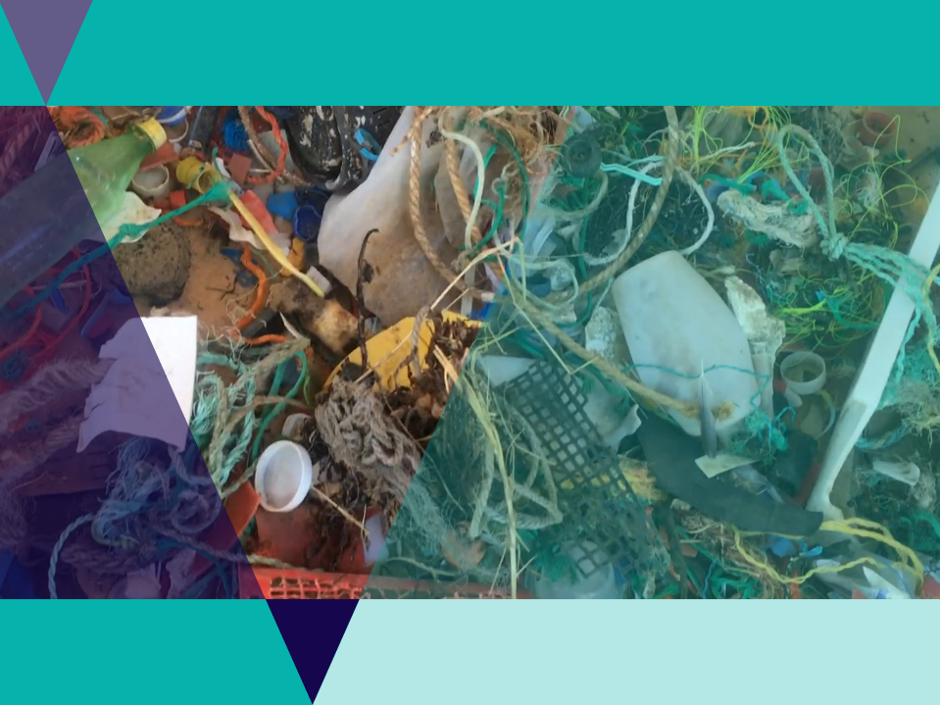
Dream
What items around the house or school could be designed better?

Slide 22
Design
How will the new product work?
What materials will you need?
How will it be cost effective?

Slide 23
Deliver
Draw a plan for your design.
Label the sections.
Describe the features and benefits.
Pitch your product to a friend or your teacher.

Slide 24
Debrief
What have you learned from this task?
How did your creation compare to others?
How would you do this differently next time?

Slide 25
Review Questions
It’s time to check your understanding.
Fill out the review questions worksheet.

