Slide 1
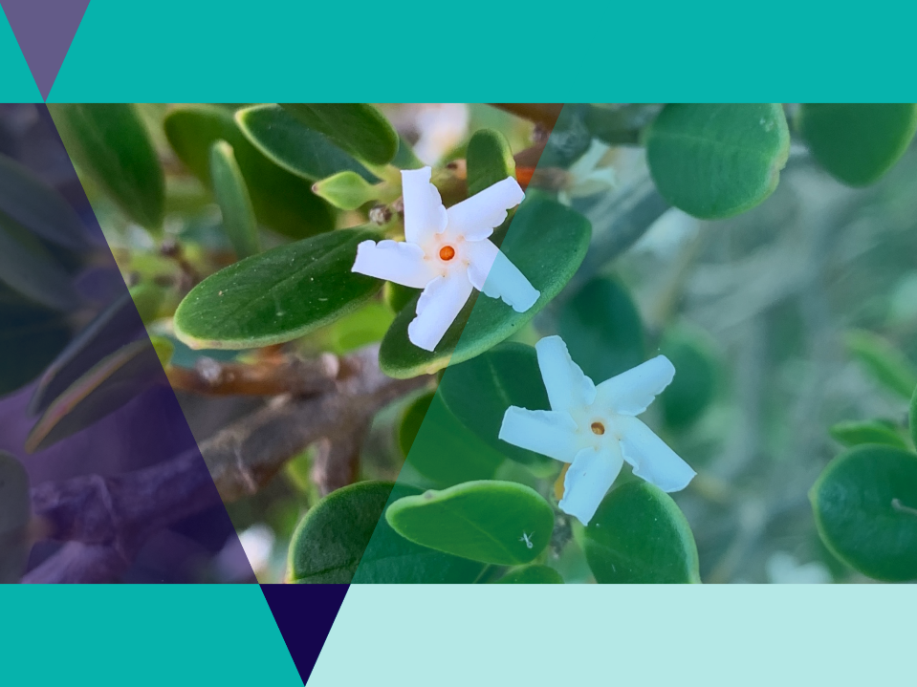

Volunteering for Threatened Flora

Slide 2

Lesson outline
Video
Quiz
Activity: Native plant names
Activity: Botanical illustration
Investigation: Natives plants for People
Investigation: Gardens for Wildlife

Slide 3
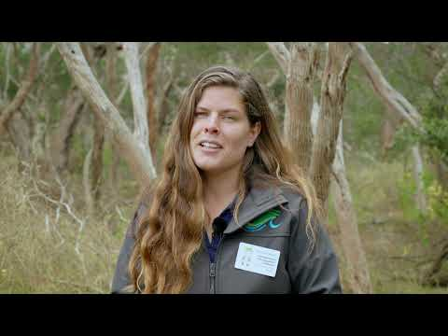
Video: Volunteering for Threatened Flora
Naomi Wells from Bellarine Catchment Network talks to Borough Coastcarer volunteers about weeding in the Moonah Woodland.

Slide 4

Quiz
It’s time for a quick quiz to see what you can remember from the video!
There are a total of 10 multiple choice questions

Slide 5
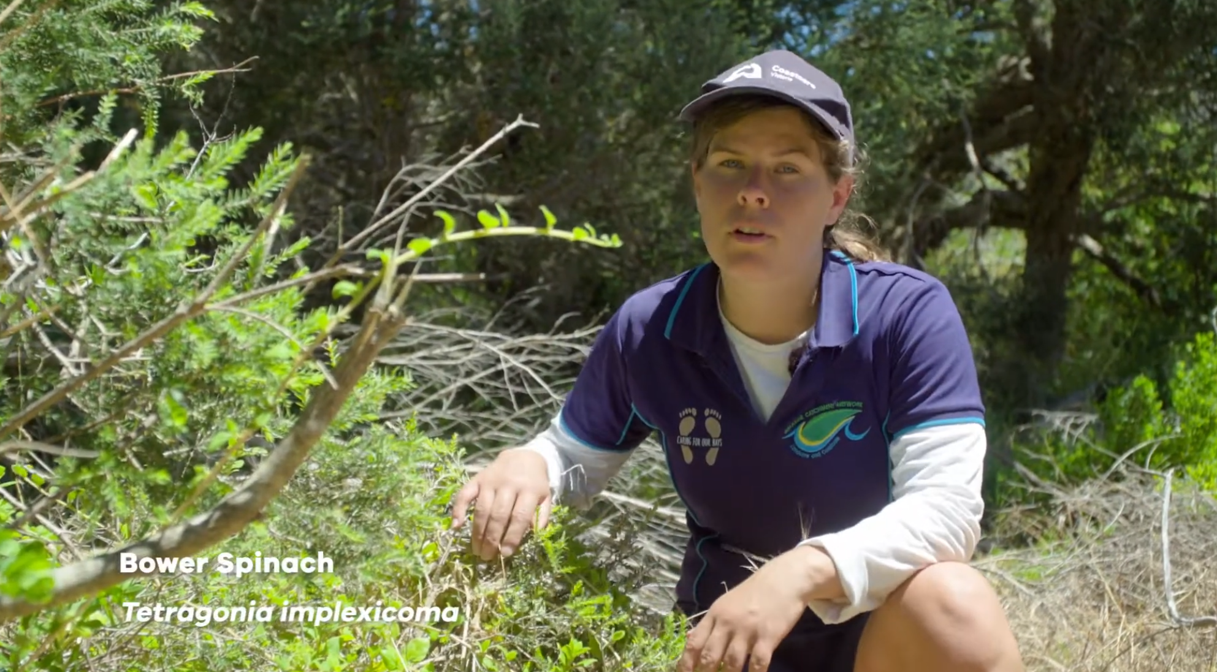
Coastal plant identification
Watch the video where Naomi gives an introduction to the common coastal plants of Victoria. She will teach you how to identify different plants and what their names are.
Bower Spinach
Tetragonia implexicoma

Slide 6

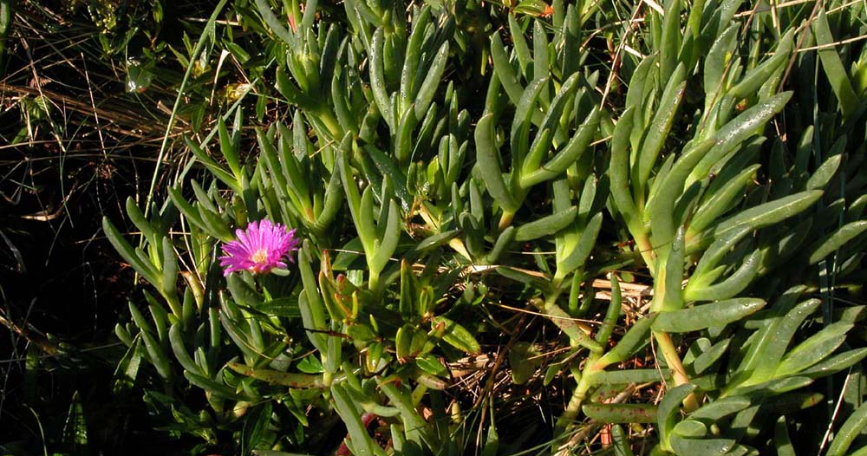
Problems with common names
Rare species do not get given a common name.
Common plants may have a different common name in each place they are common to!
E.g. What is called Karkalla in Victoria is called Pig Face in Tasmania.
The opposite problem: Two different plant species may have the same common name
E.g. Bluegum in Tasmania is a different species of Eucalyptus than bluegum's in Victoria.

Slide 7

Binomial nomenclature
In Biology, all living things are given a scientific name for their species.
‘Binomial nomenclature’ is the system used to name species.
Scientific names are made of two parts: Part one is the genus and part two is the species.
Bi-nomial nomen-clature means "two-name naming-system“
Homo sapiens is the bonomial species name for human beings.
Scientific names are internationally recognised, used by scientists to refer to specific species anywhere it is found.

Slide 8
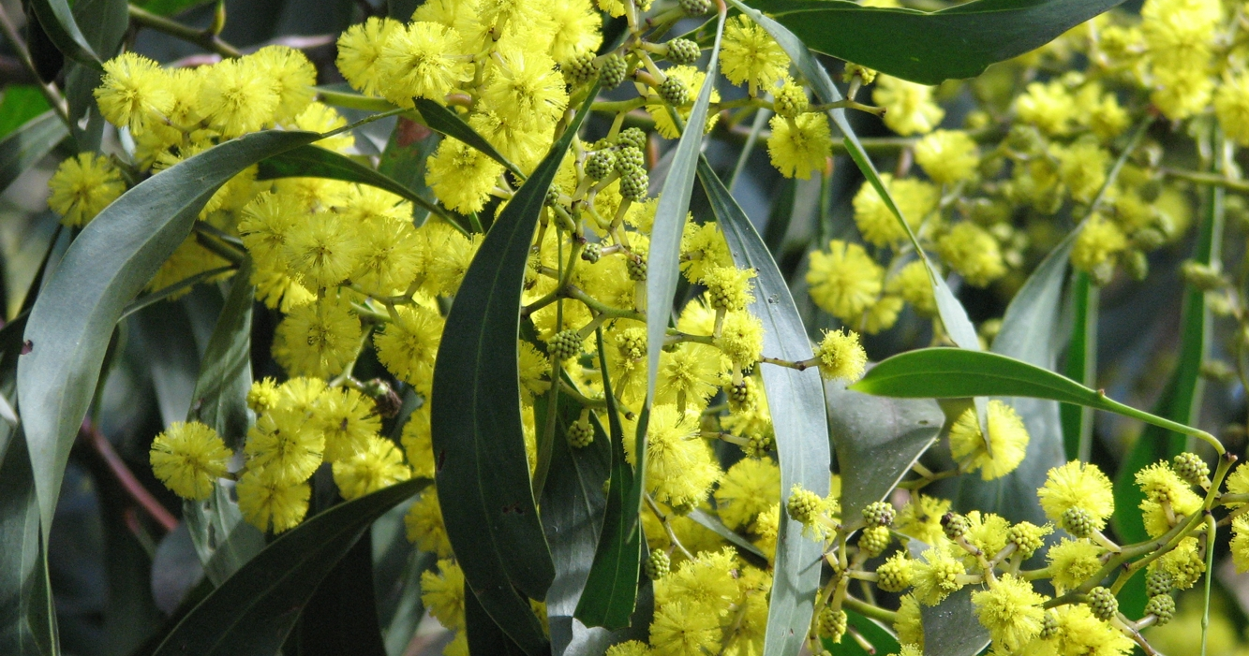
Advantages of scientific names
Every scientific name is unique, no two plants can be given the same species name. No confusion.
They’re informative – plants in the same genus are closely related.
The Latin and Greek words used are descriptive.
E.g. All wattle species are in the genus Acacia
Golden Wattle: Acacia pycnantha- is named using two Greek words: pyknos (dense) and anthos (flower).
Acacia pycnantha = Wattle with dense flowers

Slide 9
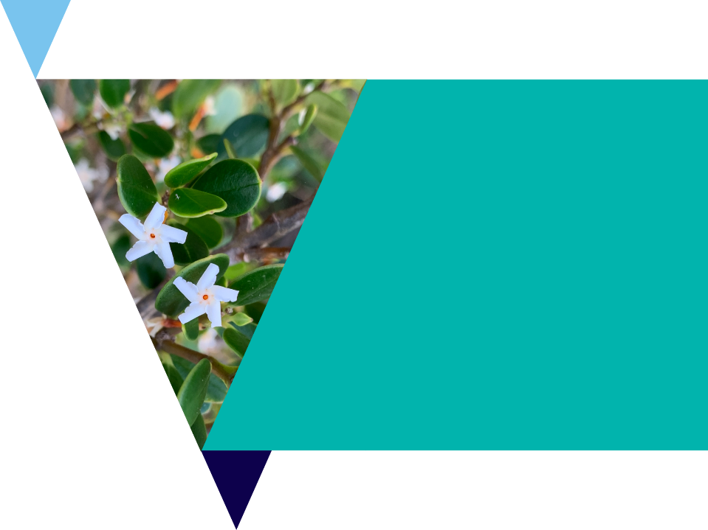
Activity 2: Scientific vs common names
Sometimes species can be known by several common names.
Use the table in Native plant names workbook to look up the common names for eight plants found in coastal Victoria.
Your task is to also find out if these plants are native or introduced.

Slide 10
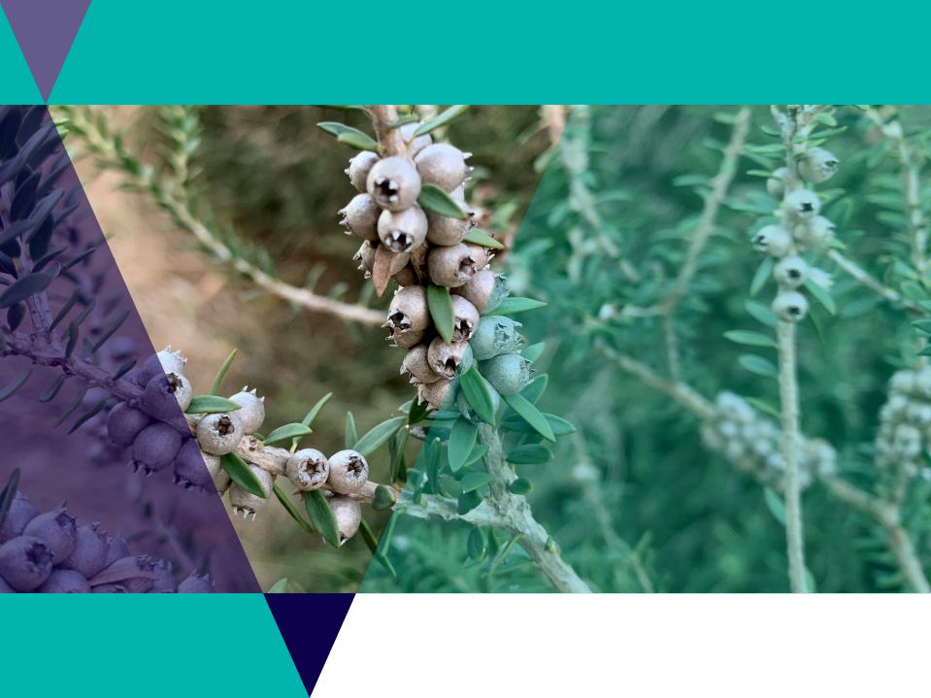
Botanical illustration
Botany is the scientific study of plants.
It began before cameras were invented, so drawing lifelike pictures of plants was an important skill.
Botanical illustrations need to be a lifelike representation of a plant.
The key is to draw exactly what you see, with no artistic addition.
An accurate botanical drawing will show a plant’s unique features which allow scientists to tell one species from another.

Slide 11
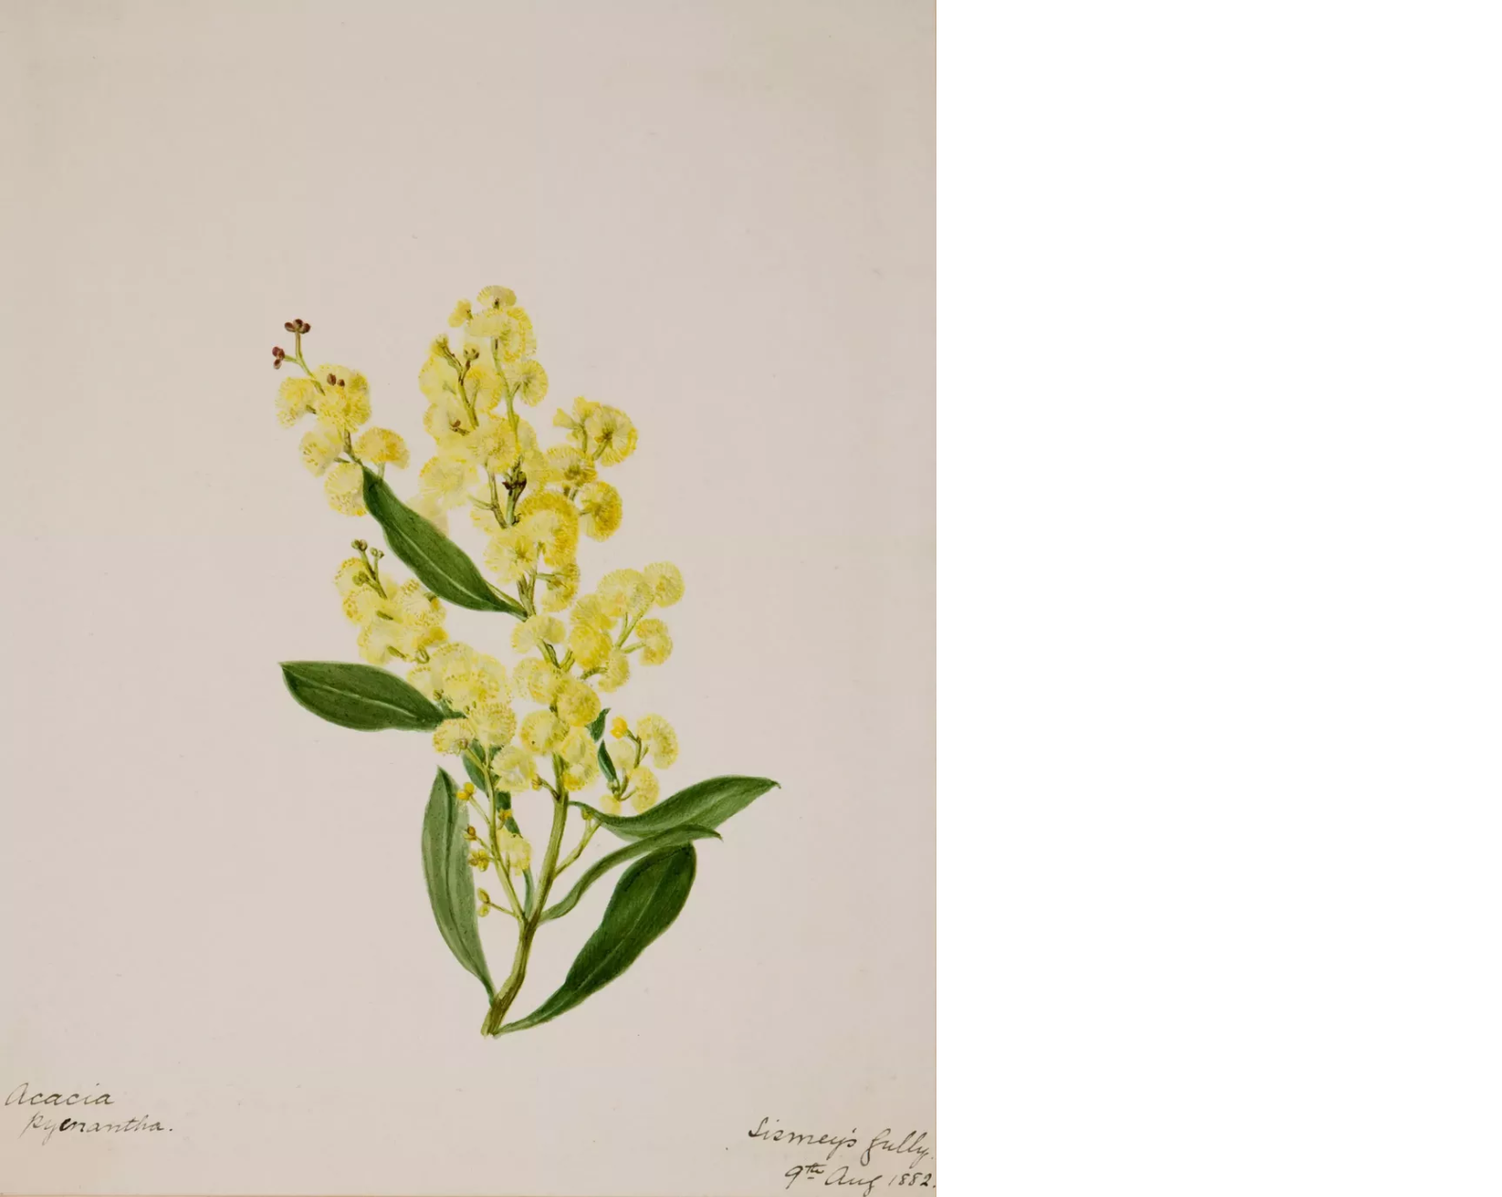
Activity 3: Botanical illustration
Is this botanical illustration accurate enough for you to recognize which wattle species it is?
It was drawn by Sarah Kay in Adelaide in 1882.
How old is this illustration?
You will practice your own botanical illustrations next.
Concentrate on drawing what you see: like the number, size and shape of the plant parts.
Don’t forget to sign and date your illustration.

Slide 12
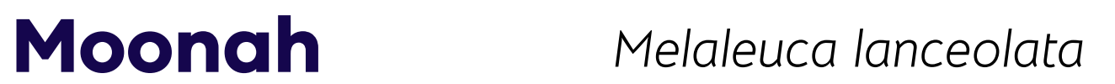
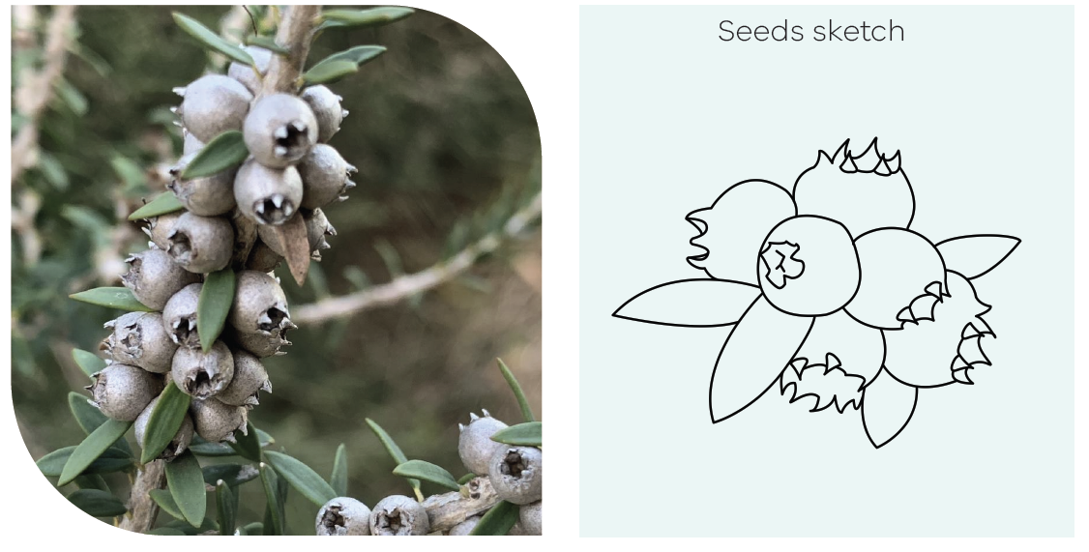
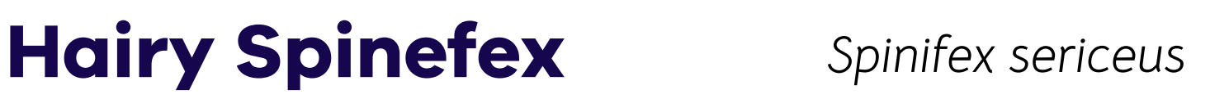
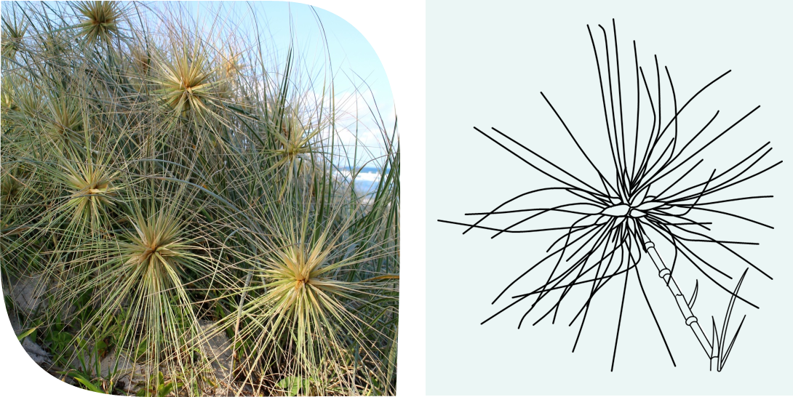


Add your own botanical illustration here.
Focus on the number of parts, and
the shape and size (the scale) of parts of the plant.
What other details can you add to make your plant more recognisable?

Slide 13
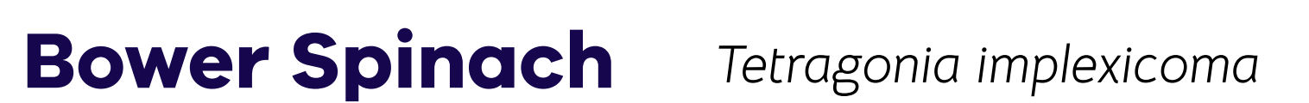
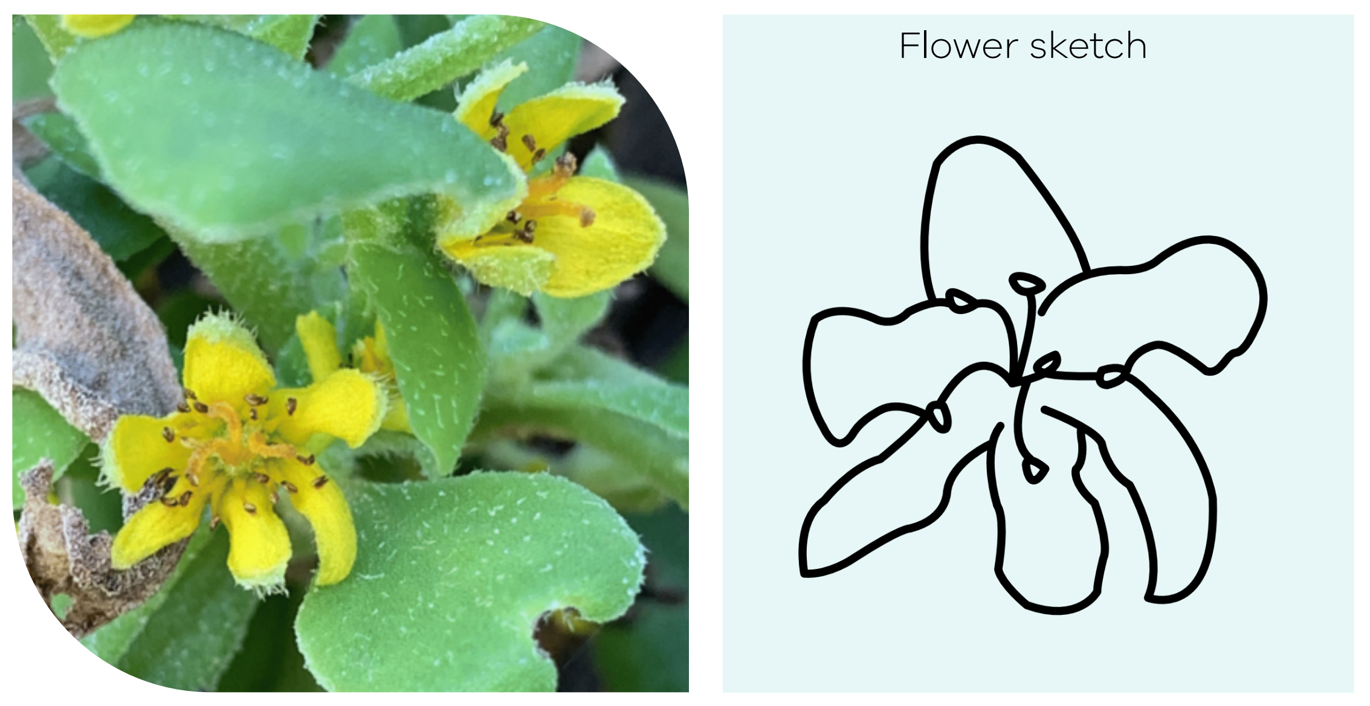
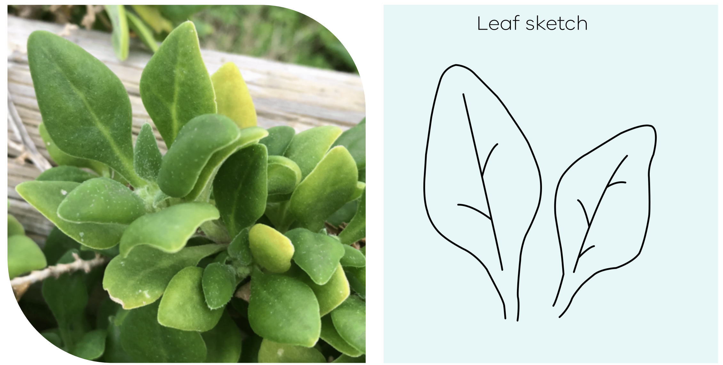
Add your own botanical illustration here.
Focus on the number of parts, and
the shape and size (the scale) of parts of the plant.
What other details can you add to make your plant more recognisable?

Slide 14
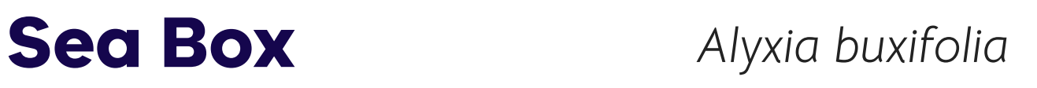
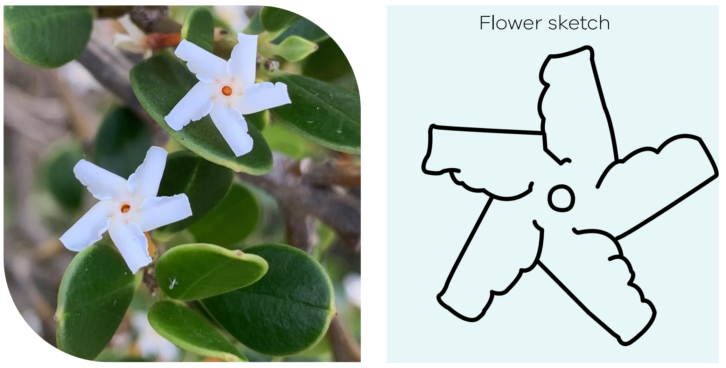
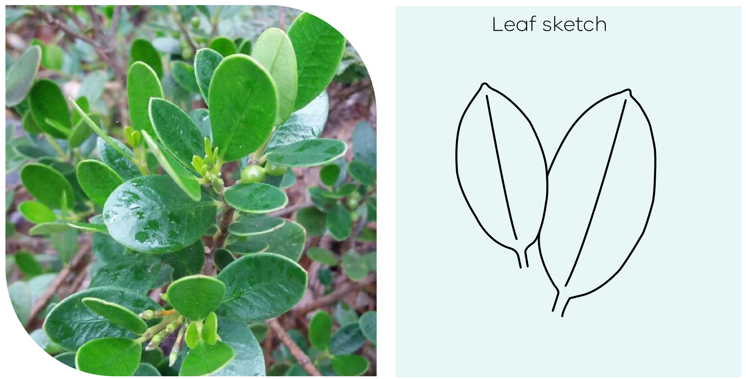
Add your own botanical illustration here.
How do the flowers and leaves differ from bower spinach?
Which details will you focus on to make those differences clear?
tails will you focus on to make those differences clear?

Slide 15

Traditional uses of native plants
Knowledge about Country, including plants and how they are used, is different for each place and is best shared by Traditional Owners.
To learn directly from Wadawurrung Traditional Owners, check out the Wadawurrung Country Plan and resources here: https://www.wadawurrung.org.au/resources
Note: A permit is required to collect native plant material from public land.

Slide 16
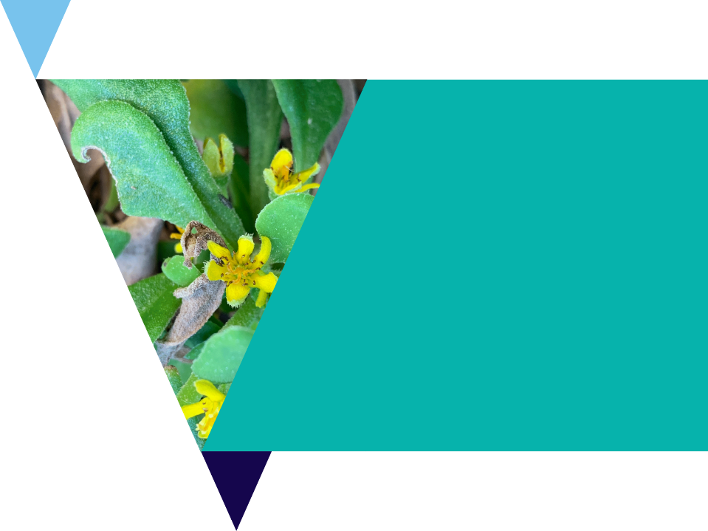
Native plants for people
Use the Coastal Plants information booklet to find the plant size, flowering season and other unique features of the native plants.
Use the Indigenous Plant Use booklet to research which food plants are commonly used by Traditional Owners.

Slide 17
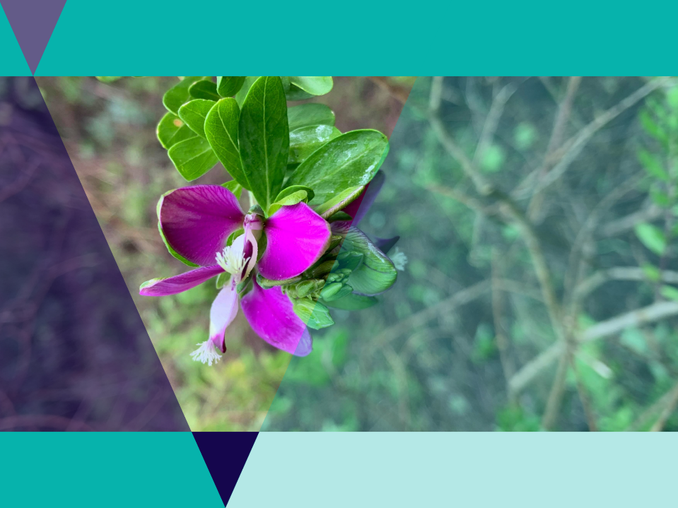
Native Gardens for Wildlife
Establishing a natural habitat garden helps you encourage native animals like birds, bats, lizards, frogs, butterflies and other insects to your garden.
Native gardens can also help:
Reduce garden maintenance costs
Decrease gardening and time commitments
Conserve local native plants and animals
make our urban areas more ecologically sustainable.

Slide 18
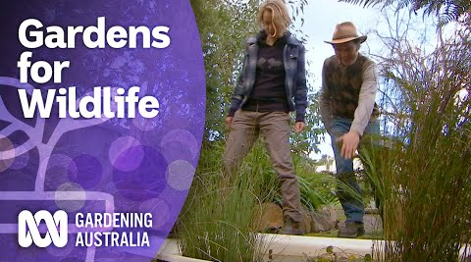
Investigation: Gardens for Wildlife
Join the Gardening Australia team and find out how to use native plants and natural principles to design a wildlife friendly garden at home.

Slide 19

Investigation: Gardens for Wildlife
Using the native species you have already researched - design a native garden for your school or home.
Use the basic ingredients listed on the site and create a plan for your garden.
Visit the Gardens for Wildlife Victoria and click on Elements of a Wildlife Garden as well as the online article Make your garden a wildlife haven.

Slide 20
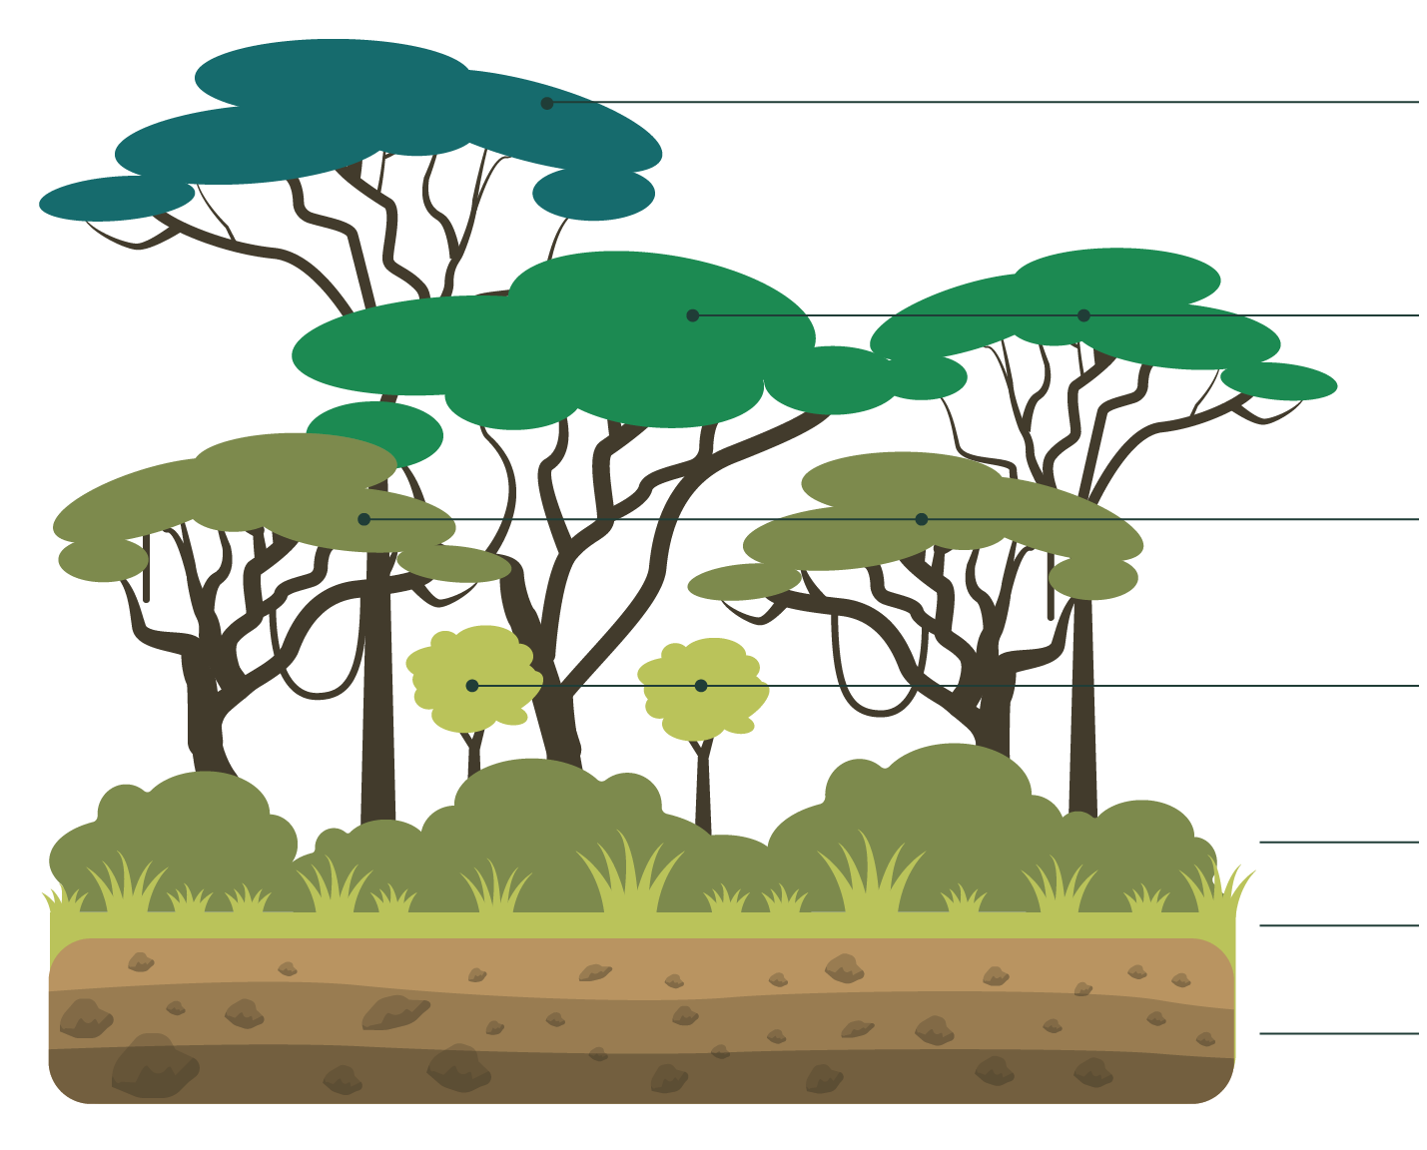
Gardens for Wildlife investigation
Wildlife gardens copy native forests which have different layers of plants providing food, nesting material and habitat.
Canopy tree: shade, flowers, perches and hollows
Middle story: Trees for shade and shelter like banksia also make leaf litter
Understory: Flowering shrubs, grevilia and wattle
Ground: Grasses for small birds and insects
Litter: Leaf litter for mulch, logs and rock for shelter
Soil: nutrients for plants and habitat for burrowing
Brainstorm which native animals would use which layers of this forest?

Slide 21
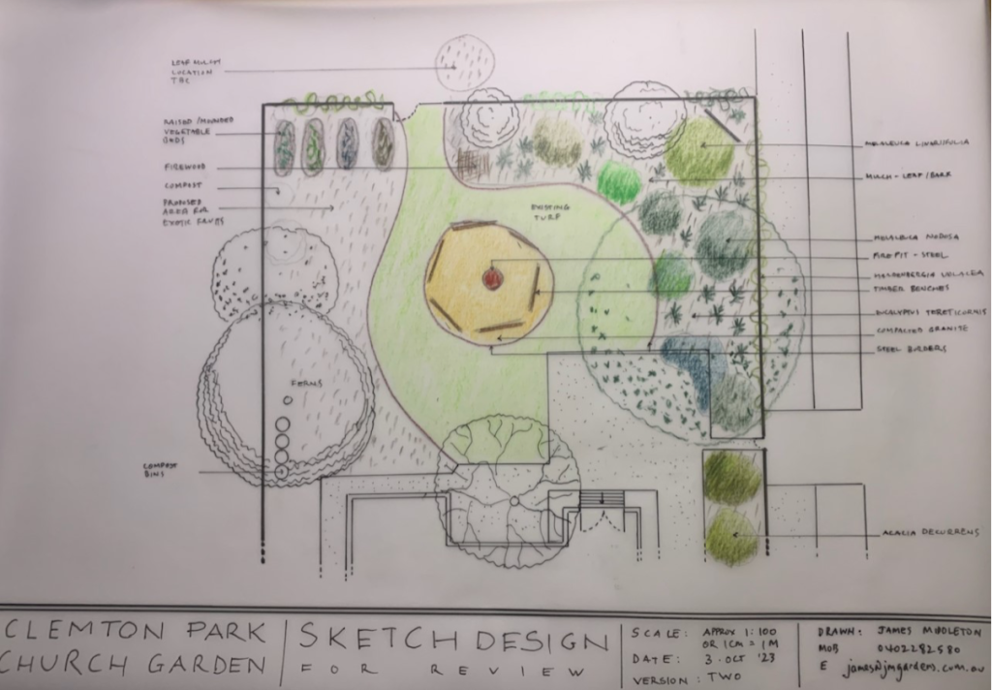
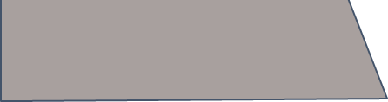
Gardens for Wildlife: Design
Landscapers also
use special drawing
techniques to illustrate
their designs.
Accurate size, scale and
shape is as important as in
botanical illustration.
Rainwater tank
Creeper on the fence
Raised vegetable garden beds
Raised vegetable garden beds
Acacia shrubs
Acacia
shrubs
Firewood and sticks for habitat
Mulch leaf/bark
Firewood and sticks for habitat
Mulch leaf/bark
Native turf grass
Fire pit
Yarning circle
Fire pit
Yarning circle
Tussock
grass
Tussoc
grass
Flowering gums
Acacia
shrubs
Acacia
shrubs

Slide 22

Review questions
It’s time to check your understanding.
Fill out the review questions worksheet.

Slide 23
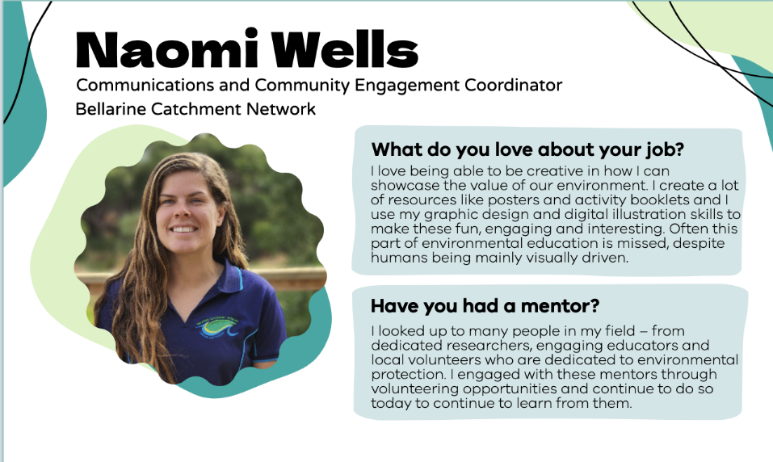
Extension

Slide 24
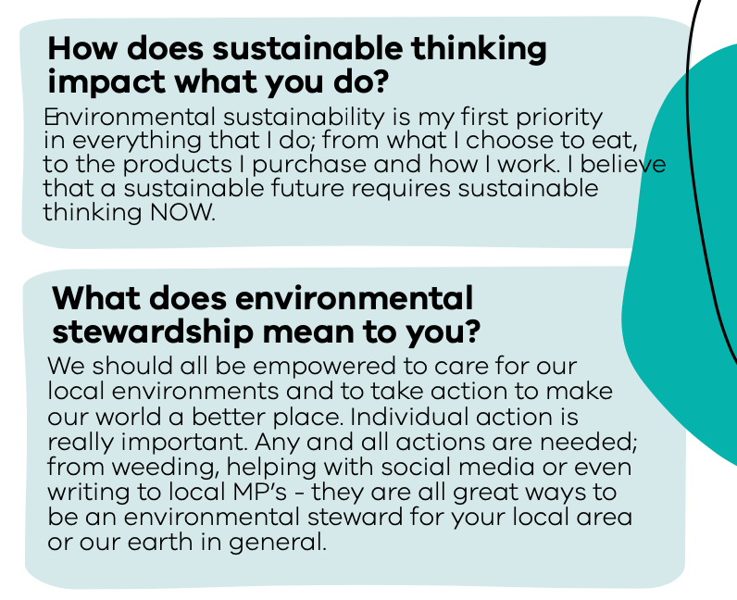


Slide 25
