Slide 1
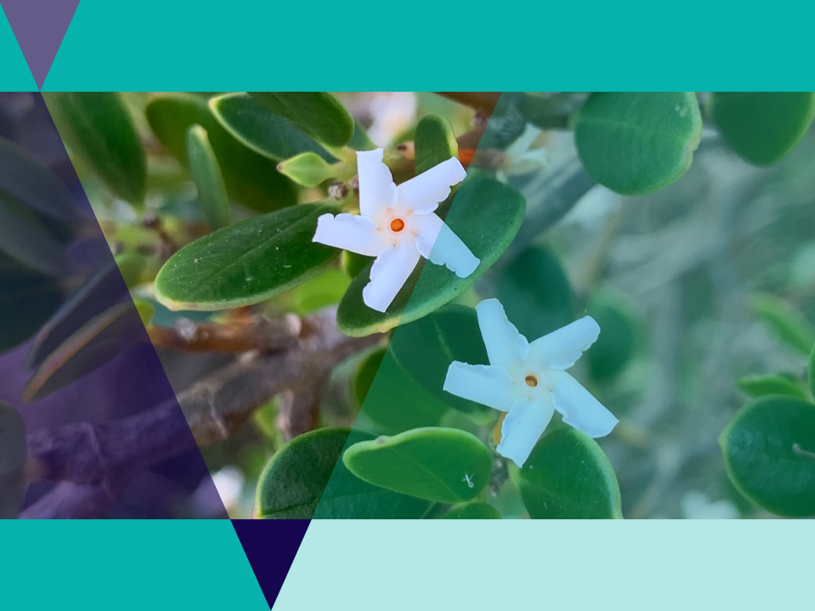
Volunteering for Threatened Flora

Slide 2
Lesson Outline
Volunteering for threatened flora video
Quiz
Binomial nomenclature activity
Natives and weeds investigation
Sketching activity
Memory game
Flyer activity
Gardens for Wildlife research task

Slide 3
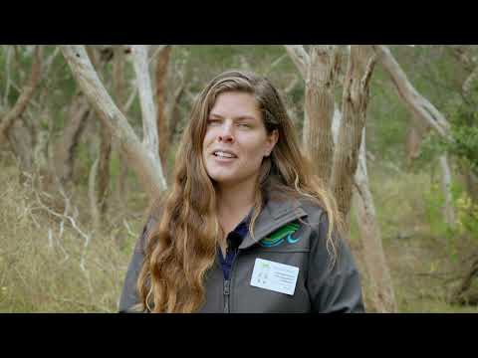
Video: Volunteering for Threatened Flora
Naomi Wells from Bellarine Catchment Network talks to Borough Coastcarer volunteers about weeding in the Moonah Woodland.

Slide 4
Quiz
It’s time for a quick quiz to see what you can remember from the video!
There are a total of 10 multiple choice questions

Slide 5
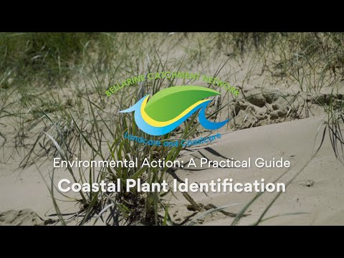
Environmental Action: Coastal Plant Identification
Naomi provides an introduction into the common coastal plants that you may find around the Victorian coastline and how you can easily identify them.

Slide 6
Binomial Nomenclature
In biology, binomial nomenclature is how species are named.
The scientific name is an internationally recognised name used by scientists to describe an organism.
The name of a species is made of two parts: one indicating the genus and one indicating the species.
Binomial nomenclature means "two-part name" or "system of two-part names".

Slide 7
Advantages of Binomial Nomenclature
It is used everywhere
It avoids having the same common name for different species
The names are unique - one name for one species
Sometimes Latin or Greek words are used.

Slide 8
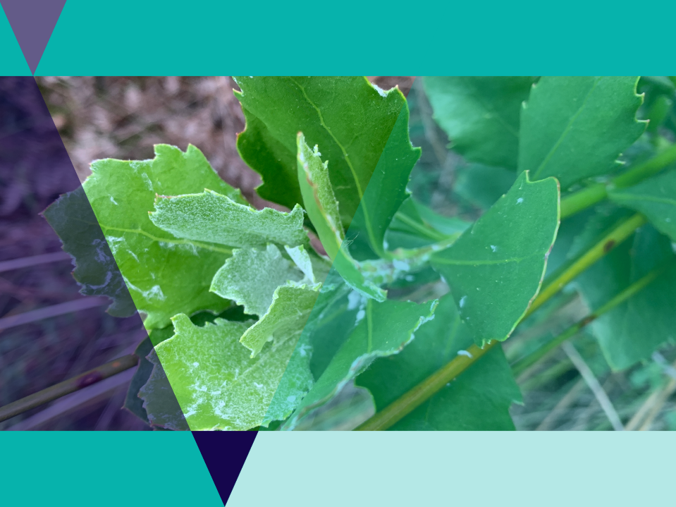
Problems with common names
Common names often have a very local distribution
A single species may be known my several common names
Different species may have the same common names
Language difference in different countries may cause confusion
Many rare species do not have a common name

Slide 9
The first word is the genus name
The second word is the species name
The species name monilifera comes from the Latin, monile, meaning necklace or collar, referring to the shiny fruit arranged around the flowers like a necklace.

Slide 10
Binomial Nomenclature Activity
Sometimes species can be known by several common names
Use the Binomial Nomenclature Activity to find the common name or names for 8 plants found Australia.
Your task is to also find out if these plants are native or introduced.

Slide 11
Botanical Illustration
Botanical illustration is always a true and lifelike representation of a plant
The emphasis of botanical illustration is on science rather than visual art.
It should highlight a plant's particular distinguishing features which enable botanists to tell one plant from another.

Slide 12
Botanical Illustration Activity
Botanical illustrations reveal a plant's physical structure such as the arrangement of reproductive parts, leaves, and stems with a three dimensional quality.
In this activity you will use the Coastal Plants worksheet to do your own botanical illustrations.

Slide 13
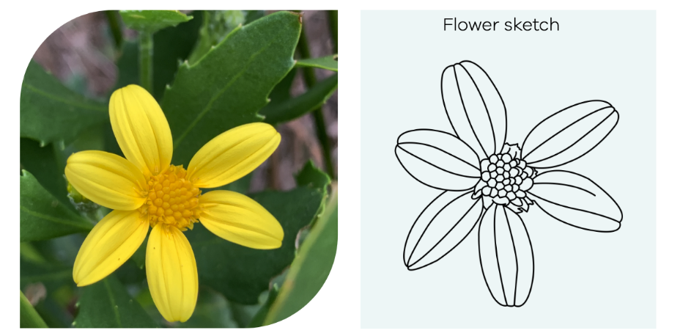

Slide 14
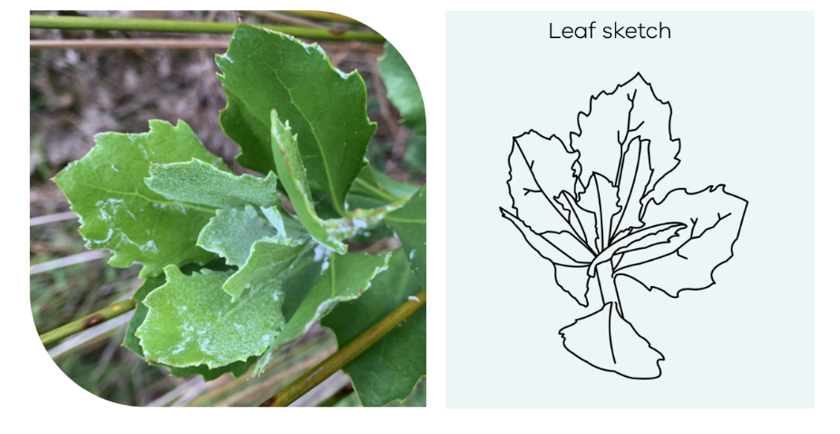

Slide 15
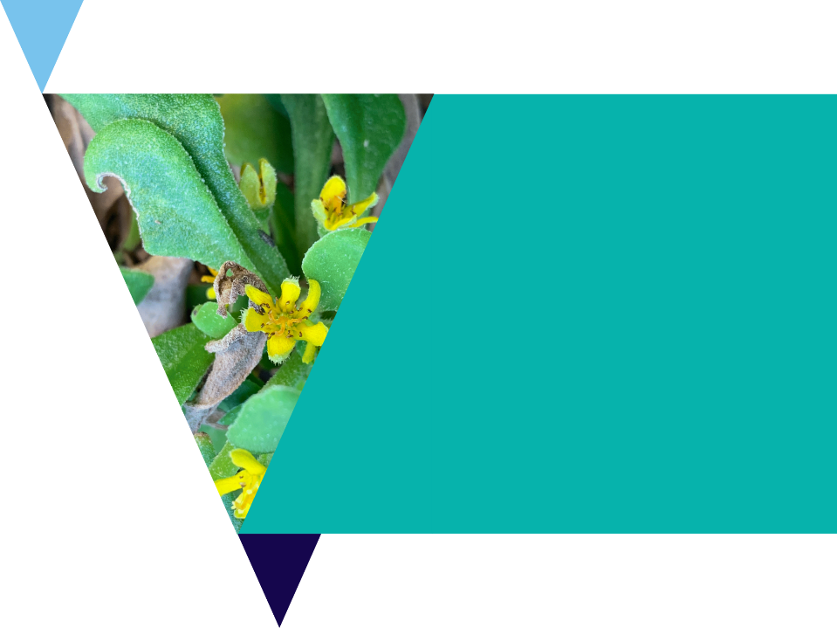
Natives and Weeds Investigation
Use the Indigenous Coastal Plants information booklet to find the plant size, flowering season and other unique features of the native plants.
Use the Weeds of Australia website to research the flowering season of the invasive plants.

Slide 16
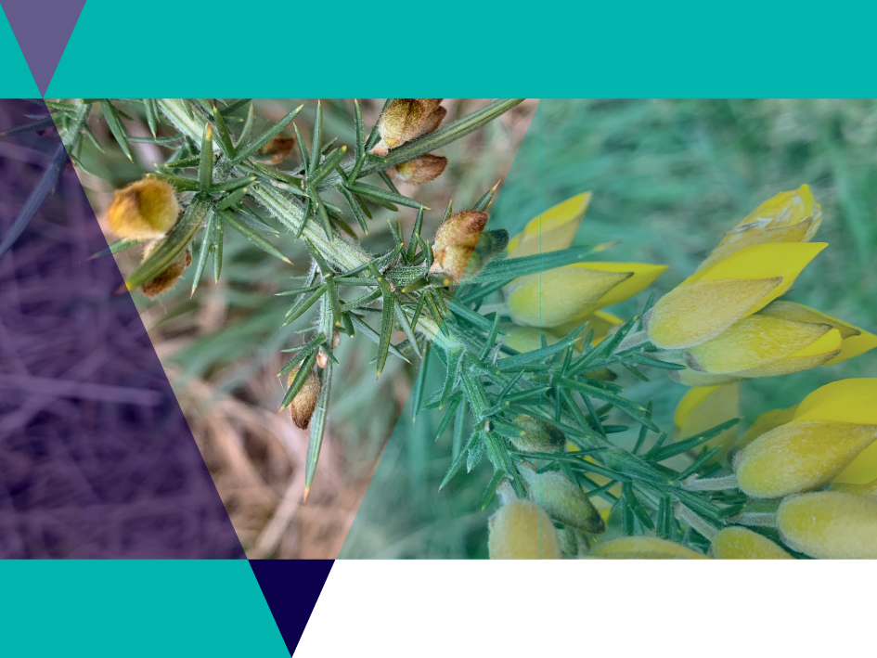
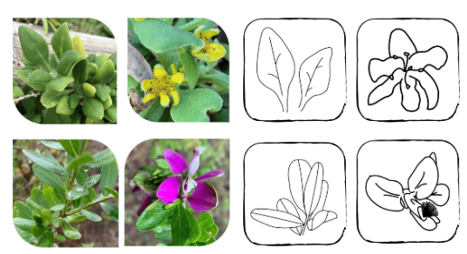
Memory Game

Slide 17
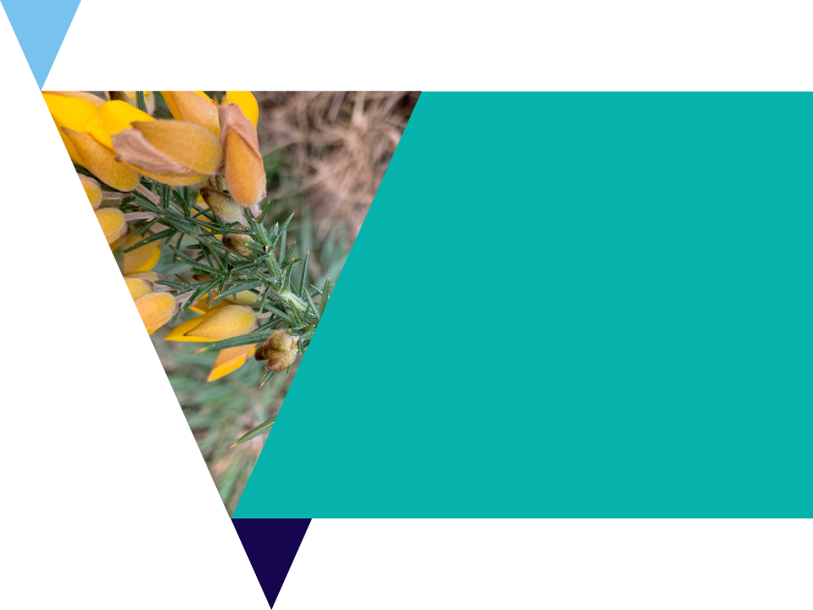
Memory Game
Use the The Memory matching game worksheet for this activity.
Test your ability to differentiate between different plants by matching sketches with pictures or names.
Cut out the squares and place them face down on the table.
Take it in turns flipping two cards over.
Use your filled out worksheets from the botanical illustration activity as a ‘cheat sheet’.

Slide 18
Invasive Weeds
Weeds have major impacts in Australia, causing damage to natural landscapes, agricultural lands, waterways and coastal areas.
They are among the most serious threats to Australia’s natural environment and primary production industries.

Slide 19
Weed Awareness Activity
On the following slide you will see an example of an old flyer to raise awareness about the Myrtle-Leaf Milkwort Weed.
Your task is to design a new, updated flyer for a local weed of your choice.
Use the headings on the example flyer as a guide, including details such as identification, distribution, look-a-likes, management, extra facts, replacement plants etc.

Slide 20
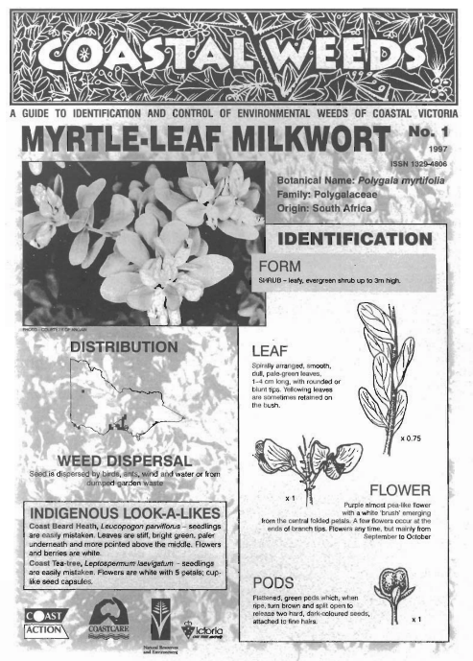
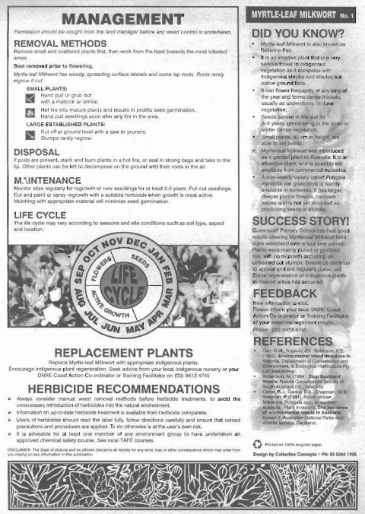

Slide 21
Traditional Uses of Native Plants
Aboriginal Australians have a close relationship to native plants.
In many Aboriginal societies making objects from plant fibres was an important activity.
Items needed for hunting as well as for carrying and collecting food were made along with ritual objects for use in religious ceremonies.
Note: a permit is required to collect native plant material from public land.

Slide 22
Traditional Uses of Native Plants Activity
Use the Uses for native plants of the Mornington Peninsula PDF to research the uses of some indigenous plants.

Slide 24
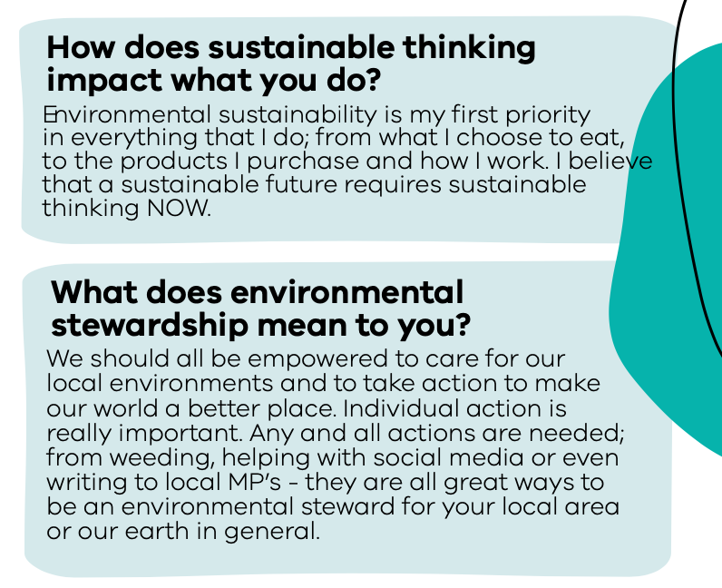

Slide 25
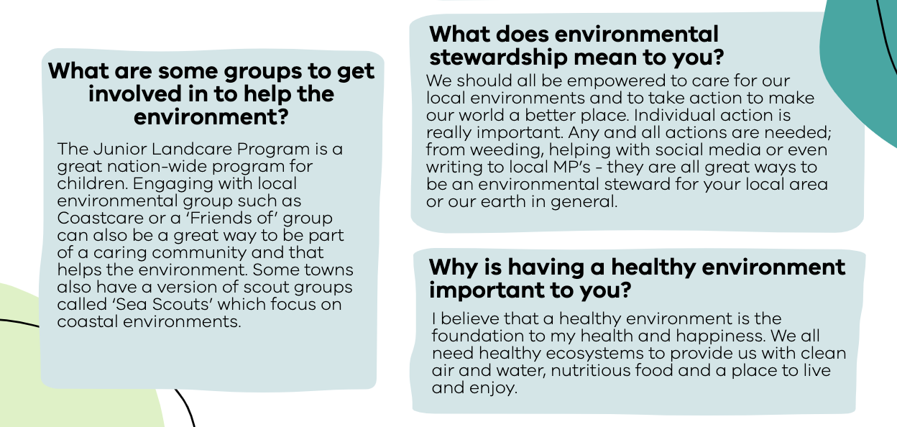

Slide 26
Native Gardens
for Native Wildlife
Establishing a natural habitat garden helps you encourage native animals like birds, bats, lizards, frogs, butterflies and other insects to your garden.
Native gardens can also help:
Reduce garden maintenance costs
Decrease gardening and time commitments
Conserve local native plants and animals
make our urban areas more ecologically sustainable.

Slide 27
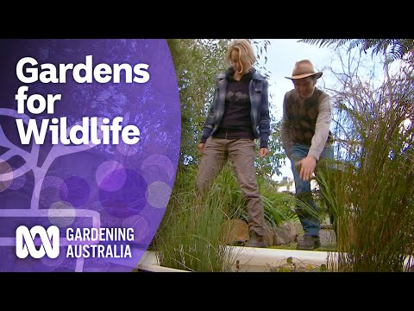
Make your garden wildlife friendly
Join the Gardening Australia team to find out some of th basic ingredients that make a garden wildlife friendly.

Slide 28
Gardens for Wildlife Investigation
Visit the Gardens for Wildlife Victoria website and click on Elements of a Wildlife Garden as well as the online article Make your garden a wildlife haven.
Your task is to research locally native species in your area and design a native garden for your school or home.
Use the basic ingredients listed on the site and create a plan for your garden.

Slide 29
Review Questions
It’s time to check your understanding.
Fill out the review questions worksheet.

