Slide 1
Victorian Coastal Monitoring Program
How to use VicWaves
- Live and historical wave buoy data

Slide 2
Introduction and access to VicWaves
VicWaves is available at https://vicwaves.com.au/
VicWaves provides an online data repository of wave buoy data that has been collected in collaboration with the following organisations:
DEECA
Deakin University
University of Melbourne
Gippsland Ports
IMOS

Slide 3
How to use VicWaves
This document is a guide to accessing live and historical data on VicWaves
Live Data
View live data
Significant Wave Height (m)
Peak Wave Period (s)
Mean Wave Period (s)
Peak Wave Direction (deg)
Mean Wave Direction (deg)
Sea Surface Temperature (degC)
Wind Speed (knots)
Wind Direction (deg)
Download past data from live sites
Historical Data
Download archived data from sites that are no longer live

Slide 4
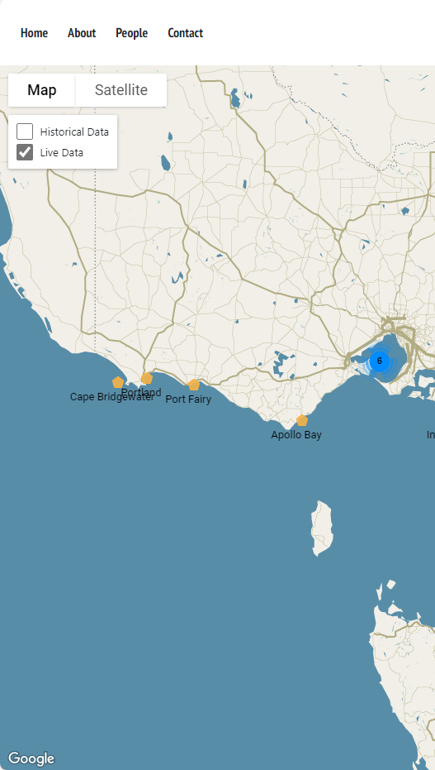
Live Data
Select ‘Live Data’
Select the location of interest - The live data will be displayed on the right-hand panel
Select ‘Expand’ to separate the graphs
To download historical data from these live sites, select the dates of interest and select ‘Export Data’
A ‘Terms and Conditions’ box will pop up. Select ‘Download’ if you agree.
A csv file will be downloaded for the site and dates selected

Slide 5
Live Data – Video

Slide 6
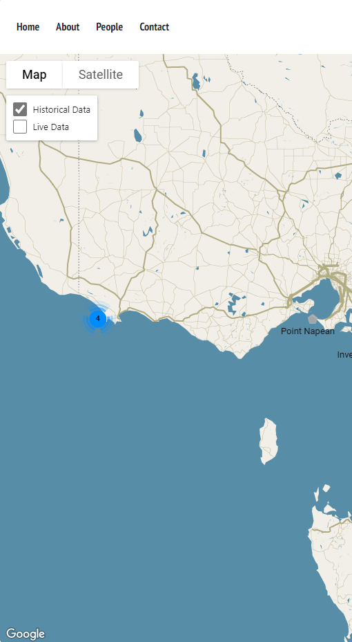
Historical Data
Select ‘Historical Data’
Select the site of interest
Select ‘Download Data Archive’
A csv file will be downloaded for the site selected

Slide 7
Historical Data - Video

Slide 8
How to use VicWaves
If you have any questions, please contact the VCMP team – vcmp@delwp.vic.gov.au

