Slide 1
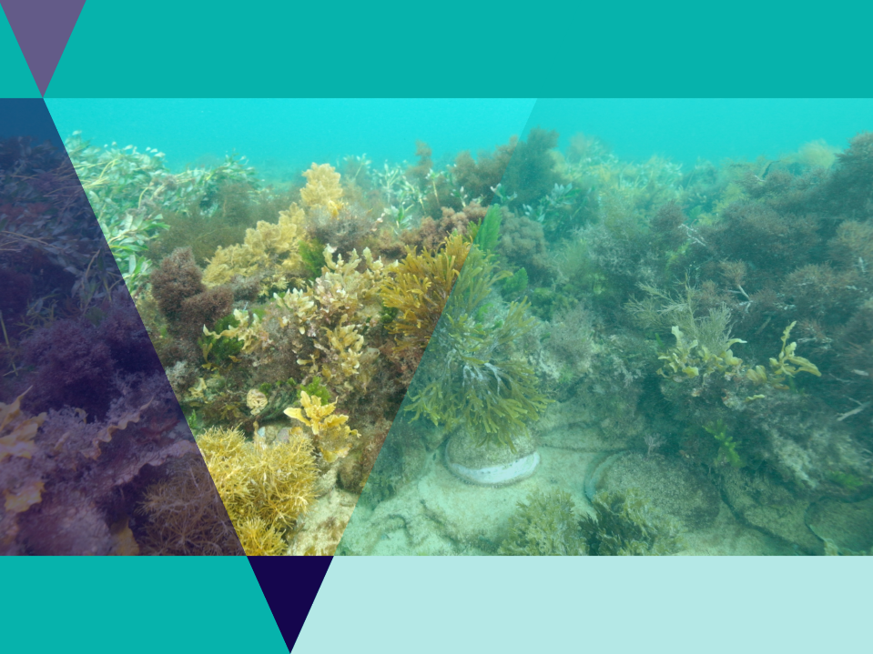

Seaweed Solutions for Sustainable Futures

Slide 2
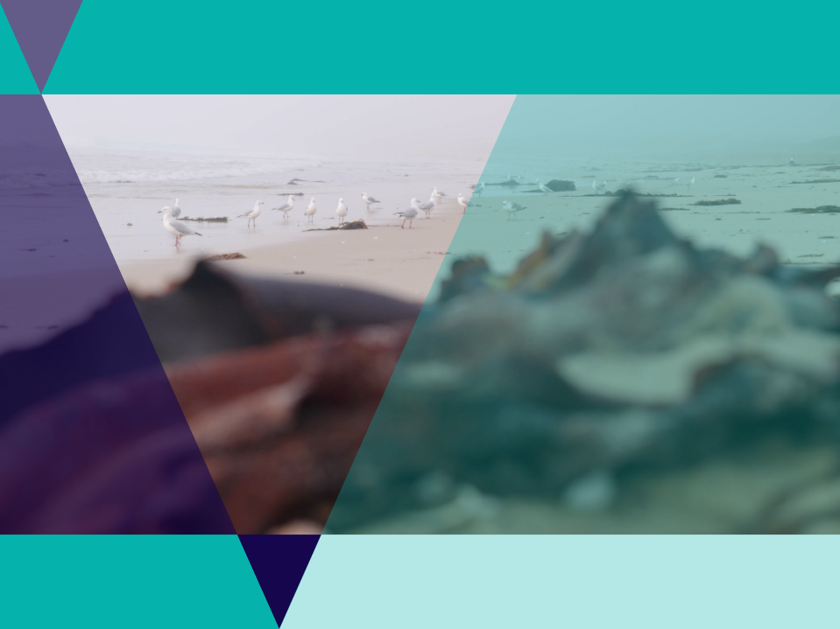
Lesson outline
Video
Game
Quiz
Activity: Seaweed biodiversity
Activity: Future job profile
Investigation: Modern uses of seaweed
Investigation: International use of edible seaweeds

Slide 3
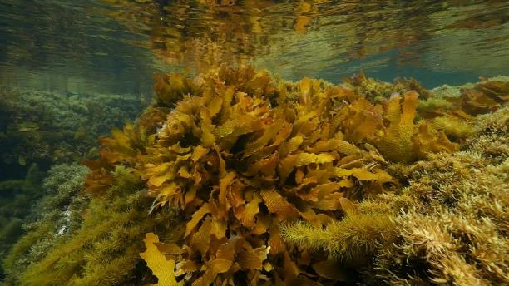


Video: Seaweed Solutions for Sustainable Solutions
Video Link: https://www.marineandcoasts.vic.gov.au/coastal-programs/coastcare-victoria/coastcare-victoria-school-kit

Slide 4
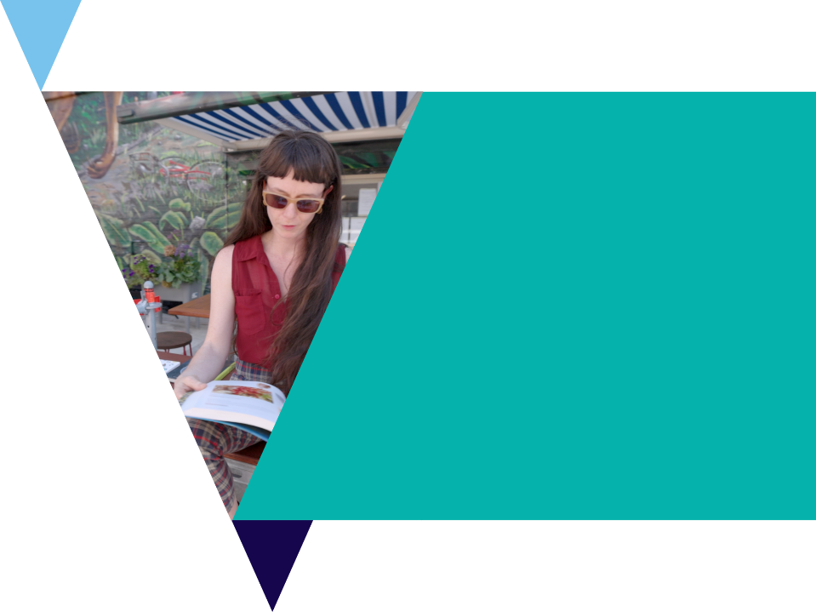
Quiz
It’s time for a quick quiz to see what you can remember from the video!
There are a total of 10 multiple choice questions

Slide 5
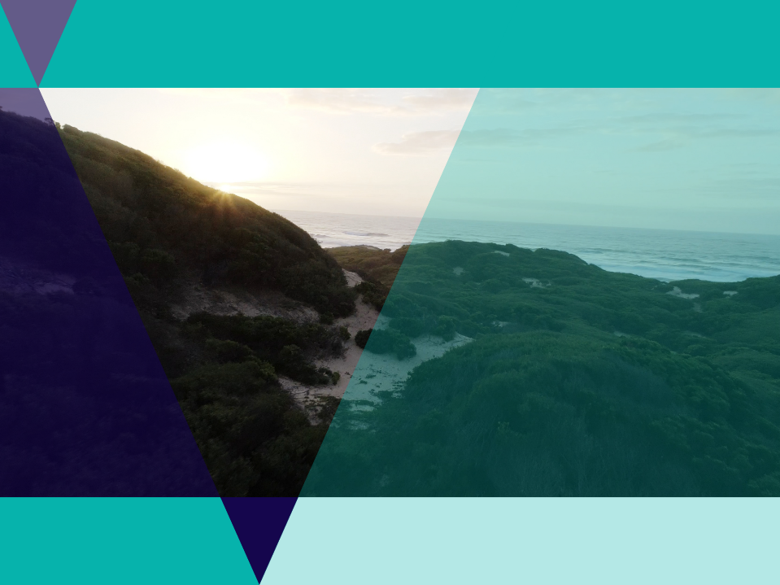
Local Country
Aunty Judy welcomed us to the video explaining that the video was being filmed on Wadawurrung Country and she grew up on Gunditjmara Country.
Use the Map of Indigenous Australia to research the Traditional Owners of the land you are learning on today.

Slide 6
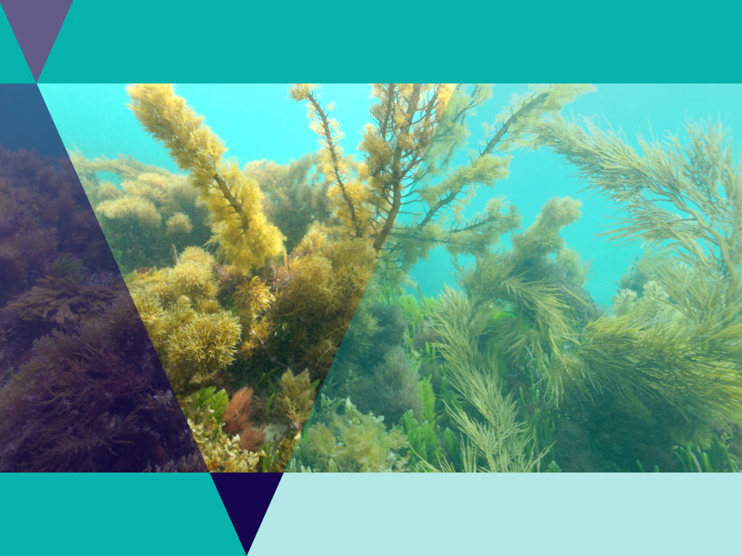
Seaweed biodiversity
Seaweeds are not plants but algae
Seaweeds get their energy from the sun through photosynthesis
Seaweeds absorb nutrients and carbon dioxide through photosynthesis.
Seaweeds are known as foundation species as they provide food, shelter and habitat for many other species.
There are three main groups of seaweed; green, brown and red.

Slide 7
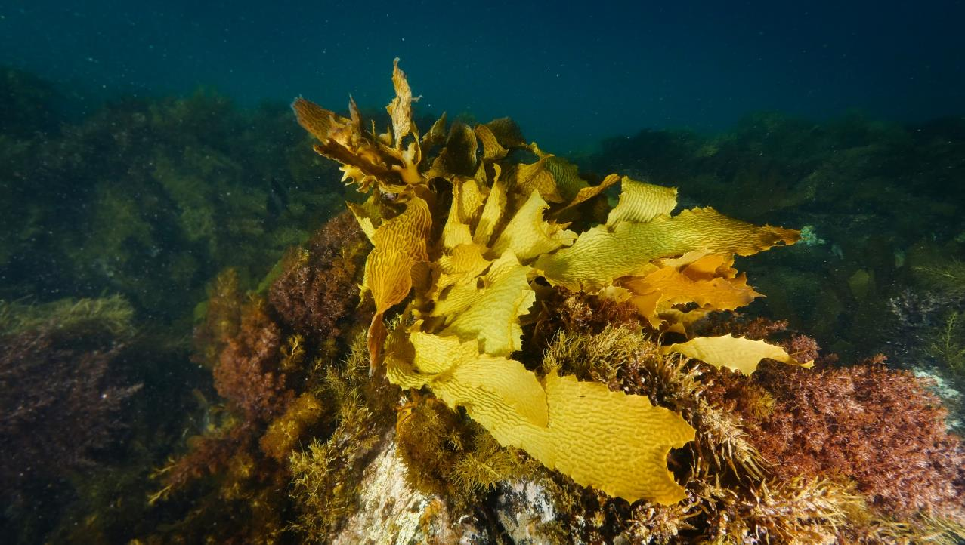
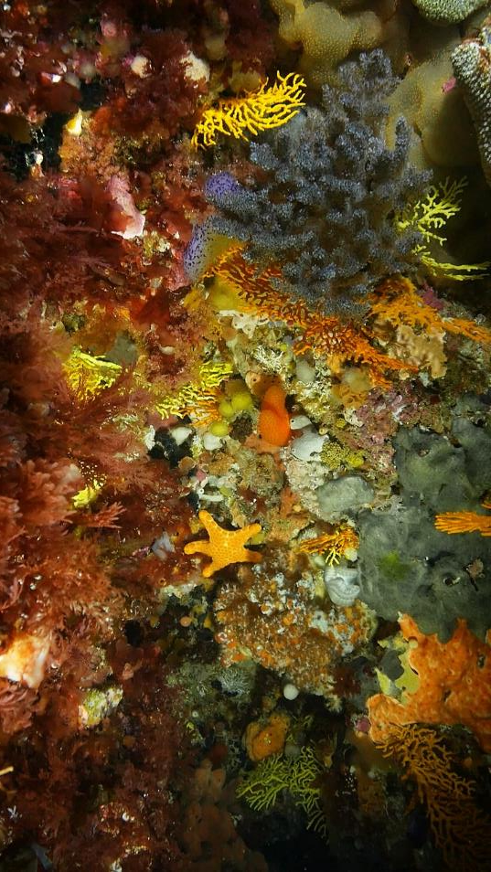
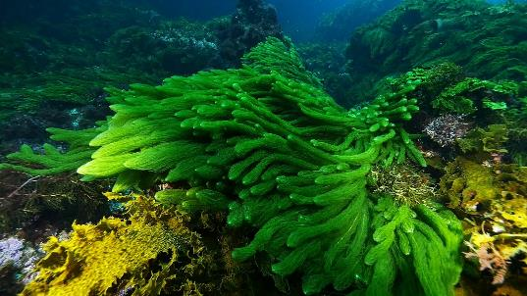
Brown algae
Red algae
Green algae
Notes:
The Great Southern Reef has a huge diversity of seaweeds. They can be divided into 3 distinct groups. Brown (like our golden kelp), red and green algae. An estimated 77% of the 565 species of red seaweed found on the Great Southern Reef are not found anywhere else on Earth! Although most predominant in freshwater, green seaweeds have many marine representatives along the Great Southern Reef.

Slide 8
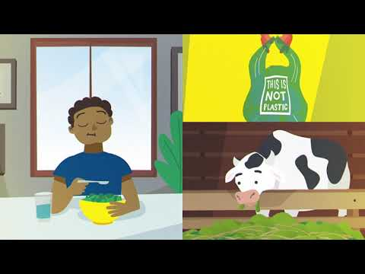
Video: WWF Seaweed Animation
Easy to grow, versatile, and beneficial to ocean ecosystems, seaweed is a carbon-sequestering super plant. It can even be farmed as an efficient way to produce highly nutritious food for both humans and animals alike

Slide 9
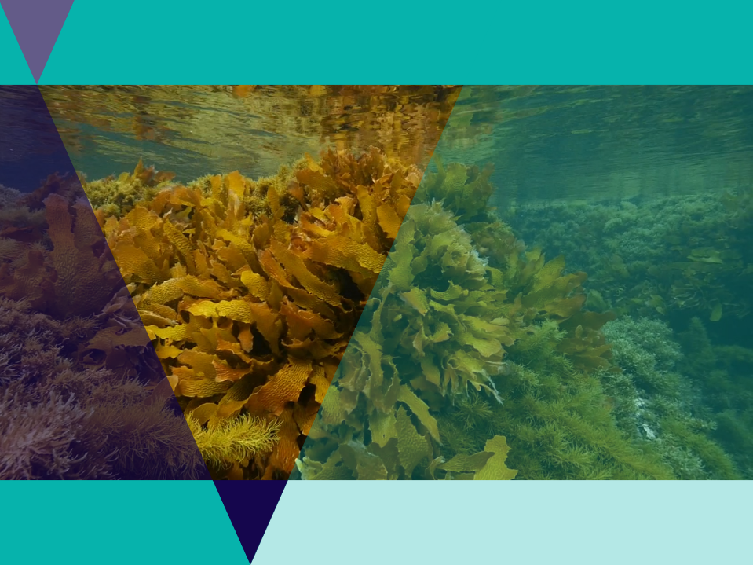
Seaweed biodiversity
Australia has the highest diversity of seaweeds in the world.
One main species - the golden kelp forms dense forests right across Australia’s southern coastline.

Slide 10
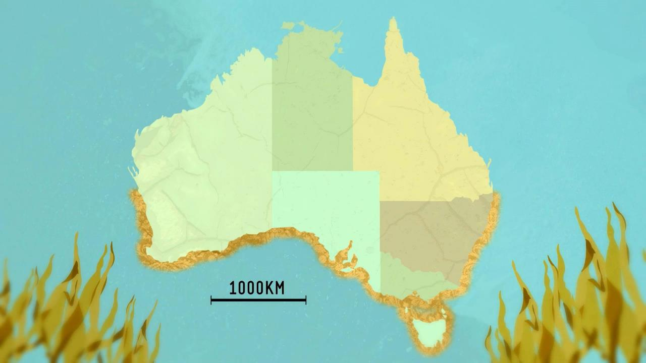
Golden kelp is the major seaweed species of the Great Southern Reef, an 8000km network of kelp forests.

Slide 11
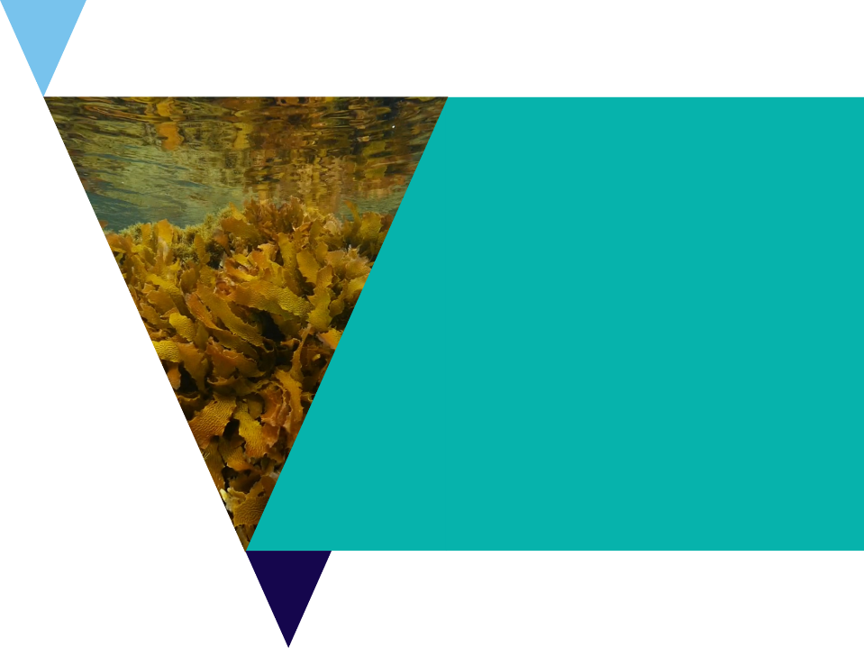
Seaweed biodiversity activity
Use the Port Phillip Bay Taxonomic Toolkit to research local species.
In the species tab, click Seaweed and Seagrasses to explore some of the local species found in Port Phillip Bay.
Use the website to fill out the Seaweed biodiversity worksheet.

Slide 12
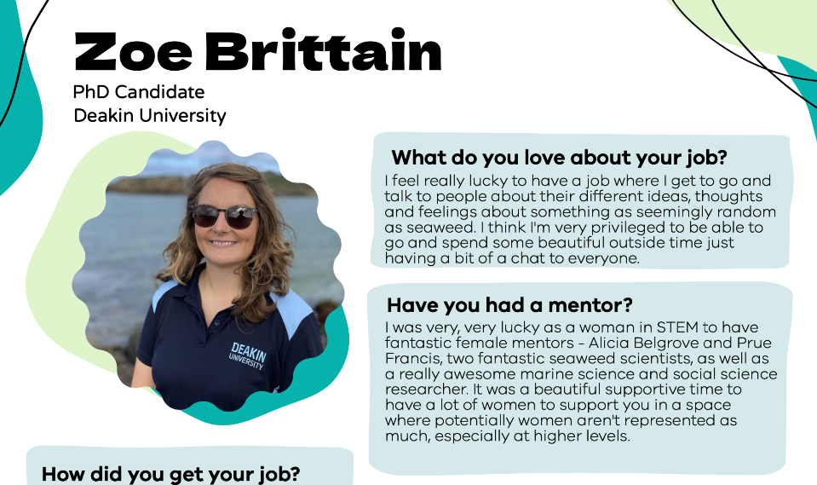
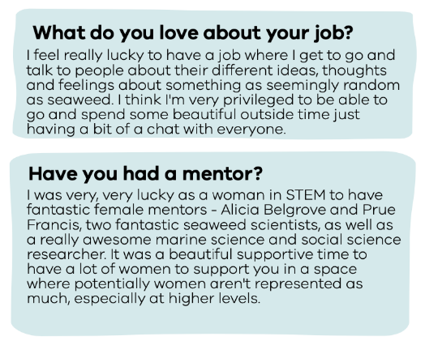

Slide 13
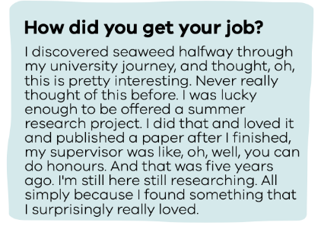
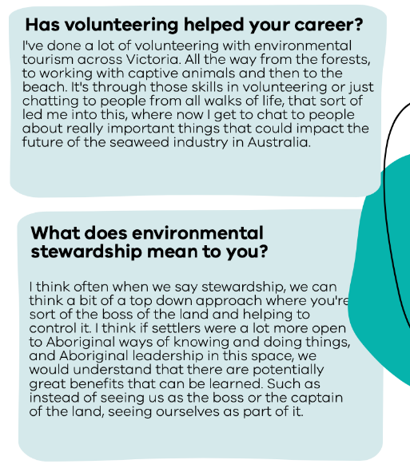
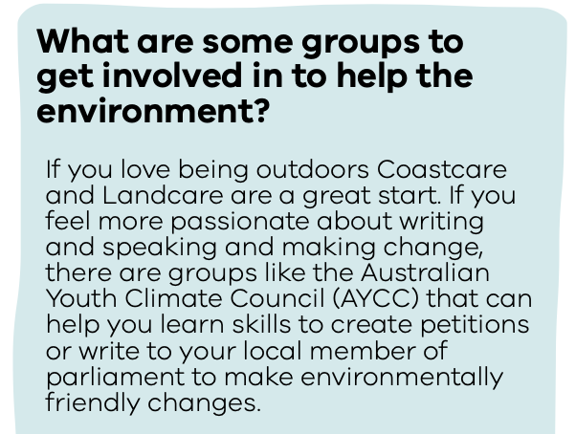

Slide 14
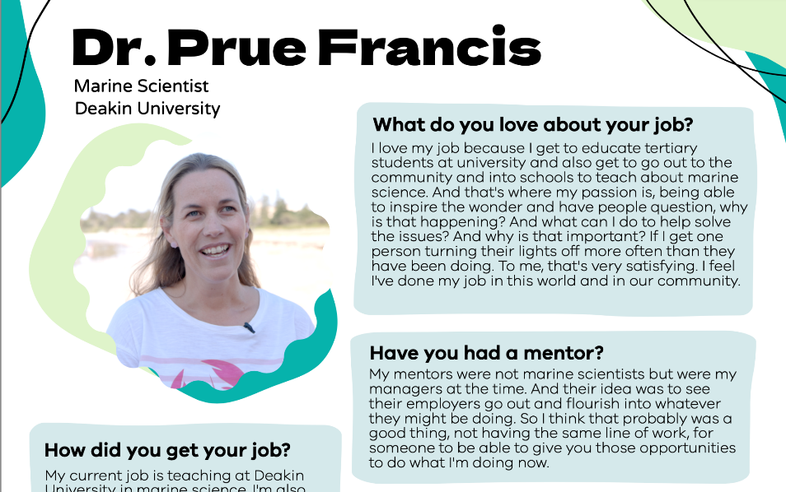
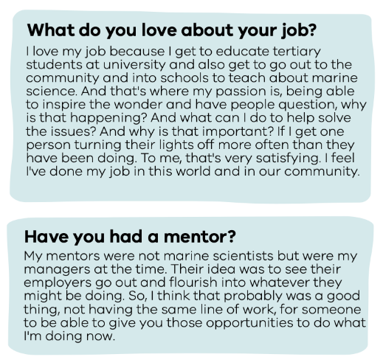

Slide 15
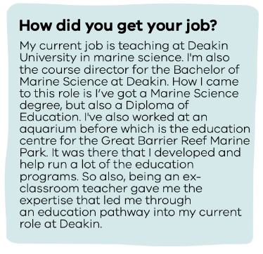
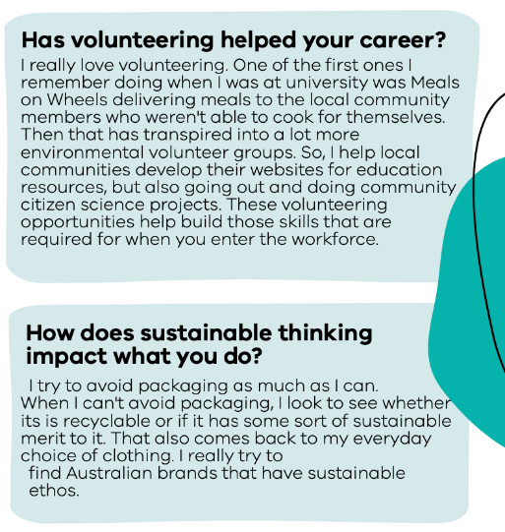
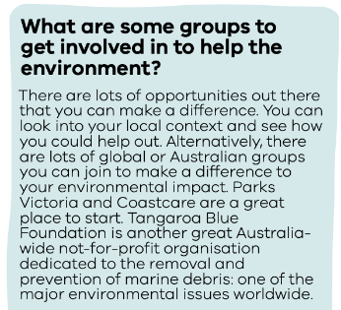

Slide 16
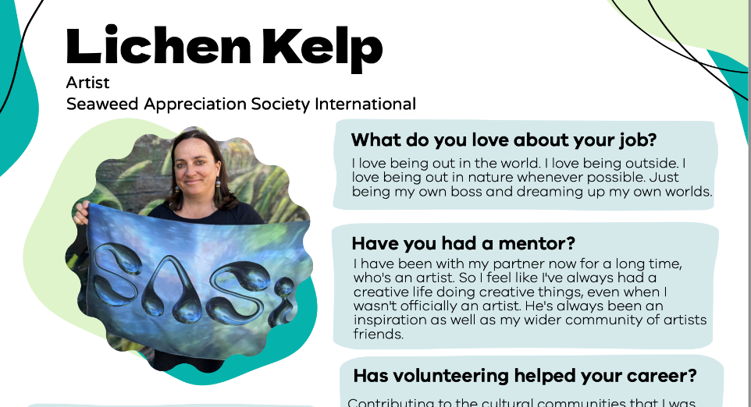
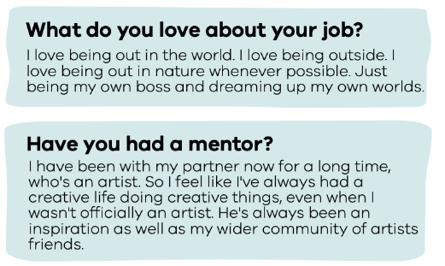

Slide 17
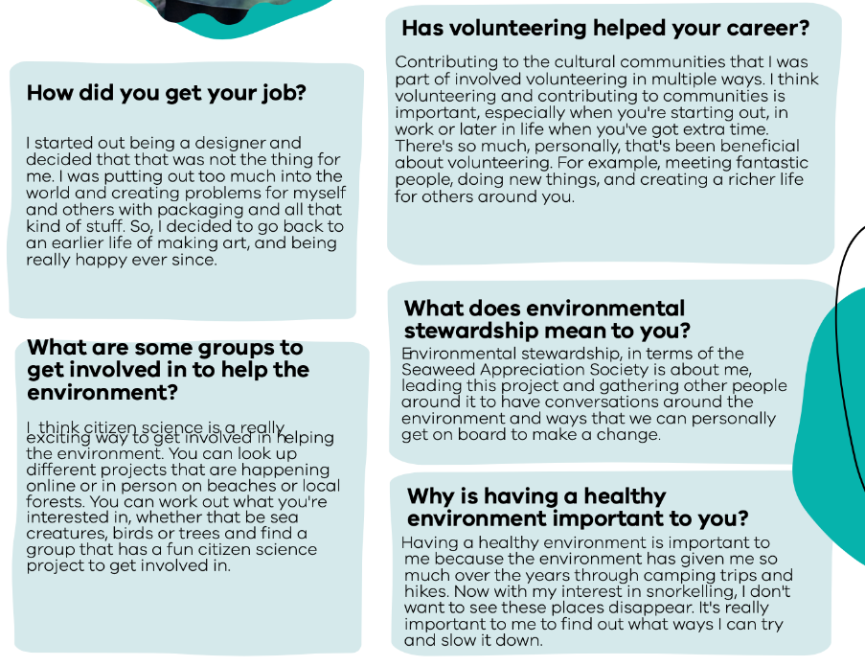

Slide 18
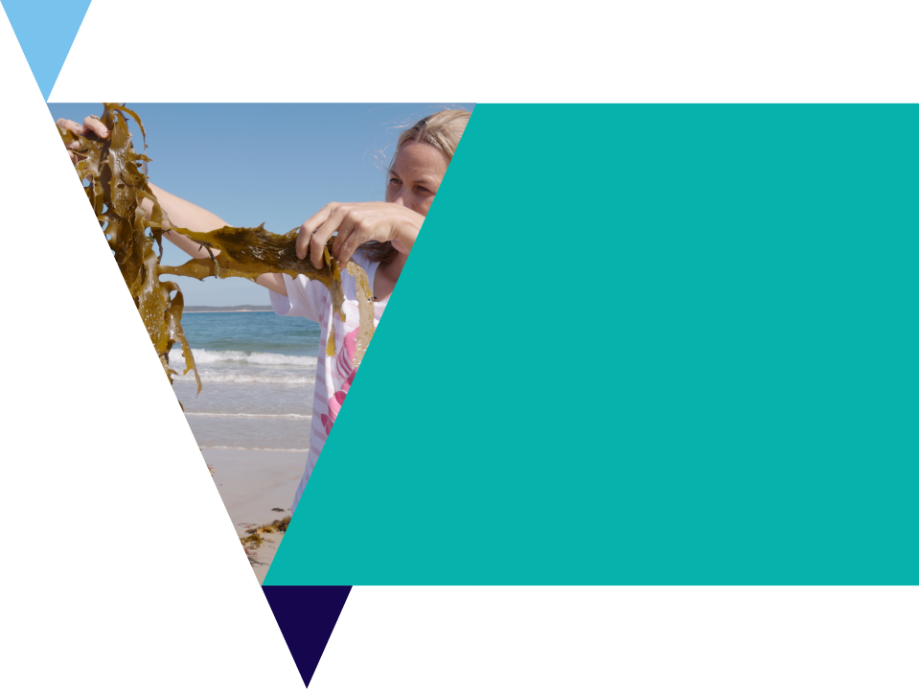
Future job profile
Look at the profile page articles to gain inspiration for your own future careers.
Use the Profile worksheet to dream up a job for their future and answer the following questions:
What might you like about this job?
Who might be a good mentor?
How might you get your job
How could volunteering help your career?
How does sustainable thinking impact what you do?
Why is having a healthy environment important to you?
What are some groups to get involved in to help the environment?

Slide 19
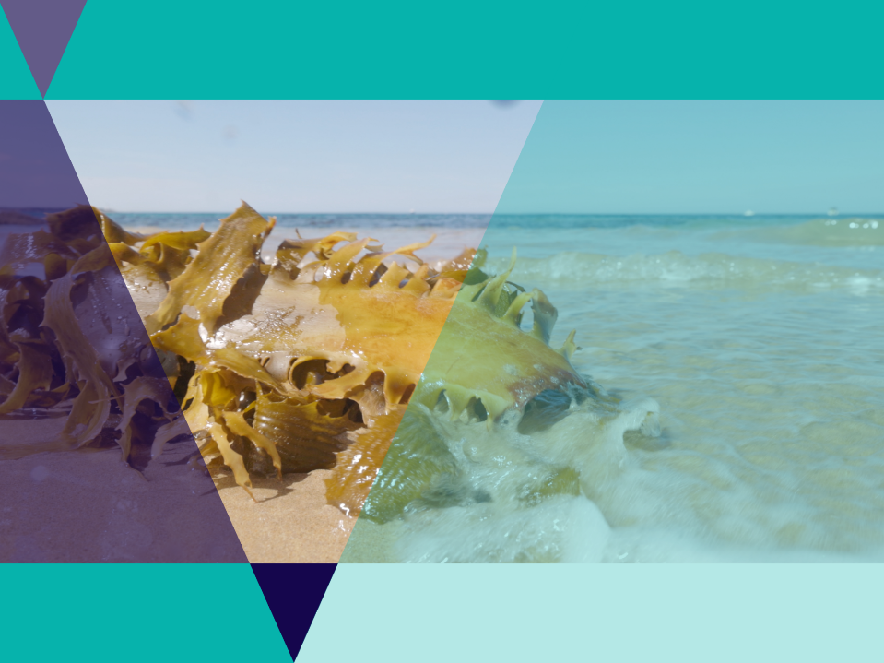
Modern seaweed industries
There is a growing and emerging seaweed industry in Australia.
The video introduced a number of modern uses including:
  Feed for cows
  Food for humans
  Pharmaceuticals
  Making plastic
  Clothing

Slide 20
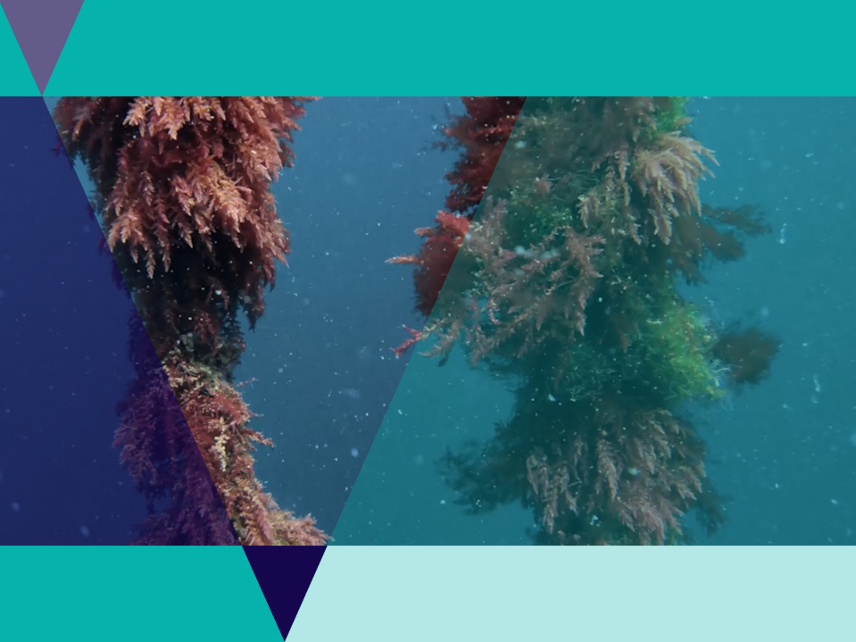
SeaForest
SeaForest are a company farming a red seaweed called Asparagopsis
When fed to cows, this seaweed reduces their methane emissions
Farming seaweed also helps to capture carbon.
Learn more on their website.

Slide 21
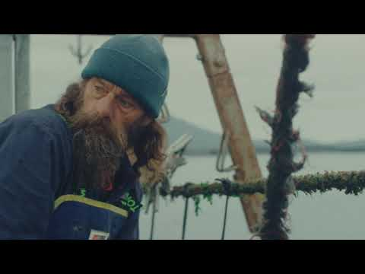
Video: SeaForest
Tasmanian based environmental biotechnology company using science to deliver at scale cultivation and supply of a native red seaweed to address two of the most significant challenges of our time... Fighting Climate Change and Producing More Food with Fewer Resources.

Slide 22
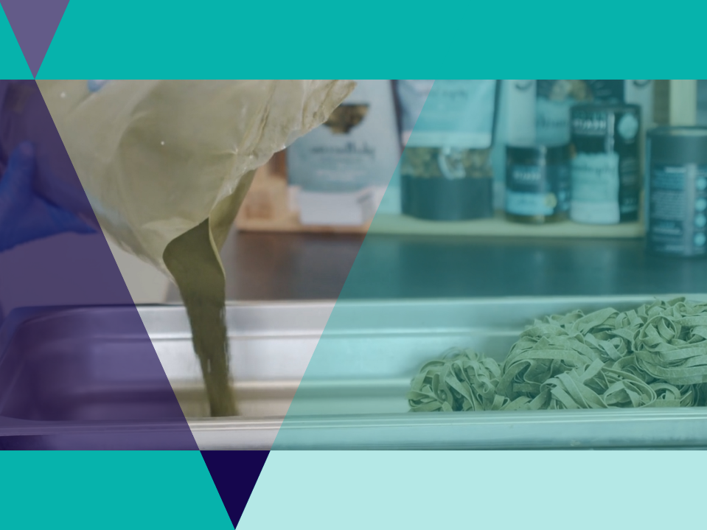
PhycoHealth
Phycohealth have made a concentrated seaweed product for nutritional health benefits.
The company makes a wide variety of products including seaweed pasta and pharmaceutical products like moisturisers.

Slide 23
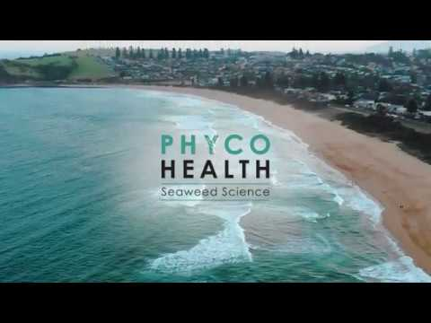
Video: PhycoHealth
Seaweed Futures based on science and growing with your health

Slide 24
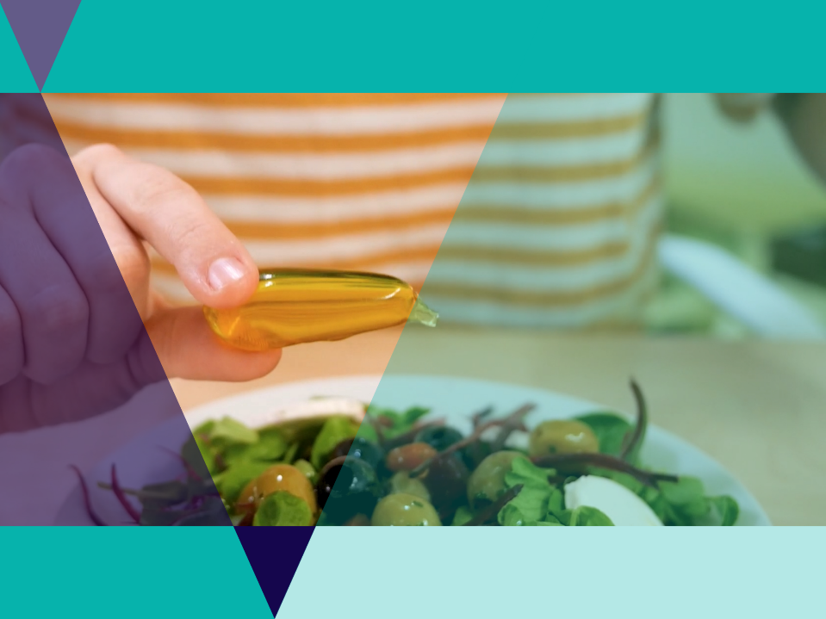
Notpla
Nopla is a revolutionary material made from seaweed
It biodegrades in weeks naturally
The company makes advanced packaging solutions made from seaweed and other natural materials as an alternative to single-use plastic.

Slide 25
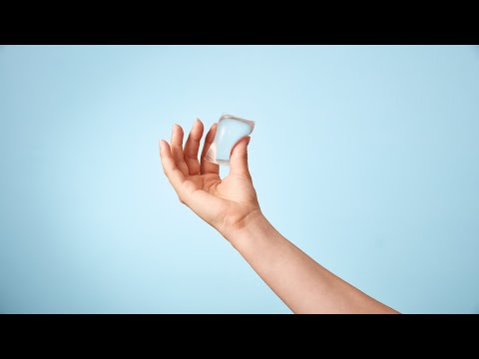
Video: Notpla
Notpla is a sustainable packaging start-up founded in 2014 by a combination of designers, chemists, engineers, and entrepreneurs.

Slide 26
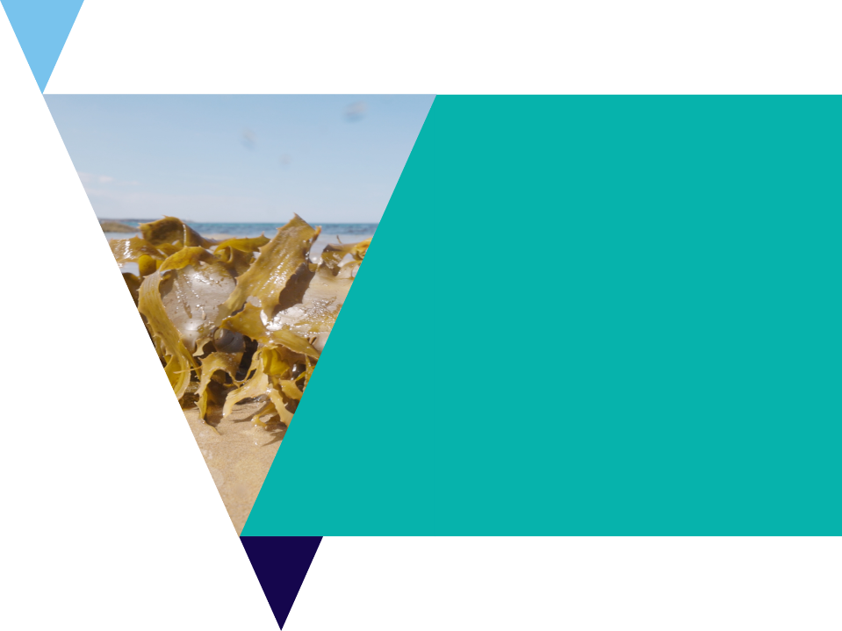
Modern use of seaweeds
Many companies are utilising seaweed in their unique way to create products.
Complete the Modern uses of seaweed worksheet, and discover:
  what seaweed species are being used
  what products are being made
  the benefits of these products to people and/or the environment.

Slide 27
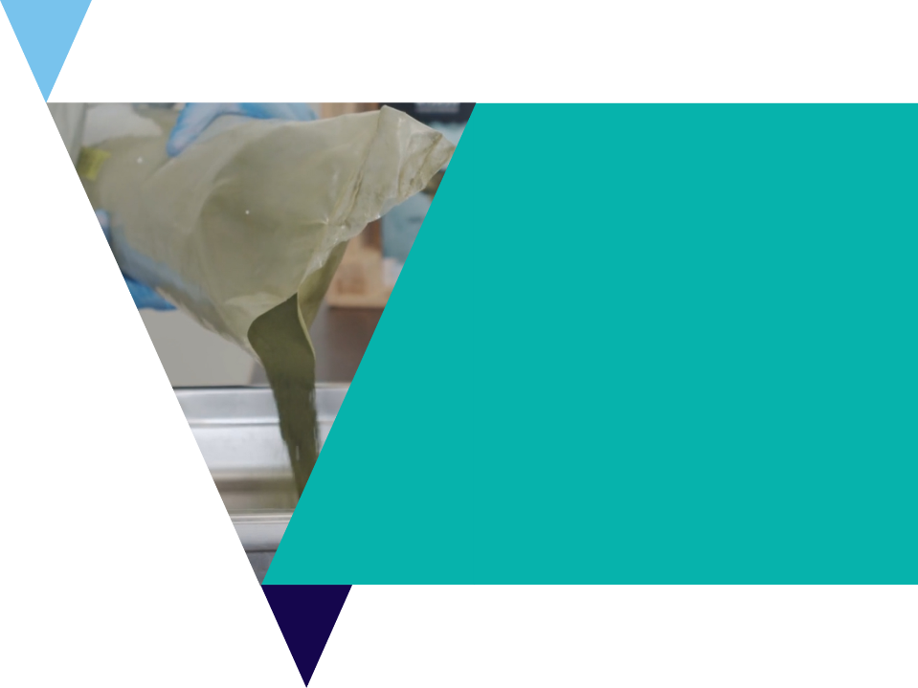
International use of edible seaweeds
Many cultures around the world have had a long history of consuming seaweed in their cuisine.
In this activity, you will research the various seaweed dishes and species used from around the world.
Use the International Use of Edible Seaweeds worksheet.

Slide 28
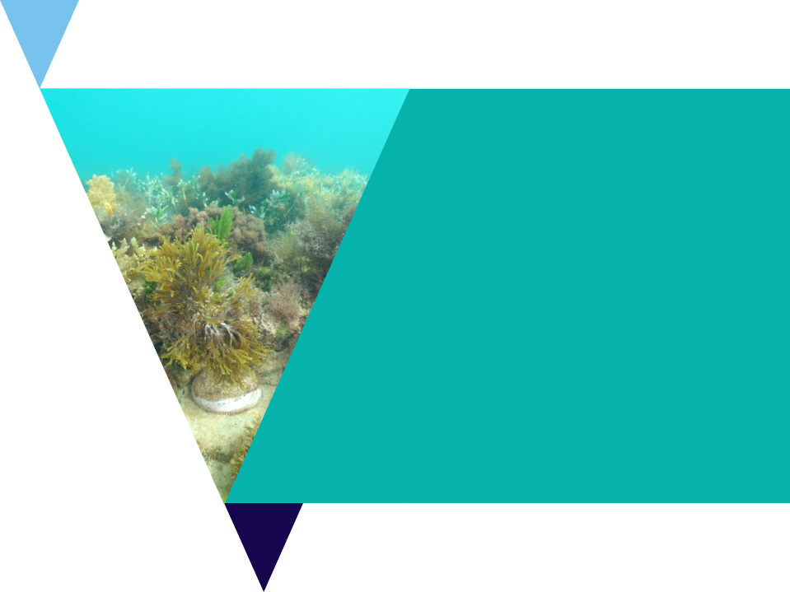
Review questions
It’s time to check your understanding.
Fill out the review questions worksheet.

