Slide 1
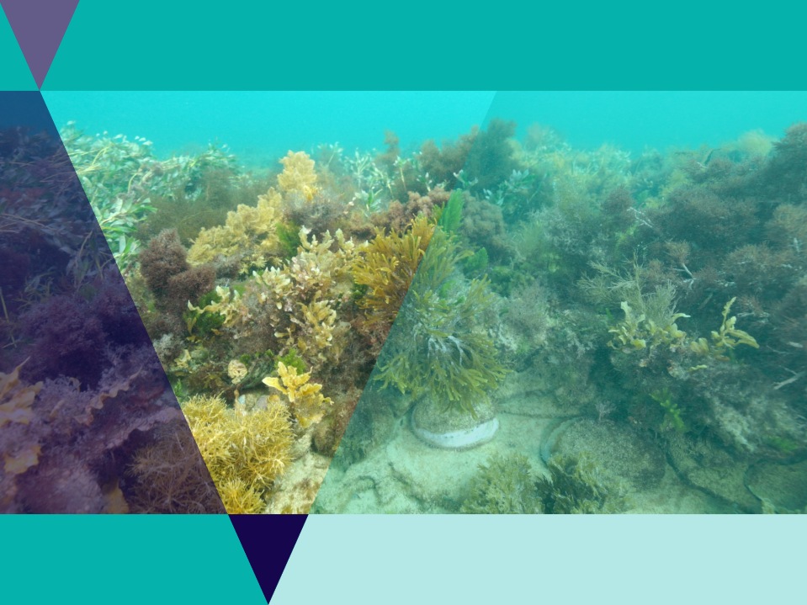
Seaweed Solutions for Sustainable Futures

Slide 2
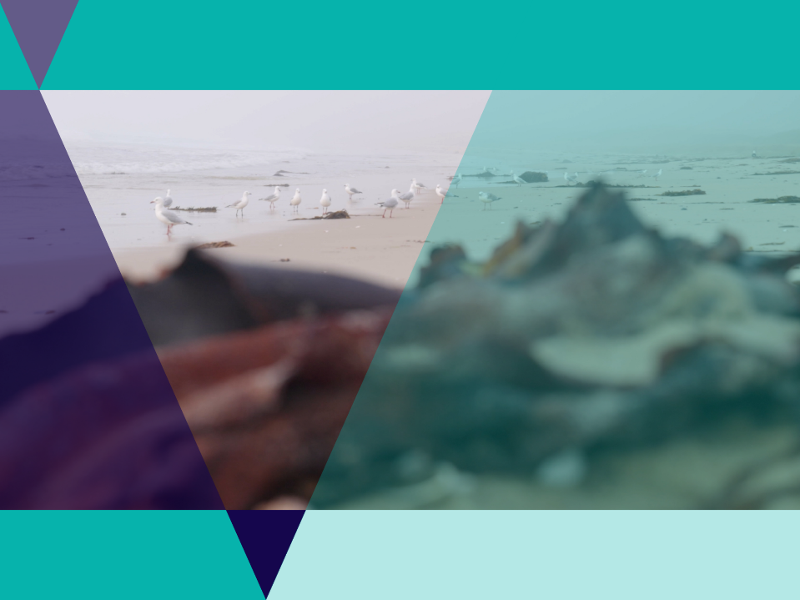
Lesson Outline
Video
Game
Quiz
Local Language Activity
Seaweed Biodiversity Activity
Future Job Profile Activity
Modern Uses of Seaweed Investigation
International Use of Edible Seaweeds Investigation

Slide 3
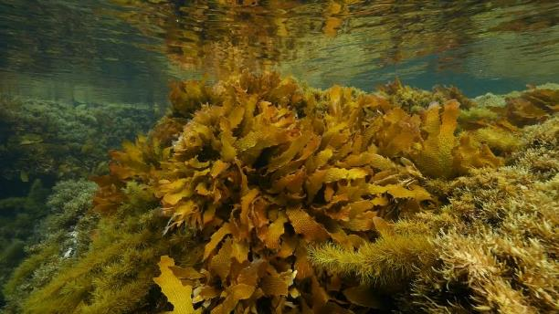
Video: Seaweed Solutions for Sustainable Solutions
Video Link: https://www.marineandcoasts.vic.gov.au/coastal-programs/coastcare-victoria/coastcare-victoria-school-kit

Slide 4
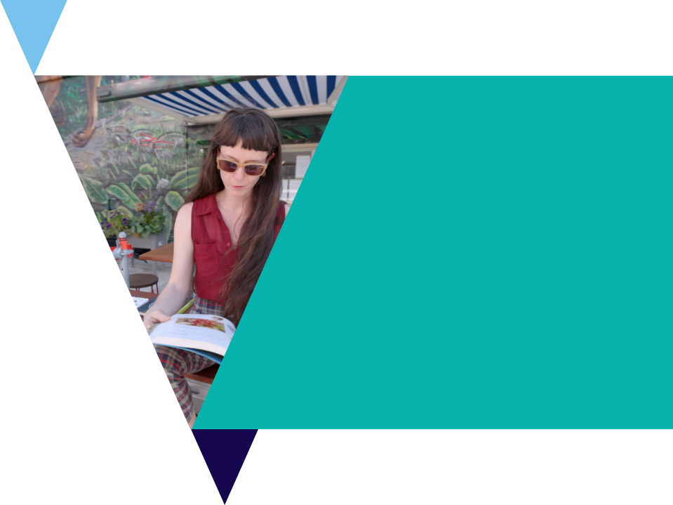
Quiz
It’s time for a quick quiz to see what you can remember from the video!
There are a total of 10 multiple choice questions

Slide 5
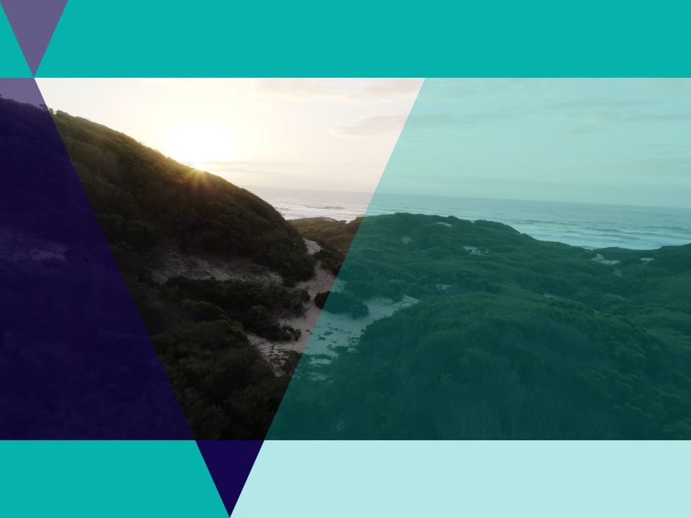
Local Lands
Aunty Judy welcomed us to the video explaining that the video was being filmed on Wadawurrung country and she grew up on Gunditjmara country.
Use the Map of Indigenous Australia to research the traditional owners of the land you are learning on today

Slide 6
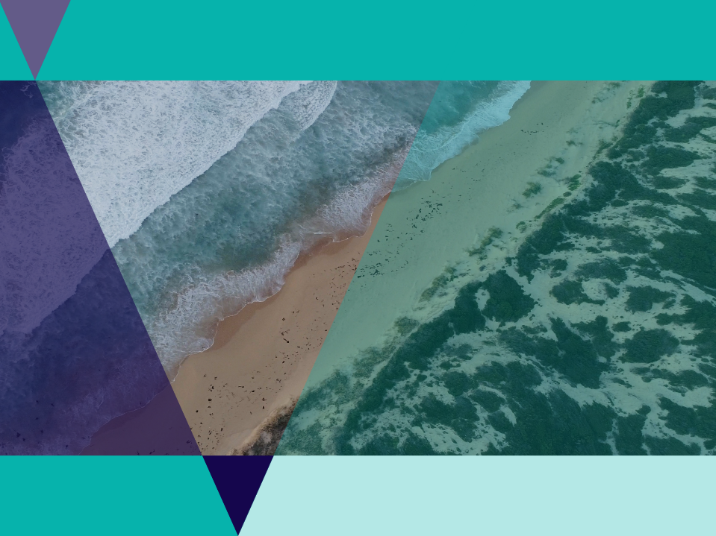
Local Language
It is estimated there are some 200 to 300 Indigenous languages spoken in Australia.
Many Aboriginal languages are already extinct.
50 Words A project by First Languages Australia and The University of Melbourne, this website aims to provide fifty words in every Indigenous language of Australia.

Slide 7
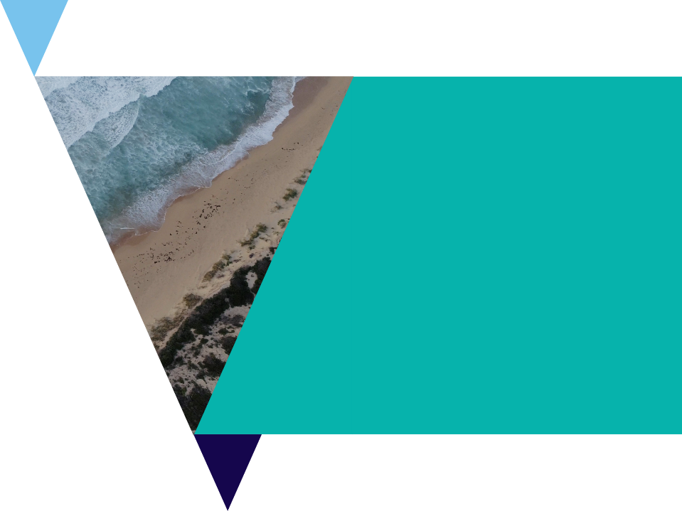
Local Languages Activity
Use the Local Languages Worksheet and go to the 50 words project website to record 5 words in local indigenous language.
Hello
Let’s go
Fish
Water
Sky
Listen to the pronunciation of the words and write down how it sounds to you

Slide 8
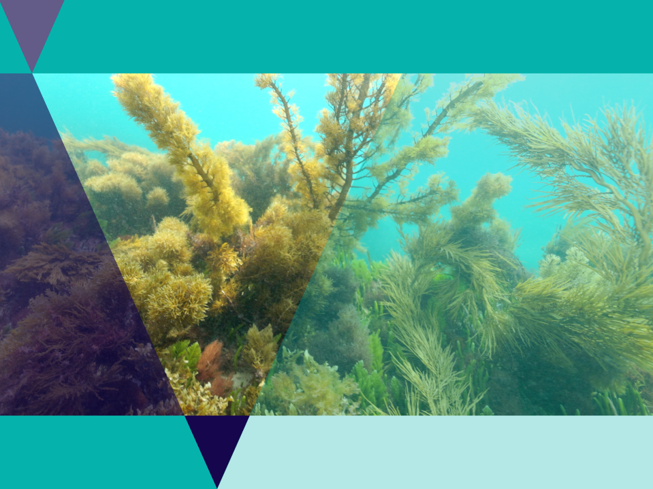
Seaweeds
Seaweeds are not plants but algae
Seaweeds get their energy from the sun through photosynthesis
Seaweeds absorb nutrients and carbon dioxide through photosynthesis.
Seaweeds are known as foundation species as they provide food, shelter and habitat for many other species.
There are three main groups of seaweed; green, brown and red.

Slide 9
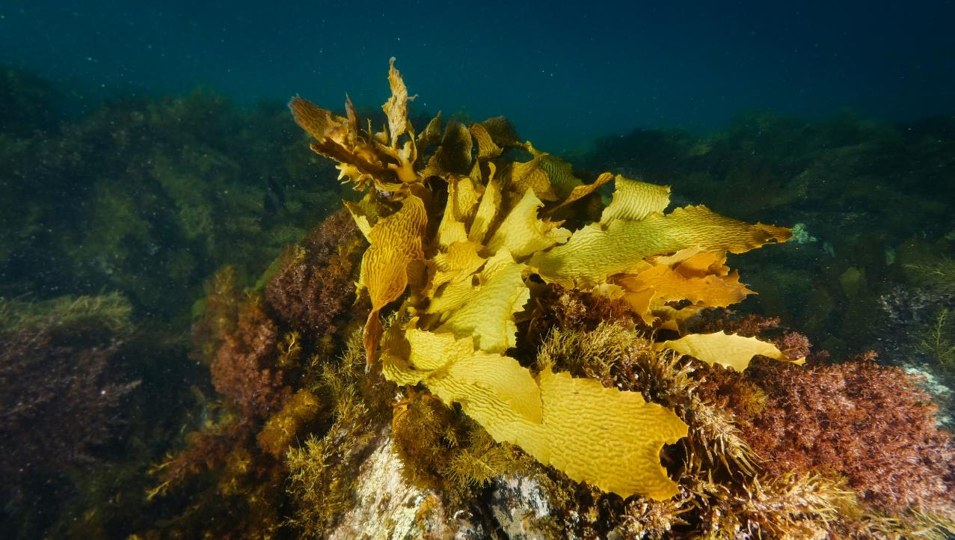
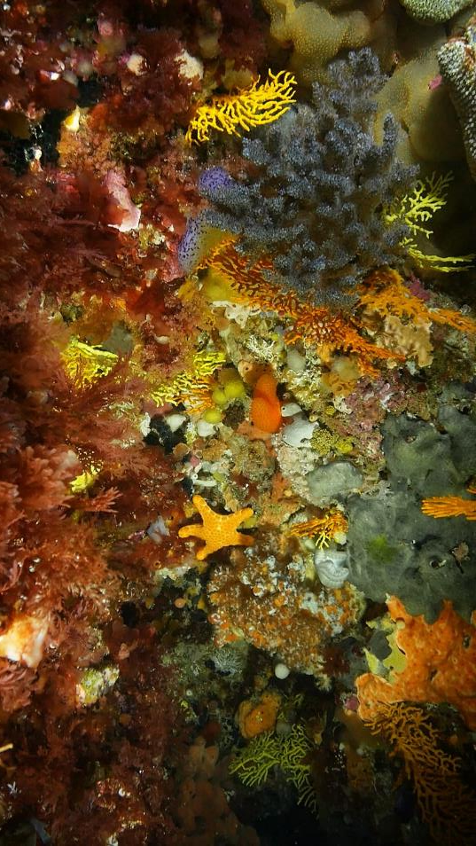
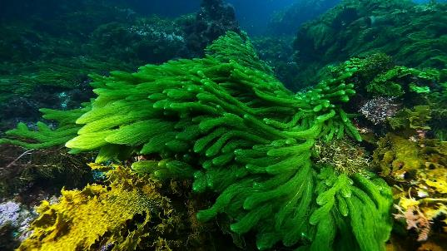
Brown algae
Red algae
Green algae
Notes:
The Great Southern Reef has a huge diversity of seaweeds. They can be divided into 3 distinct groups. Brown (like our golden kelp), red and green algae. An estimated 77% of the 565 species of red seaweed found on the Great Southern Reef are not found anywhere else on Earth! Although most predominant in freshwater, green seaweeds have many marine representatives along the Great Southern Reef.

Slide 10
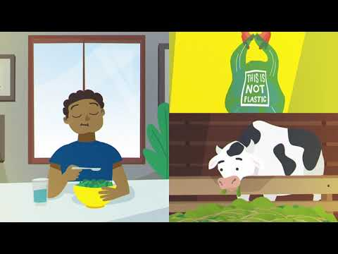
Video: WWF Seaweed Animation
Easy to grow, versatile, and beneficial to ocean ecosystems, seaweed is a carbon-sequestering super plant. It can even be farmed as an efficient way to produce highly nutritious food for both humans and animals alike

Slide 11
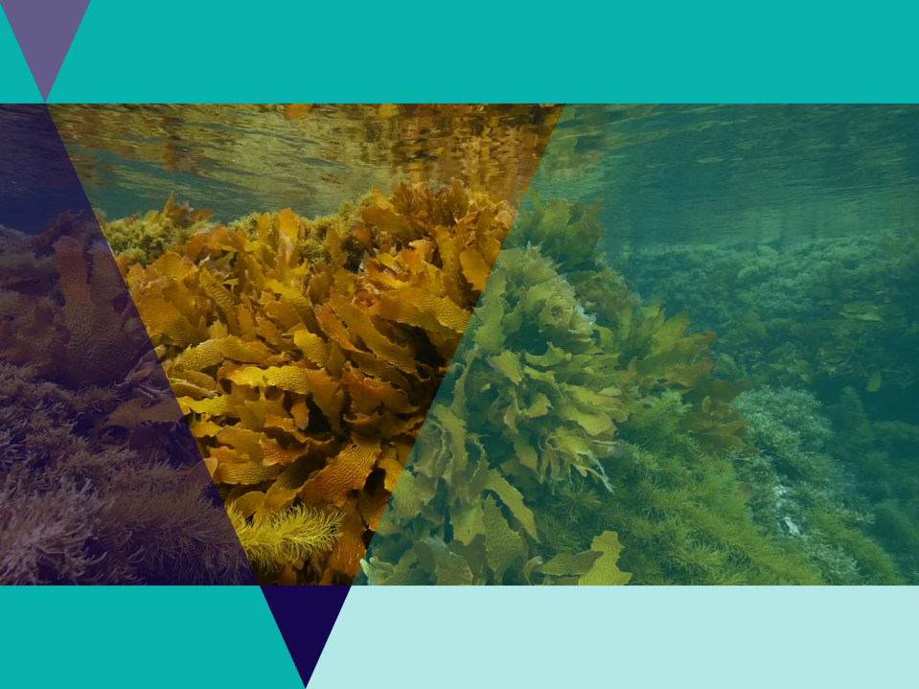
Australia has the highest diversity of seaweeds in the world
One main species - the golden kelp forms dense forests right across Australia’s southern coastline.

Slide 12
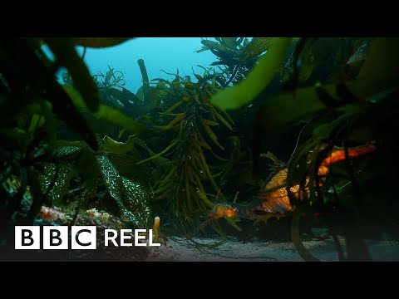
Video: The Unique Power of Australian Seaweed
Humans have been making use of seaweed for over 45,000 years. In the run-up to COP26, we look at the incredible abilities of this ancient organism and the ingenious ways it can help us secure the future of our planet.

Slide 13
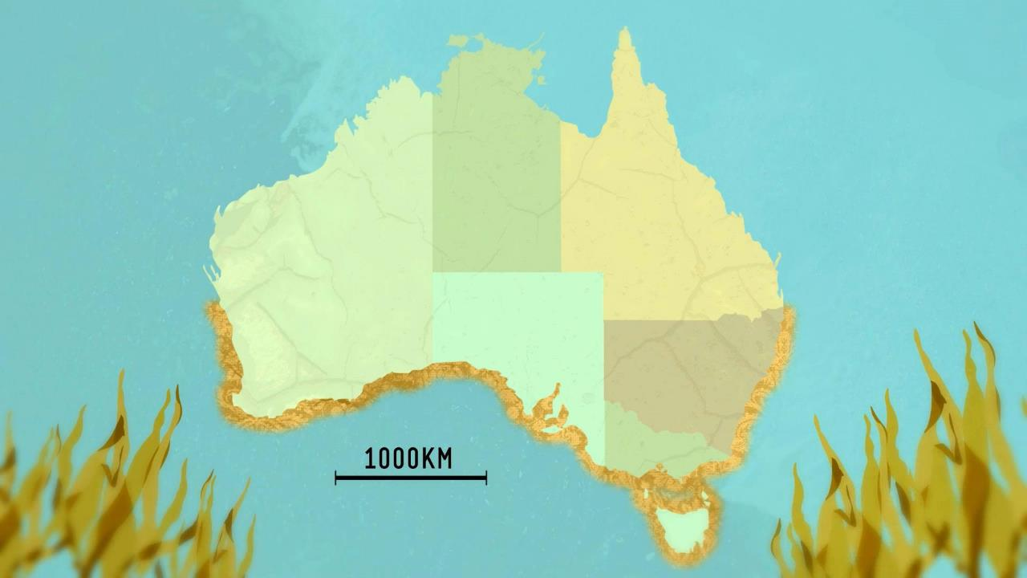
Golden kelp is the major seaweed species of the Great Southern Reef, an 8000km network of kelp forests.

Slide 14
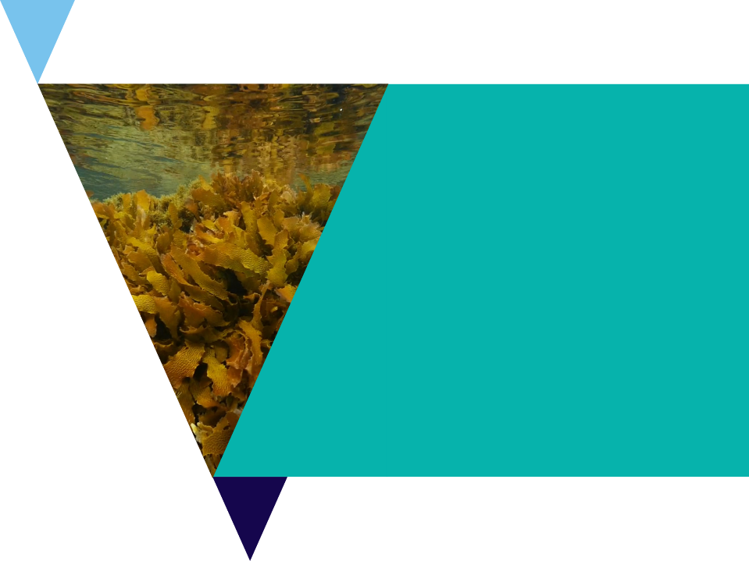
Seaweed Biodiversity Activity
Use the Port Phillip Bay Taxonomic Toolkit to research local species.
In the species tab, click Seaweed and Seagrasses they can then explore some of the local species found in Port Phillip Bay.
Use the website to fill out the Seaweed Biodiversity Worksheet,

Slide 15
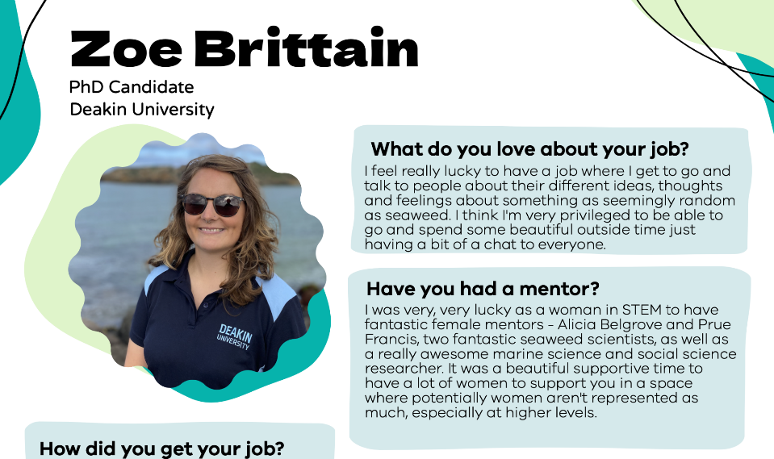
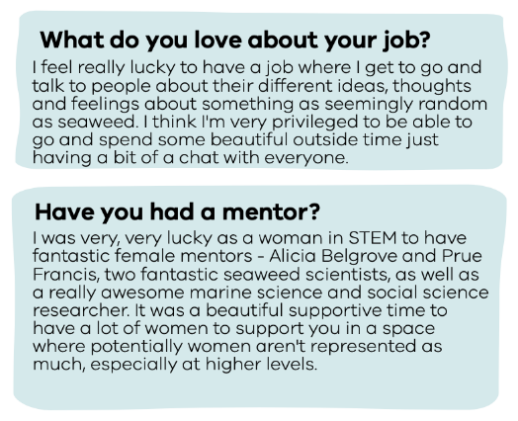

Slide 16
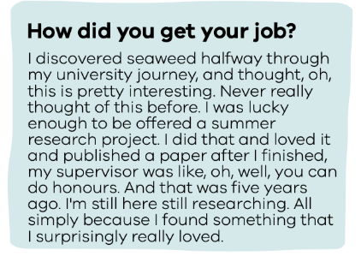
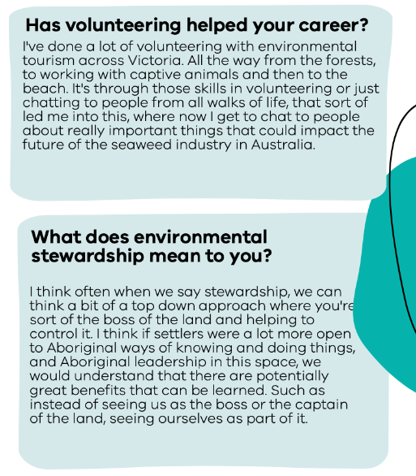
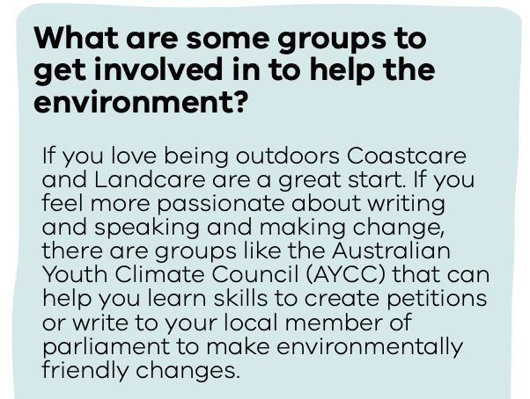

Slide 17
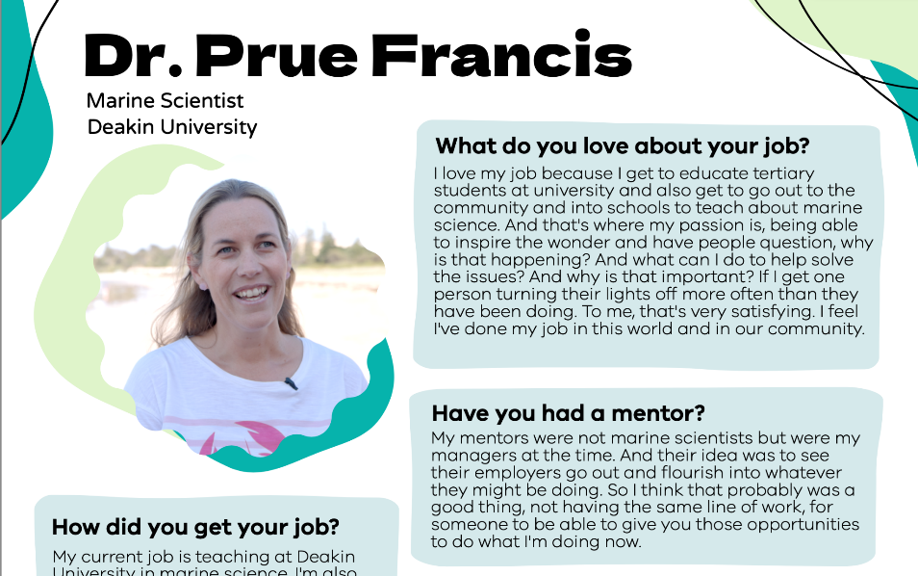
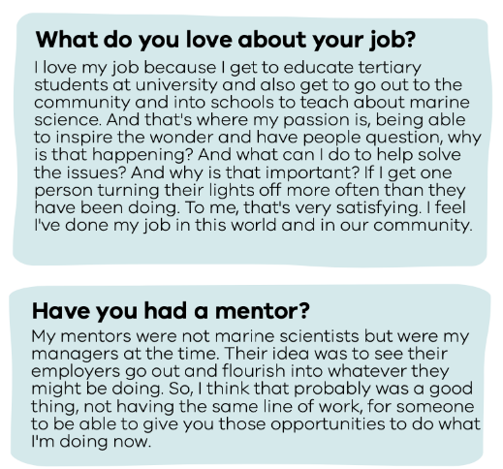

Slide 18
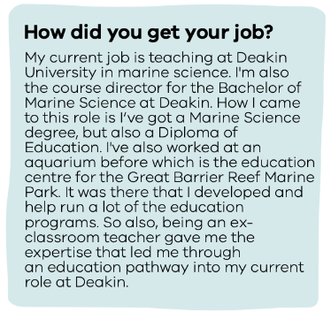
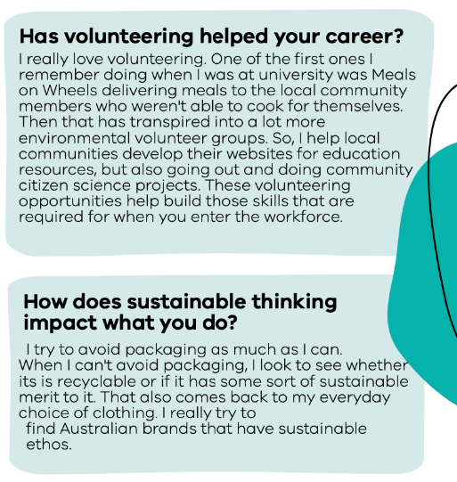
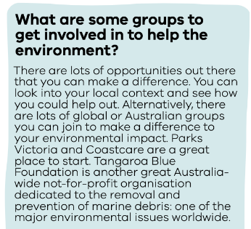

Slide 19
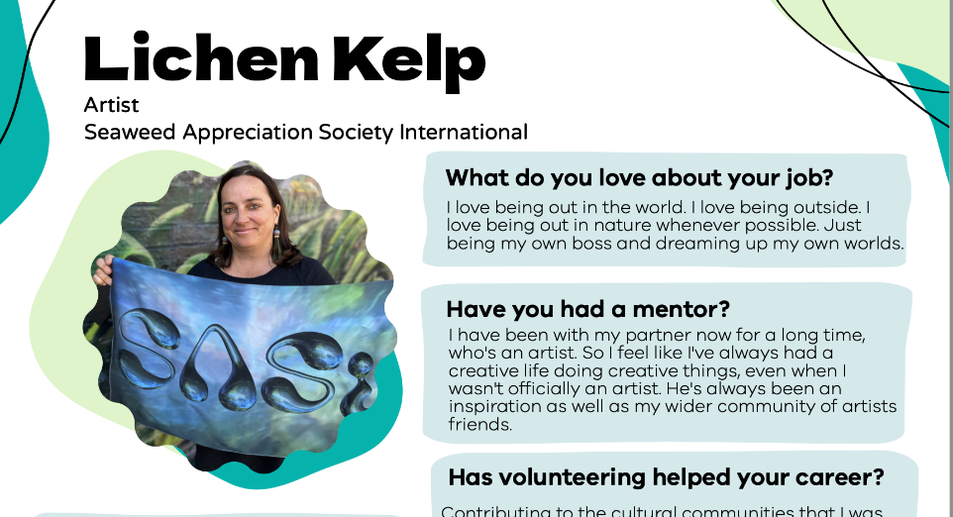
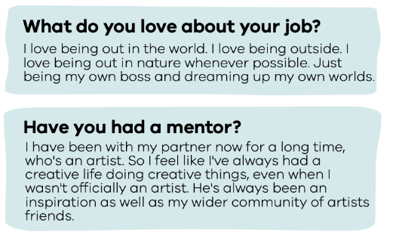

Slide 20
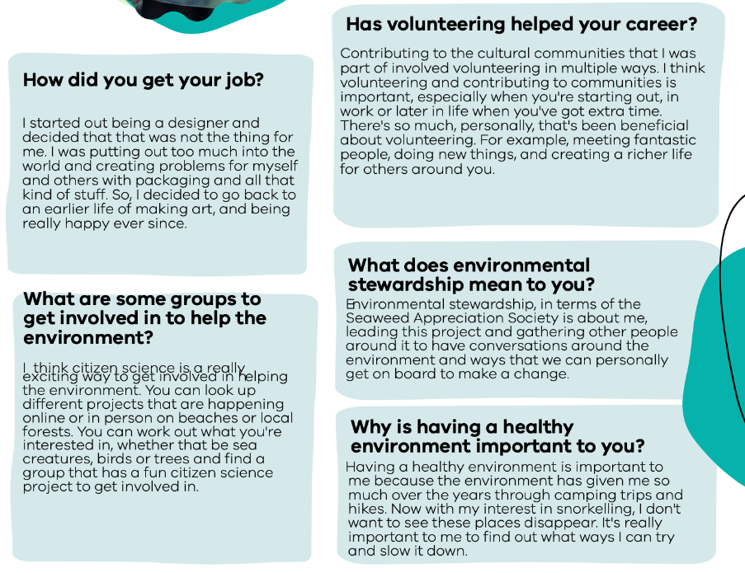

Slide 21
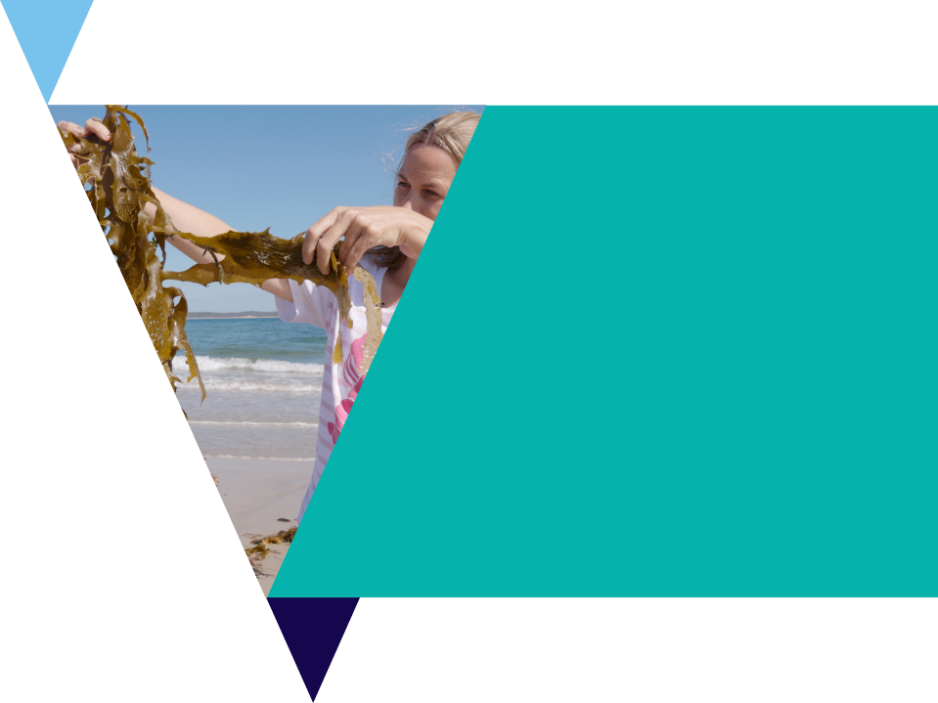
Future Job Profile Activity
Look at the profile page articles to gain inspiration for your own future careers.
Use the Profile worksheet to dream up a job for their future and answer the following questions:
What might you like about this job?
Who might be a good mentor?
How might you get your job
How could volunteering help your career?
How does sustainable thinking impact what you do?
Why is having a healthy environment important to you?
What are some groups to get involved in to help the environment?

Slide 22
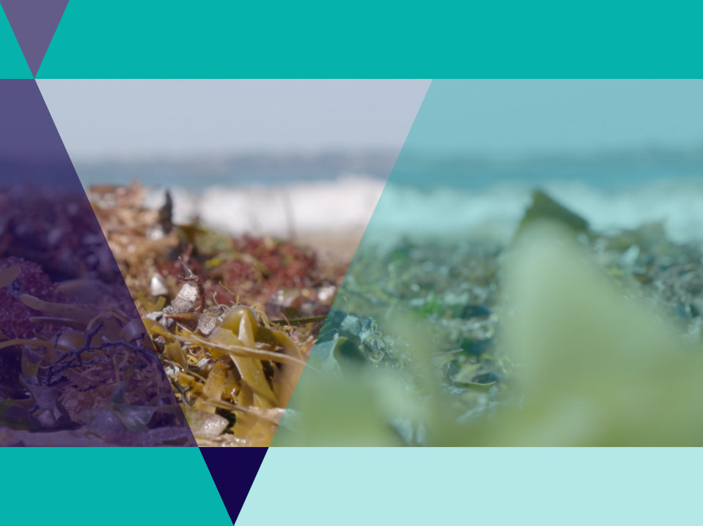
Traditional Uses of Seaweeds
Zoe Brittain has been researching the indigenous use of seaweeds and mentioned in the video a range of uses including
Diet
Building houses
Clothing,
Medicine
Spiritual practices.

Slide 23
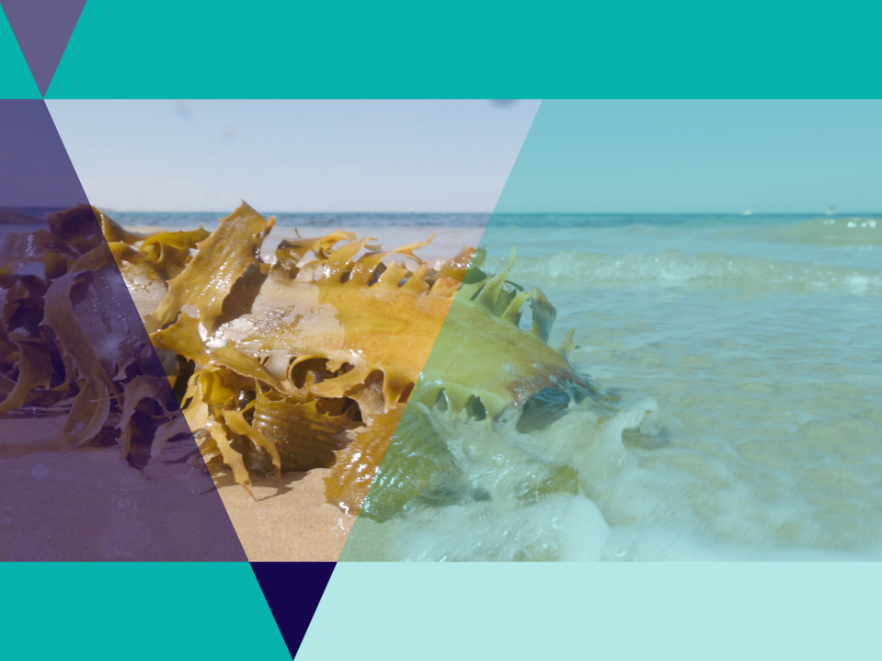
Modern Seaweed Industries
There is a growing an emerging seaweed industry in Australia.
The video introduced a number of modern uses including
Feed for cows
Food for humans
Pharmaceuticals
Making plastic
Clothing

Slide 24
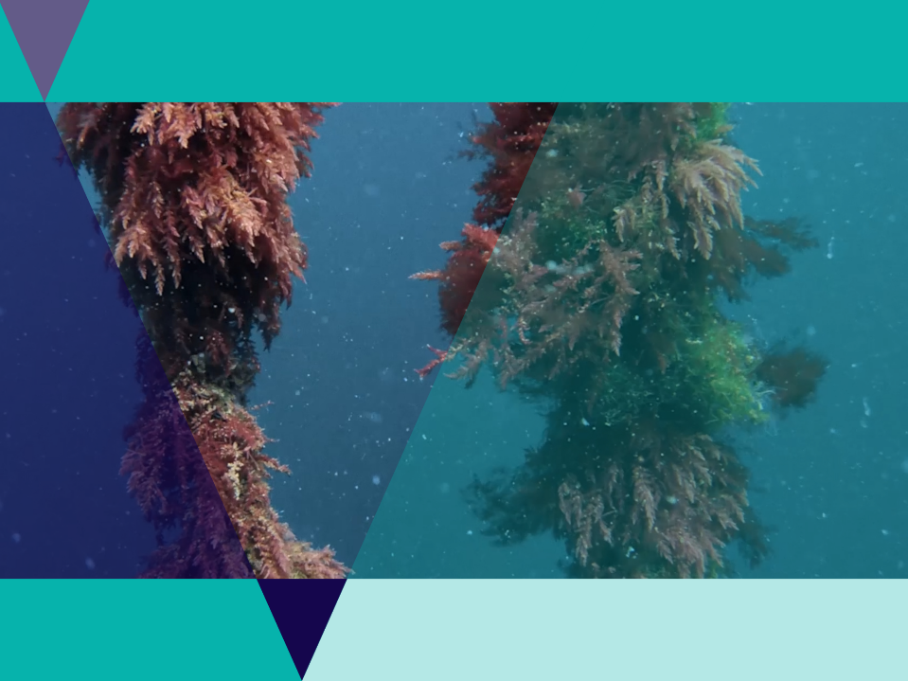
Seaforest
Seaforest are a company farming a red seaweed called Asparagopsis
When fed to cows, this seaweed reduces their methane emissions
Farming seaweed also helps to capture carbon.
Learn more in the video and on their website.

Slide 25
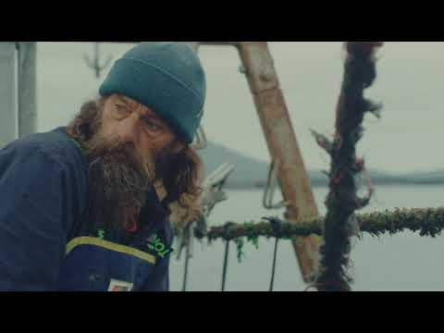
Video: Seaforest
Tasmanian based environmental biotechnology company using science to deliver at scale cultivation and supply of a native red seaweed to address two of the most significant challenges of our time... Fighting Climate Change and Producing More Food with Fewer Resources.

Slide 26
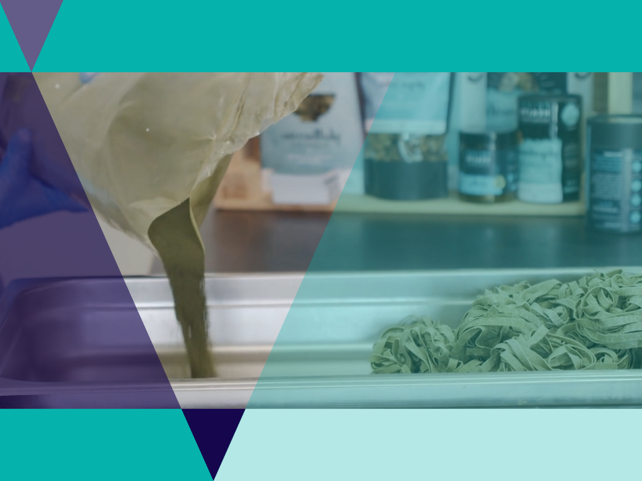
Phycohealth
Phycohealth have made a concentrated seaweed product for nutritional health benefits.
The company makes a wide variety of products including seaweed pasta and pharmaceutical products like moisturisers.

Slide 27
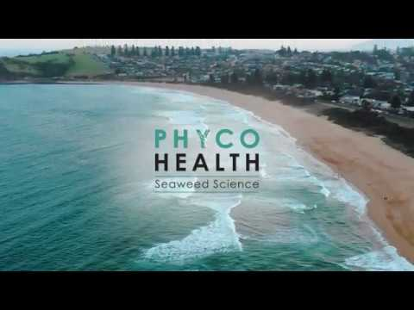
Video: Phycohealth
Seaweed Futures based on science and growing with your health

Slide 28
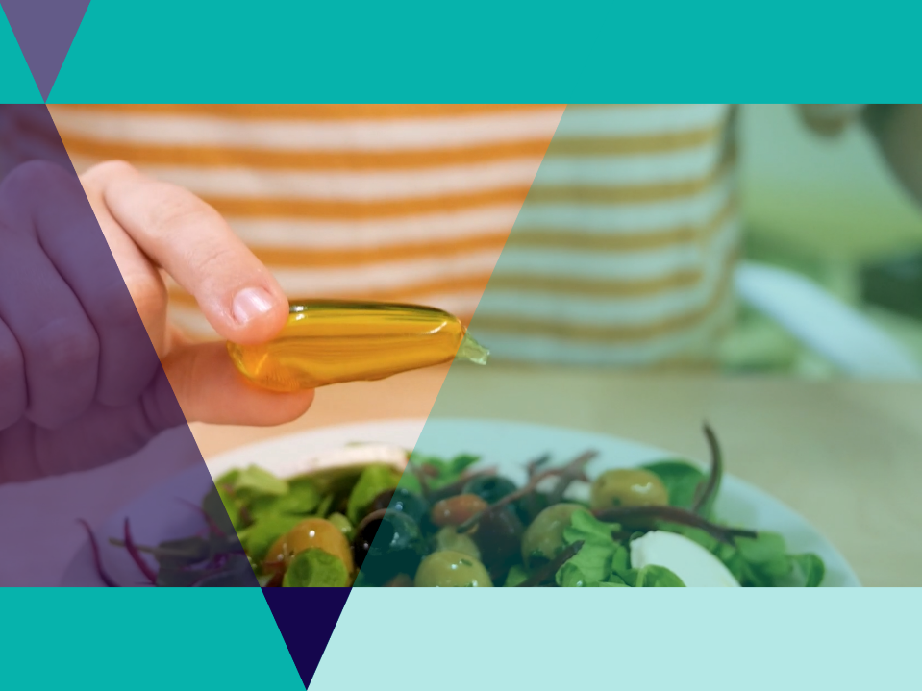
Nopla
Nopla is a revolutionary material made from seaweed
It biodegrades in weeks naturally
The company makes advanced packaging solutions made from seaweed and other natural materials as an alternative to single-use plastic.

Slide 29
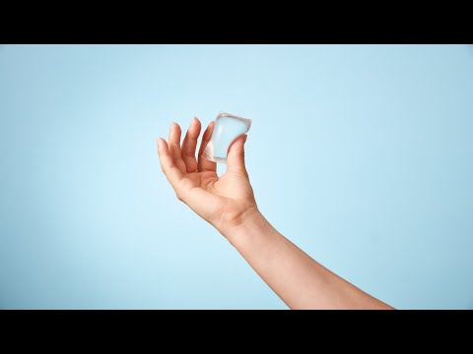
Video: Nopla
Notpla is a sustainable packaging start-up founded in 2014. A combination of designers, chemists, engineers, and entrepreneurs.

Slide 30
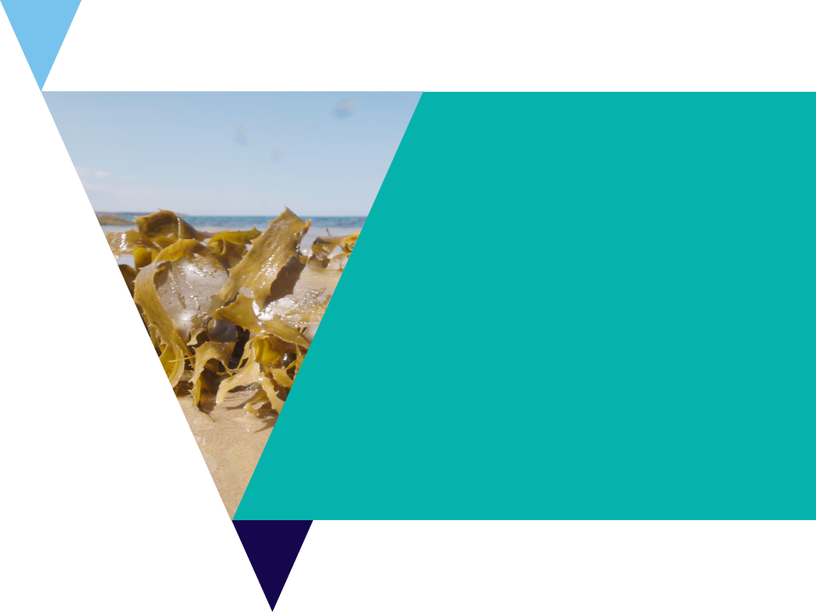
Modern Use of Seaweeds Investigation
Many companies are utilising seaweed in their unique way to create products.
Use the Modern Uses of Seaweed Investigation Worksheet to find out
what seaweed species are being used
what products are being made
the benefits of these products to people and/or the environment.
There is also blank space for students to find another organisation utilising seaweed.

Slide 31
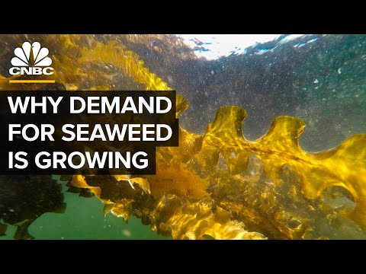
Video: Why Demand For Seaweed Is About To Boom
Seaweed is used in more than just sushi. It can be found in almond milk, baby food and lotion. Kelp is used in medicine, animal feed, fertilizer and even as a biofuel.

Slide 32
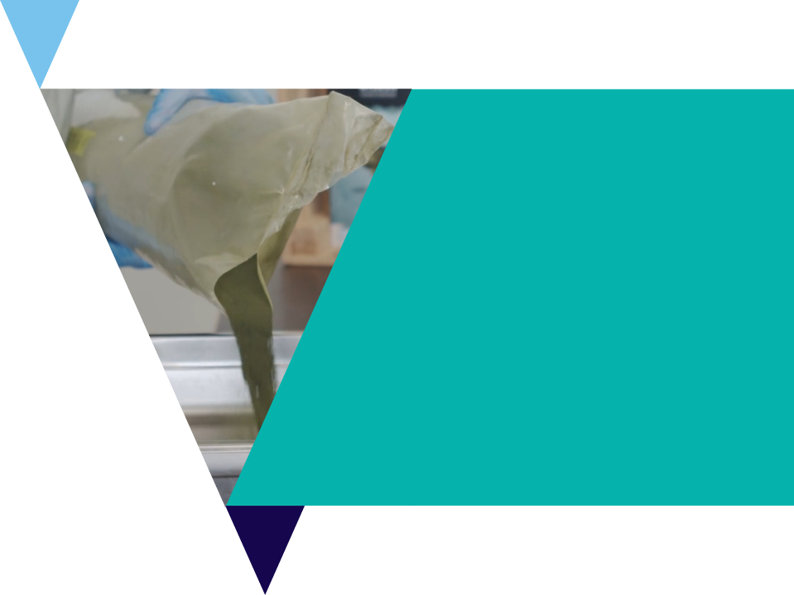
International Use of Edible Seaweeds
Investigation
Many cultures around the world have had a long history of consuming seaweed in their cuisine.
In this activity, you will research the various seaweed dishes and species used from around the world.
Use the International Use of Edible Seaweeds worksheet.

Slide 33
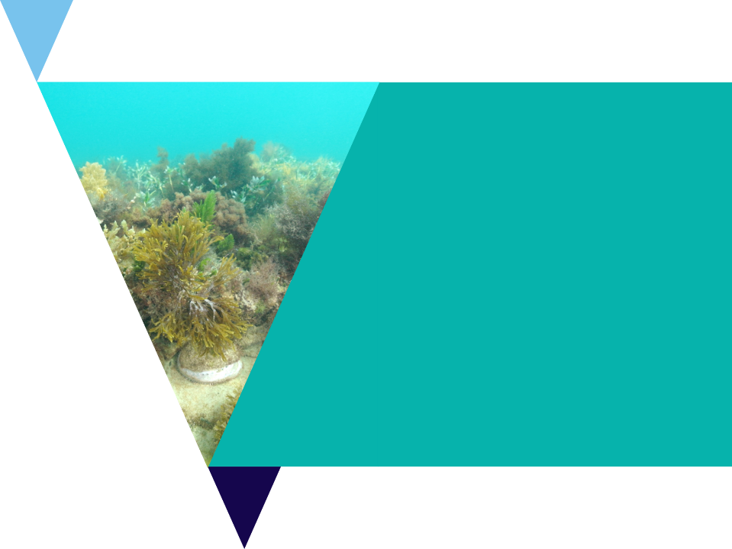
Review Questions
It’s time to check your understanding.
Fill out the review questions worksheet.

