Slide 1
Ecosystems and Edible Urchins

Slide 2
Lesson Outline
Video
Game
Quiz
Comic Strip Activity
Top Down System Activity
Adaptations Investigation
Urchin Sampling Activity
Sustainable Seafood Investigation

Slide 3
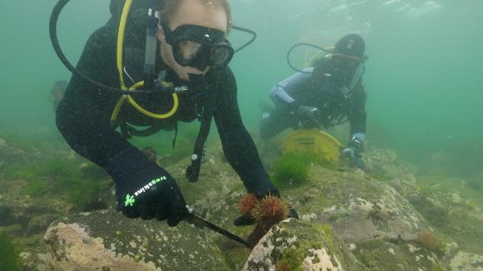
Video: Ecosystems and Edible Urchins
Video Link: https://www.marineandcoasts.vic.gov.au/coastal-programs/coastcare-victoria/coastcare-victoria-school-kit

Slide 4
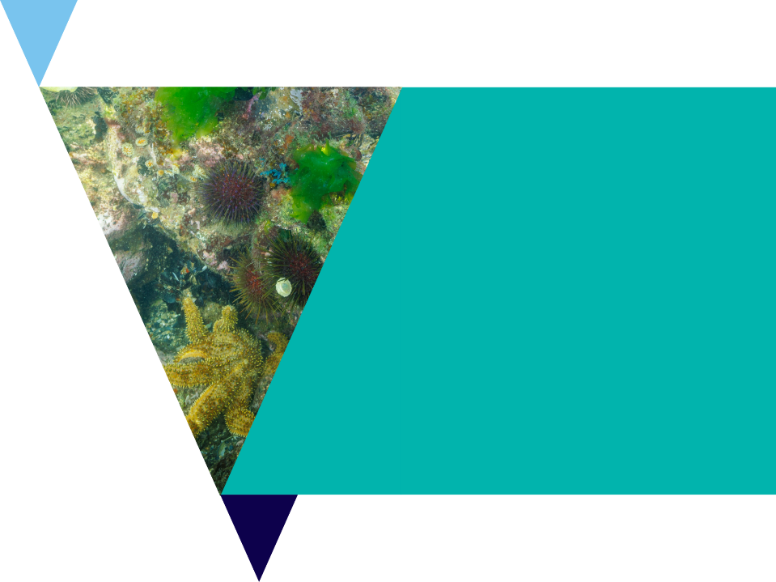
Quiz
It’s time for a quick quiz to see what you can remember from the video!
There are a total of 10 multiple choice questions

Slide 5
Sea Urchins
Sea Urchins are spiny echinoderms
Echinoderms are a group of organisms that have spiny skin
Sea Urchins are herbivores

Slide 6
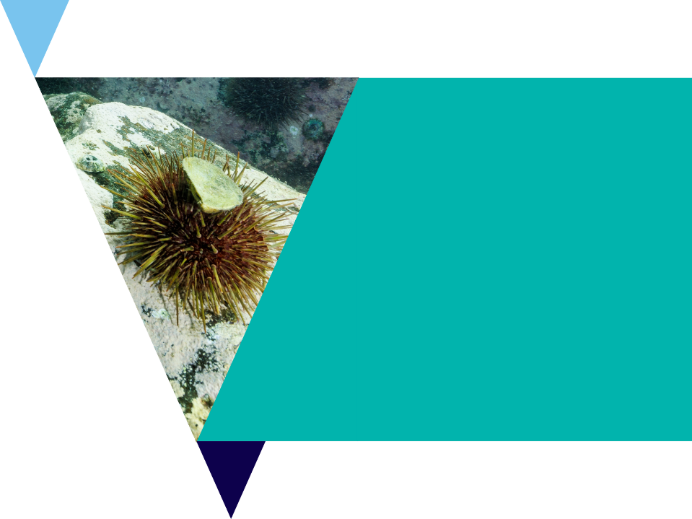
What’s the problem? Activity
Review the text front the video explaining what scientists think caused the urchin problem.
As the video plays underline biotic (living) factors and circle abiotic (non-living factors).

Slide 7
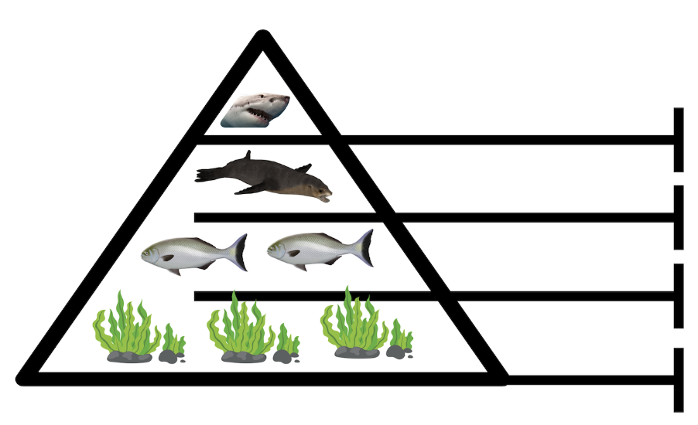
Top Carnivores
Tertiary Consumer
Carnivores
Secondary Consumer
Herbivores
Primary Consumer
Primary Producers

Slide 8
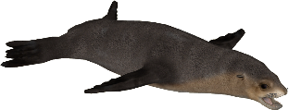
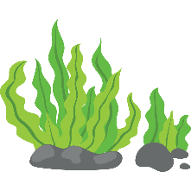
Top down
The presence of predators keeps the herbivores in check,
ensuring that the producers are not over exploited.

Slide 9
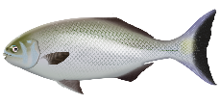
Bottom up
Here, lack of food has caused a decrease in the populations
of higher trophic levels.

Slide 10
Comic Strip Activity
Use the text front the video explaining what scientists think caused the urchin problem to create a comic strip.

Slide 11
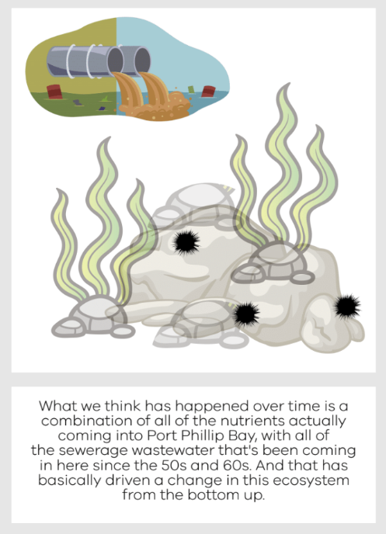

Slide 14
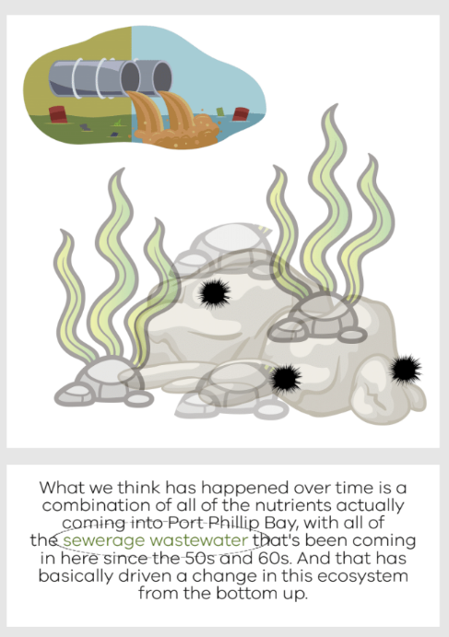

Slide 15
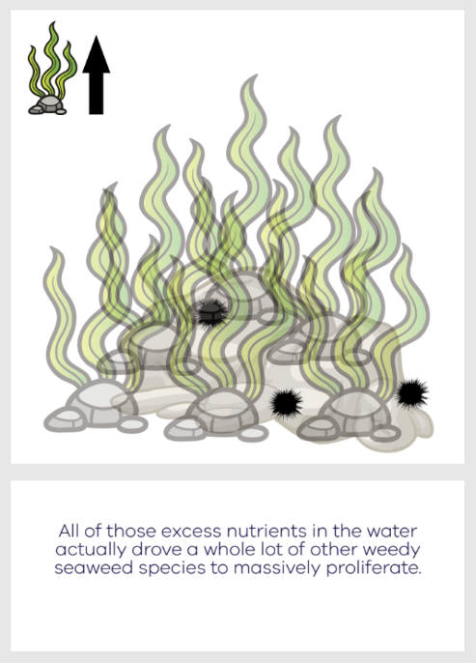

Slide 18
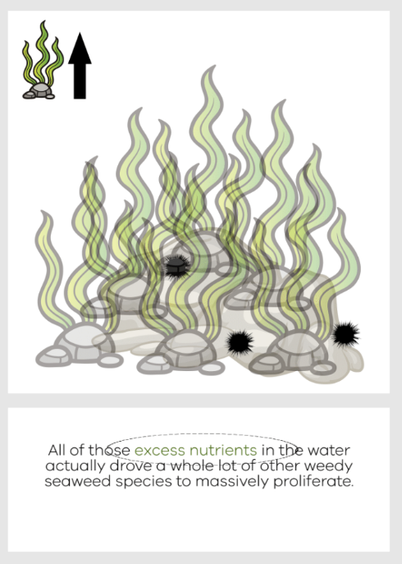

Slide 19
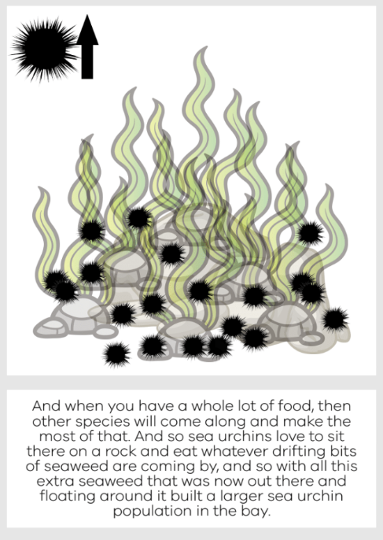

Slide 22
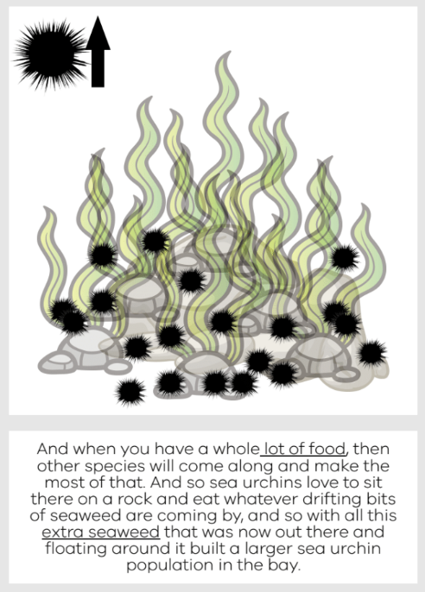

Slide 23
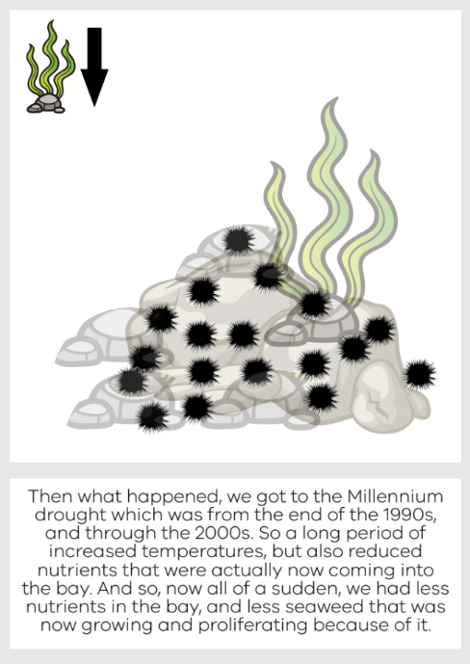

Slide 26
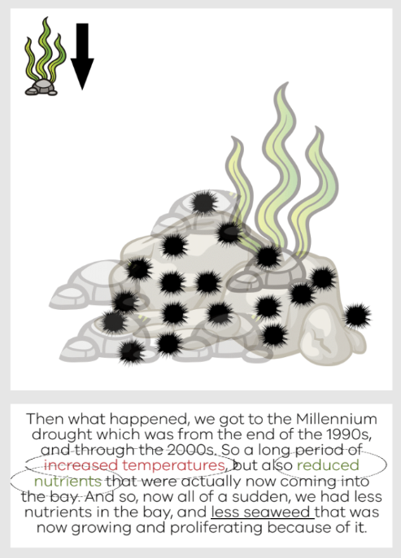

Slide 27
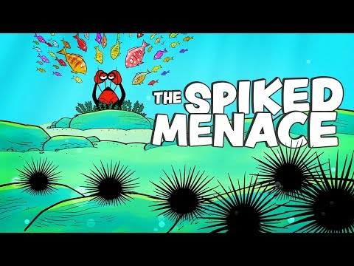
Extension Video:
Ecosystems and Edible Urchins

Slide 28
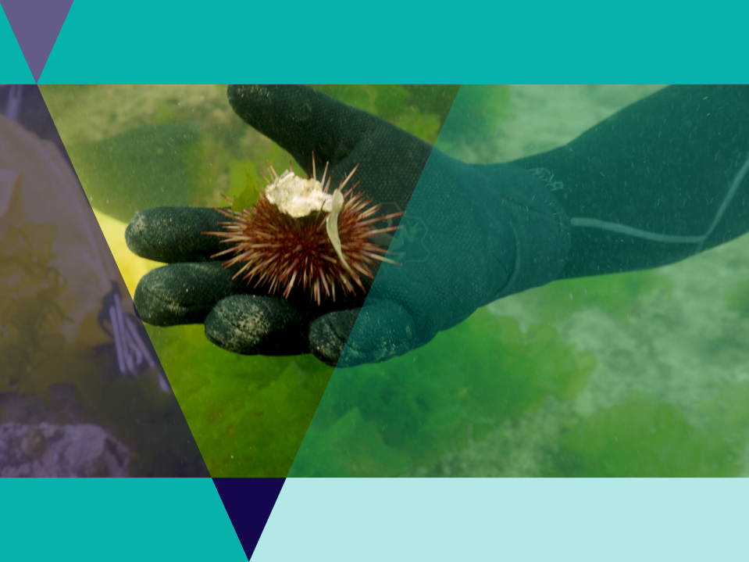
Adaptations
Adaptations are a special way that an organism is suited to survive and reproduce in an environment.
Adaptations help and organism to survive / reproduce.

Slide 29
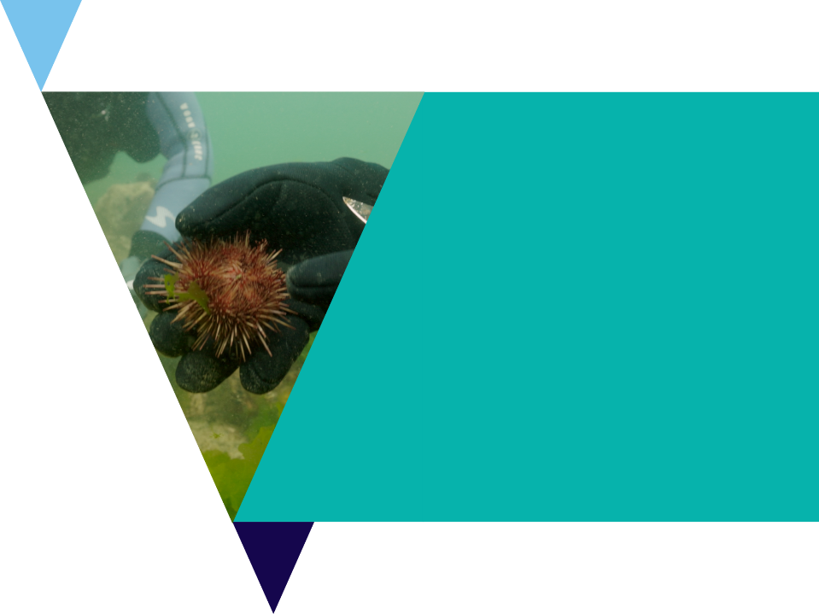
Adaptations
There are three main types of adaptations:
Behavioural: things organisms do to survive / reproduce
Physiological: a body process that helps an organism survive / reproduce.
Structural: a physical feature that helps an organism survive / reproduce.

Slide 30
Adaptations Investigation
Urchins are highly successful animals that can be found in all of the world’s oceans, to depths as deep at 5000m!
There are 950+ species worldwide.
Only an animal highly suited (adapted) to their environment could be so successful.
In this task you will investigate the various adaptations of sea urchins using the Urchin adaptations investigation worksheet.

Slide 31
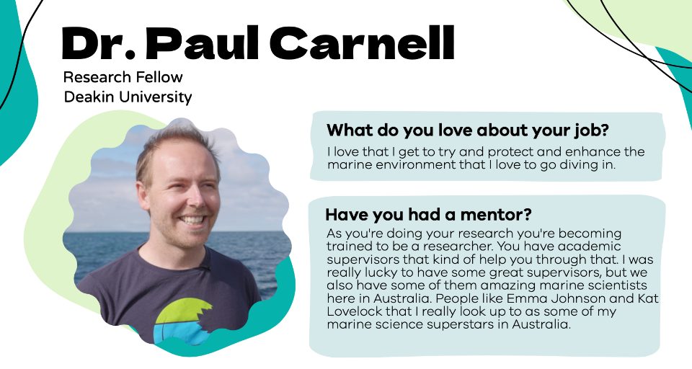
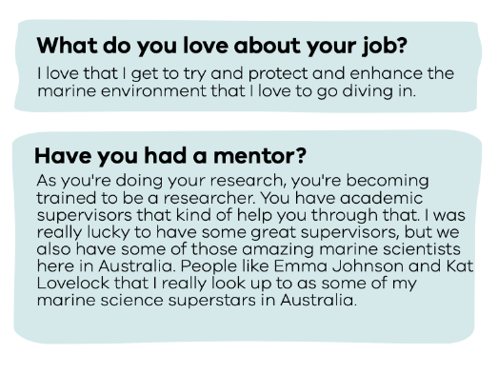

Slide 32
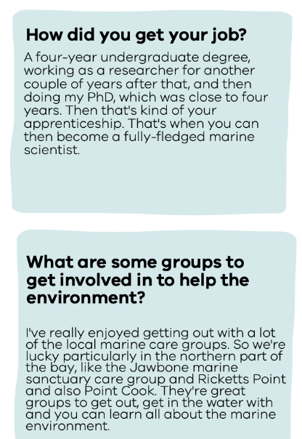
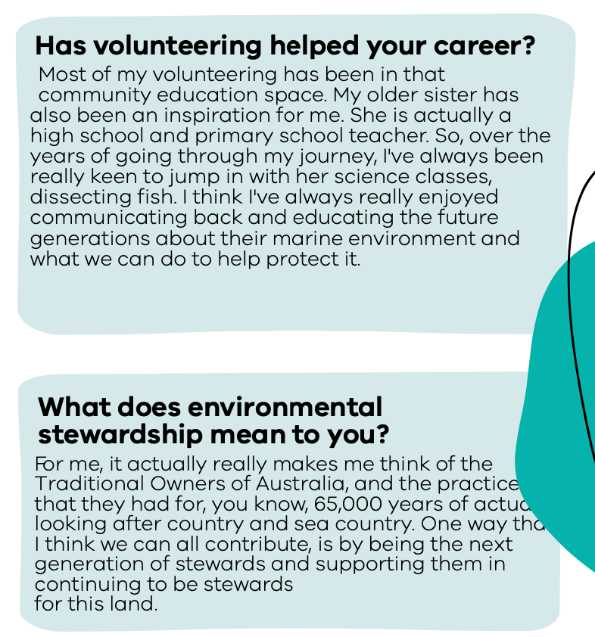

Slide 33
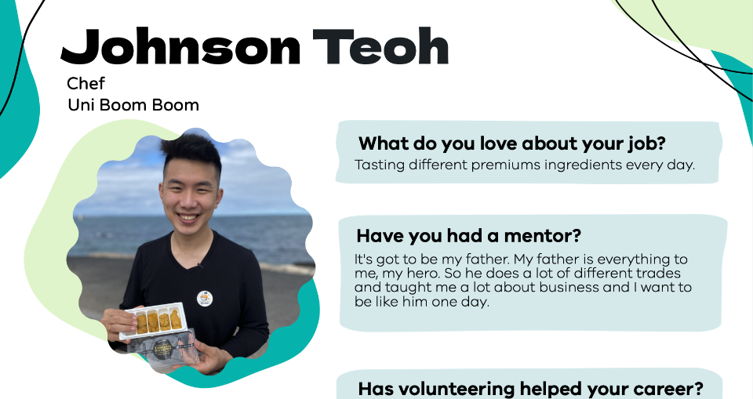

Slide 34
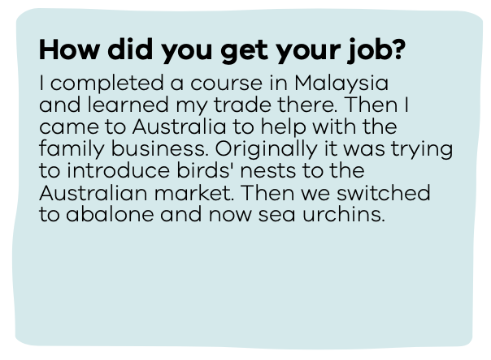
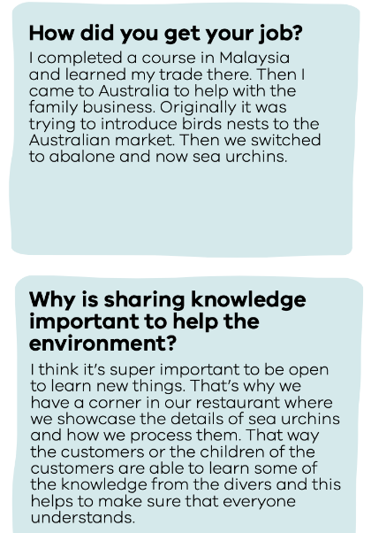
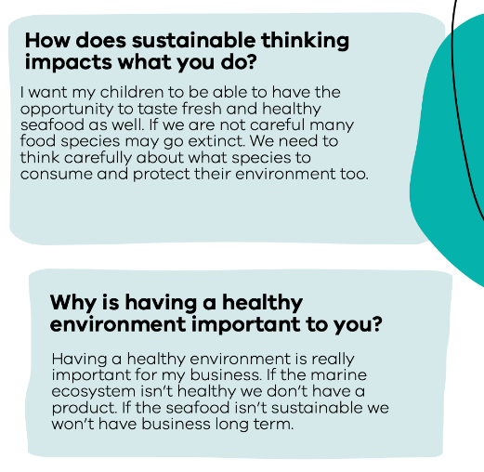

Slide 35
Sampling
Often when sampling underwater scientists use a square called a quadrat to count organisms of interest in an area.
They can then extrapolate to make predictions about the broader densities of that organism over the area of the reef.

Slide 36
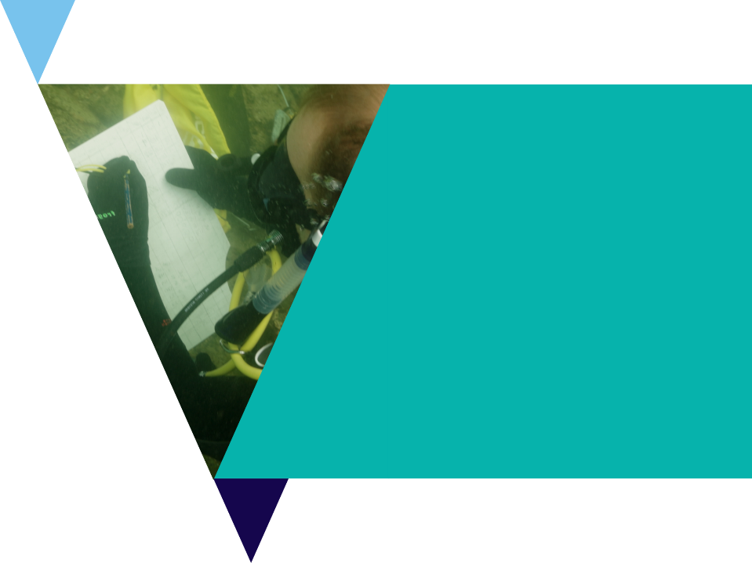
Urchin Sampling Activity
In this activity you will learn about scientific data collection methods.
Using the Urchin investigation reef grids or online lesson version, you can collect data on the urchin densities in five different reefs.
Compare results with others in the class.
You may like to turn this activity in a competition between individuals or as groups to see who can get the closest estimates to the actual reef numbers.

Slide 37
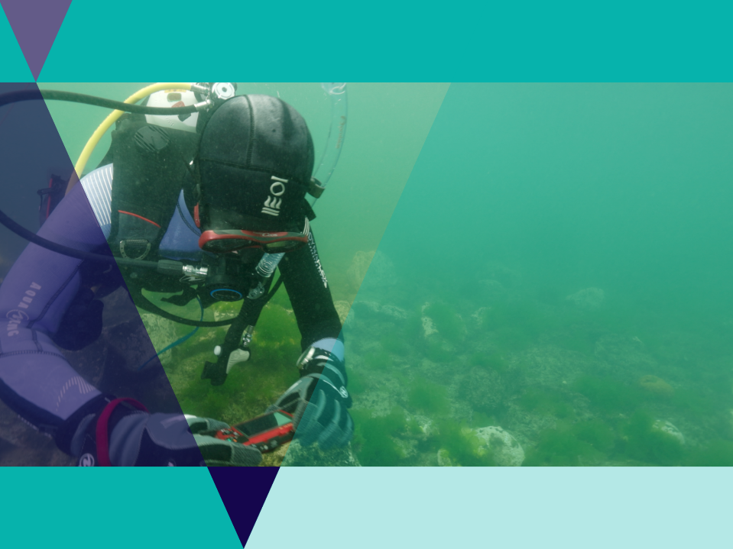
Activity Reflection
How accurate were your estimates?
‘Reflect on the experimental design, how could the experiment be improved to be more accurate?

Slide 38
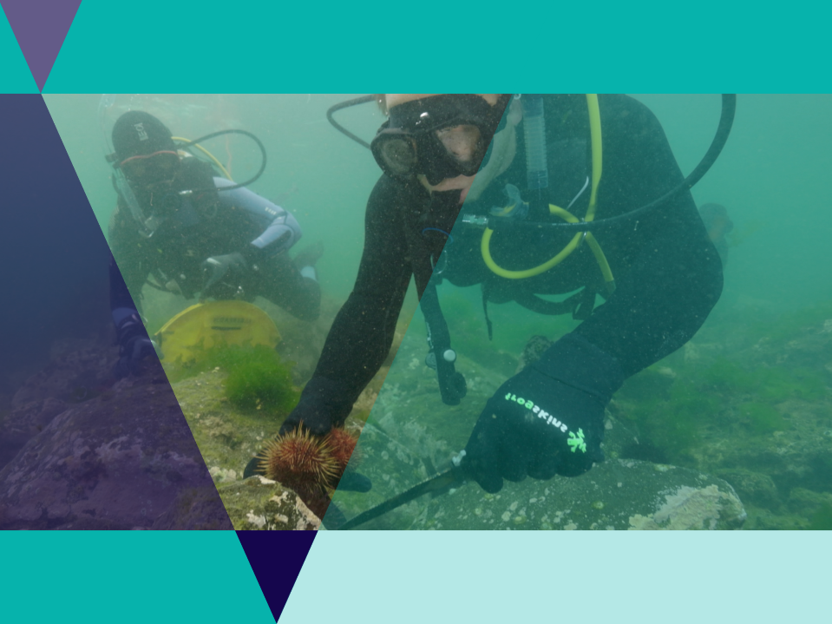
Collecting Urchins
Removing urchins from the reef may help seaweed grow back
Urchins are considered a sustainable seafood
People with a license can collect 40 urchins per person per day
Urchins must be collected below 2m deep and never from a marine sanctuary.

Slide 39
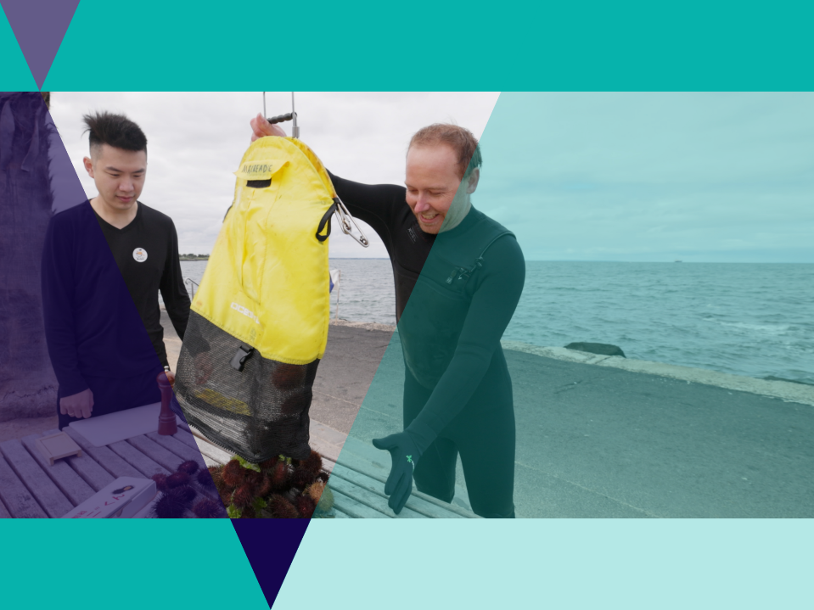
Eating Urchins
Currently in Australia eating sea urchins is rare but there are many urchins in the local waters.
More people eating urchins may be better for the environment.
What makes other marine species sustainable?

Slide 40
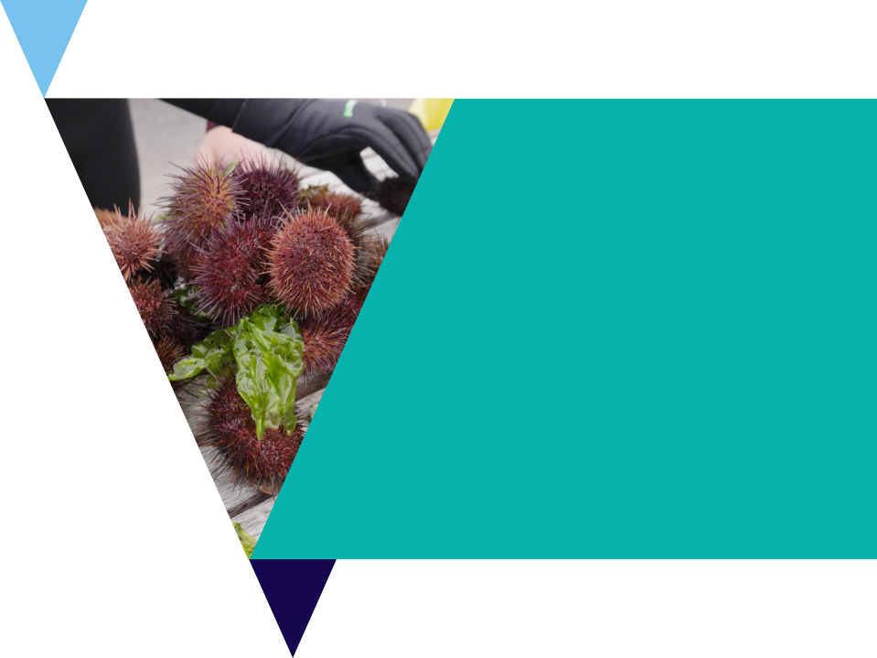
Sustainable Seafood Investigation
As general rule, the lower they are in the food chain and the more sustainable they are likely to be.
Often the smaller the prey of the organism, the more sustainable it is likely to be.
A traffic light system is often used to indicate sustainability:
Green = sustainable
Orange = eat les
Red = say no

Slide 41
Review Questions
It’s time to check your understanding.
Fill out the review worksheet on top down systems.

