Slide 1


Ecosystems and Edible Urchins

Slide 2
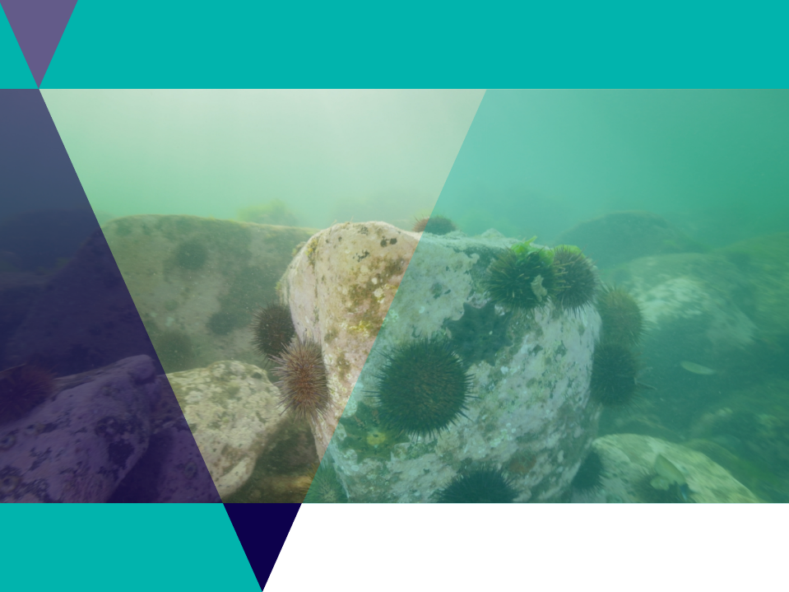


Lesson outline
Video
Game
Quiz
Activity: Comic strip
Activity: Top down system
Activity: Urchin sampling
Investigation: Adaptations
Investigation: Sustainable seafood

Slide 3
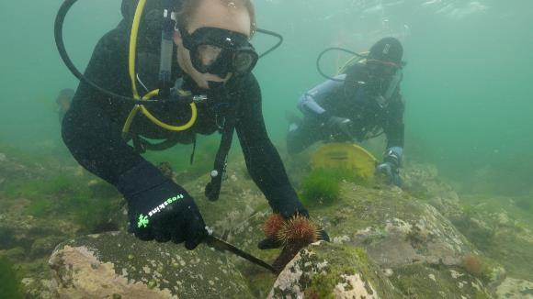
Video: Ecosystems and Edible Urchins
Video Link: https://www.marineandcoasts.vic.gov.au/coastal-programs/coastcare-victoria/coastcare-victoria-school-kit

Slide 4
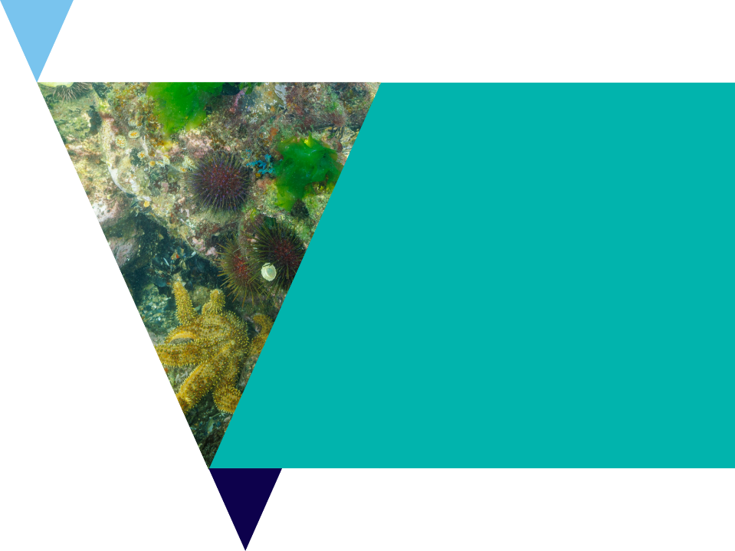
Quiz
It’s time for a quick quiz to see what you can remember from the video!
There are a total of 10 multiple choice questions.

Slide 5
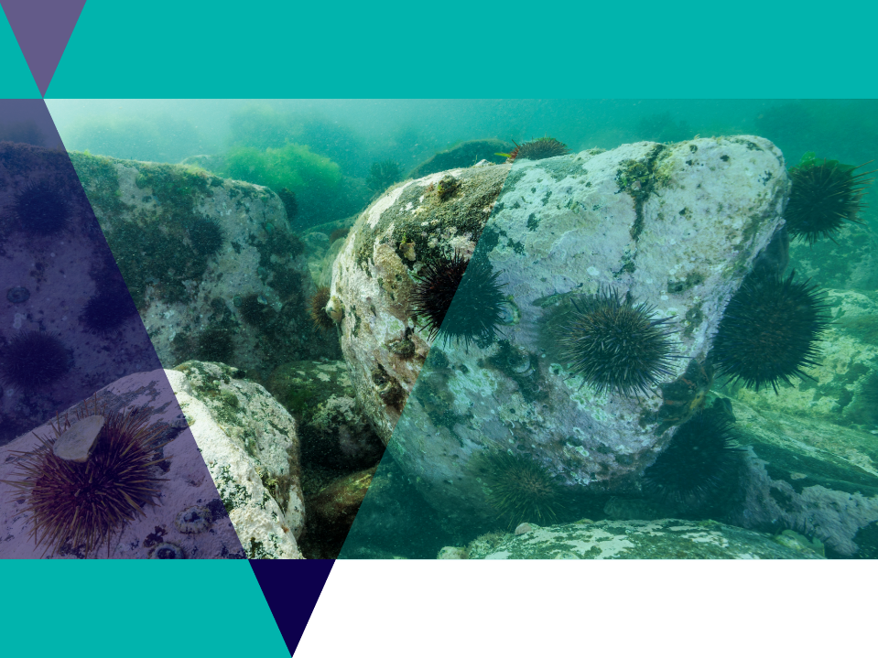
Sea urchins
Sea urchins are spiny echinoderms
Echinoderms are a group of organisms that have spiny skin
Sea urchins are herbivores

Slide 6
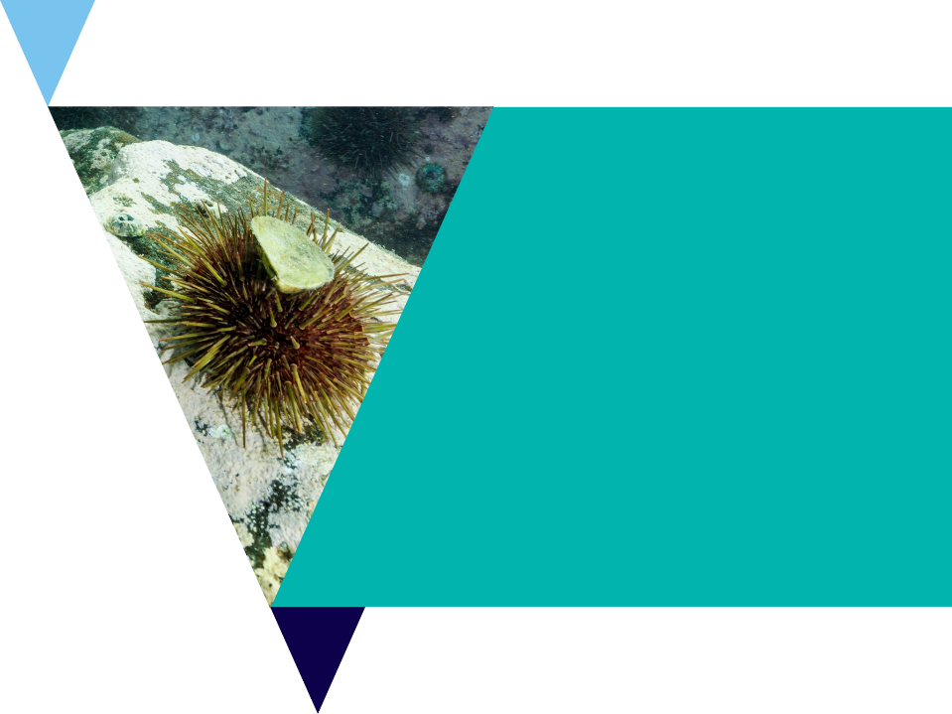
Biotic and abiotic factors in ecosystems
Biotic = living
    Biotic factors in an ecosystem are the living things which grow like plants and animals
Abiotic = non-living
Abiotic factors in an ecosystem are the non-living things which help the living things grow like water, sunlight and nutrients.

Slide 7
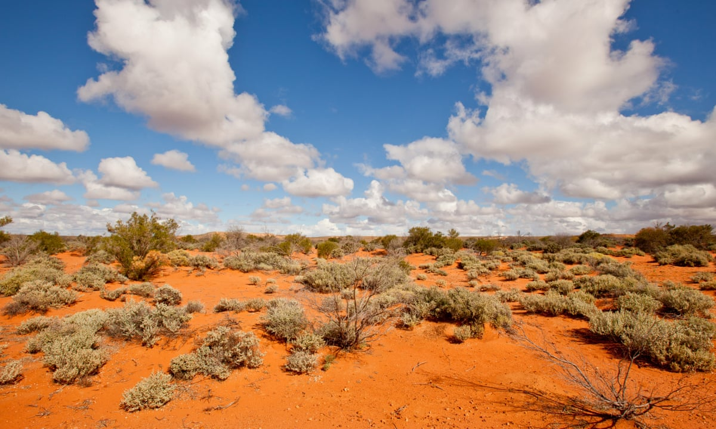
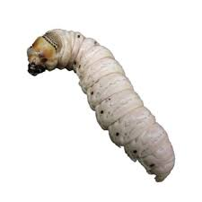
Biotic & abiotic factors – class discussion
Desert Ecosystem
Sunshine
Heat
Wildflowers
Honey-eater bird
Sand
Bacteria in the soil
Clouds
Rain
Dead tree
Witchetty grub feeding on the dead tree
Abiotic
Abiotic
Biotic
Biotic
Abiotic (although most soil has millions of biotic life forms mixed into the abiotic rock particles).
Abiotic
Abiotic
Abiotic
Biotic
Notes:
Ask the class to raise their hand and ‘vote’ on weather each ecosystem factor is biotic or abiotic – each answer will appear as you click the presentation.
*soil has living and non-living elements. Rock particles like sand and dead plant particles are not living. But all the Bacteria, fungi, tiny insects etc mixed in, are living.

Slide 8
What’s causing the problem?
In your worksheet - read the text from the video where the scientists explain what caused the urchin problem.
As the video plays
underline biotic (living) factors
and
circle abiotic (non-living factors).
Were more biotic or abiotic factors to blame?

Slide 9
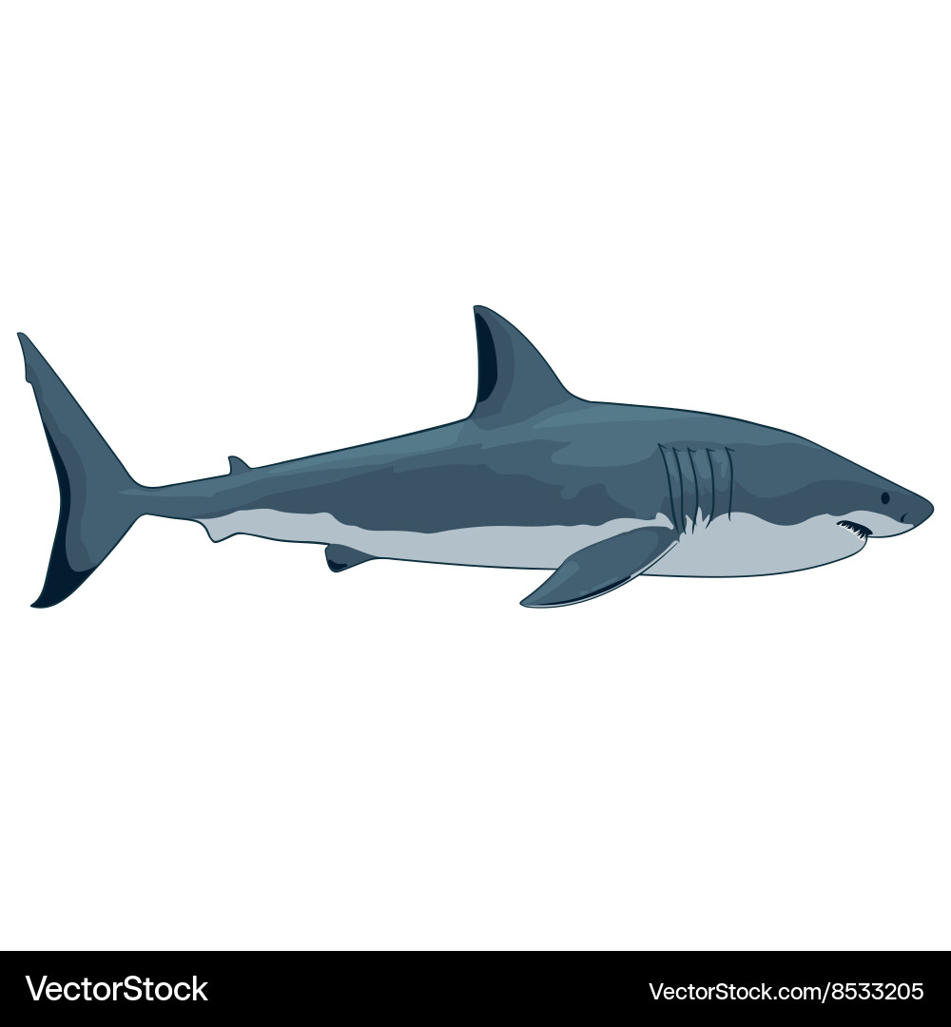
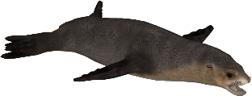

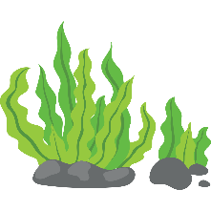
Population pyramid
Predators
Tertiary Consumers
Carnivores
Secondary Consumers
Herbivores
Primary Consumers
Plants
Primary Producers

Slide 10


Top down
population control
Predators keep the herbivore population in check,
Which means that the primary producers are not over consumed.

Slide 11
Bottom up
population control
Lack of primary producers has caused a decrease in the herbivore population so there is also less food for the predator population.

Slide 12
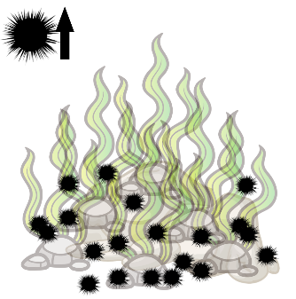
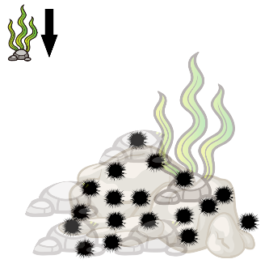
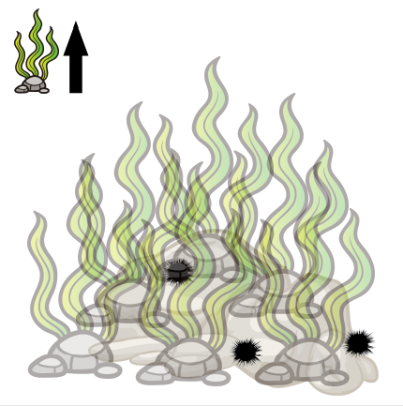
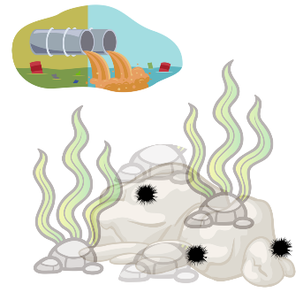
Comic strip activity
Cut out the pictures on your worksheet and stick them with the matching text
What we think has happened over time is a combination of all of the nutrients actually coming into Port Phillip Bay, with all of the sewerage wastewater that's been coming in here since the 50s and 60s. And that has basically driven a change in this ecosystem from the bottom up | All of those excess nutrients in the water actually drove a whole lot of other weedy seaweed species to massively proliferate. | And when you have a whole lot of food, then other species will come along and make the most of that. And so sea urchins love to sit there on a rock and eat whatever drifting bits of seaweed are coming by, and so with all this extra seaweed that was now out there and floating around it built a larger sea urchin population in the bay | Then what happened, we got to the Millennium drought which was from the end of the 1990s, and through the 2000s. So a long period of increased temperatures, but also reduced nutrients that were actually now coming into the bay. And so, now all of a sudden, we had less nutrients in the bay, and less seaweed that was now growing and proliferating because of it.

Slide 13
Comic strip activity
Now our comic is in the correct order: are the
sea urchins in the ecosystem experiencing
top-down, or bottom-up control?
What we think has happened over time is a combination of all of the nutrients actually coming into Port Phillip Bay, with all of the sewerage wastewater that's been coming in here since the 50s and 60s. And that has basically driven a change in this ecosystem from the bottom up | All of those excess nutrients in the water actually drove a whole lot of other weedy seaweed species to massively proliferate. | And when you have a whole lot of food, then other species will come along and make the most of that. And so sea urchins love to sit there on a rock and eat whatever drifting bits of seaweed are coming by, and so with all this extra seaweed that was now out there and floating around it built a larger sea urchin population in the bay | Then what happened, we got to the Millennium drought which was from the end of the 1990s, and through the 2000s. So a long period of increased temperatures, but also reduced nutrients that were actually now coming into the bay. And so, now all of a sudden, we had less nutrients in the bay, and less seaweed that was now growing and proliferating because of it.

Slide 14
Comic strip activity
Make your own comic strip
Watch another video about sea urchins
Write down four key parts of the story
Illustrate your comic strip
NBC News: Sea otters are helping protect California kelp forests
Animated video: Who’s eating all the kelp in Tasmania?
First | But.. | Then.. | Now

Slide 15
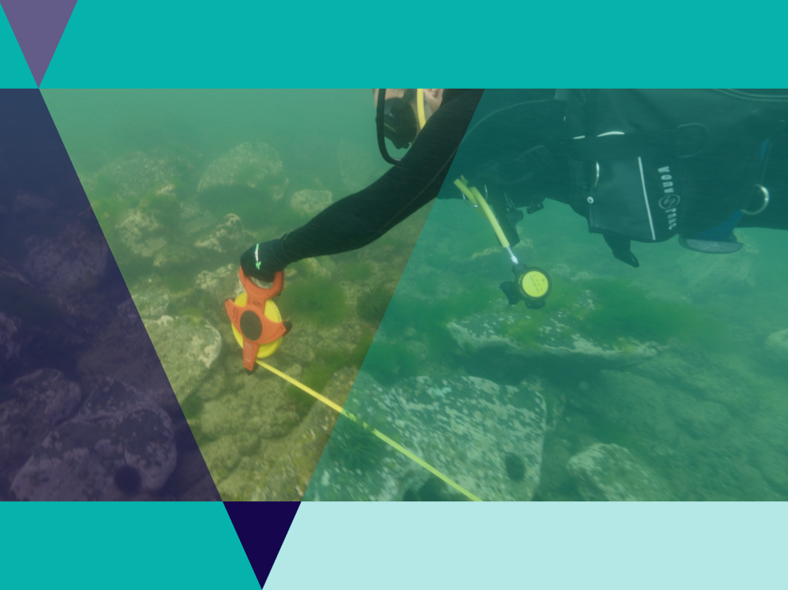
Urchin population sampling
Often when sampling underwater scientists use a square called a quadrat to count organisms of interest in an area.
They can then extrapolate to make predictions about the broader densities of that organism over the area of the reef.
Malmesbury Science: Sampling with Quadrats – GCSE Biology Practical

Slide 16
Urchin population sampling
You will need a quadrat
You will need to know the area of your ecosystem
Divide the area into 1m squares and assign coordinates
A random number generator to choose random coordinates for your quadrat
To be accurate you should sample 10% of your ecosystem
Calculate 10% of your reef
Count the urchins inside your quadrat
Calculate the average of all your counts = urchins per m2
Multiply this answer by the number of meter squares on your reef = population estimate.

Slide 17

Urchin population sampling
In this activity you will learn about scientific data collection methods.
Using the Urchin investigation reef grids, you can collect data on the urchin densities in five different reefs.
Compare results with others in the class.
You may like to turn this activity in a competition between individuals or as groups to see who can get the closest estimates to the actual reef numbers.

Slide 18
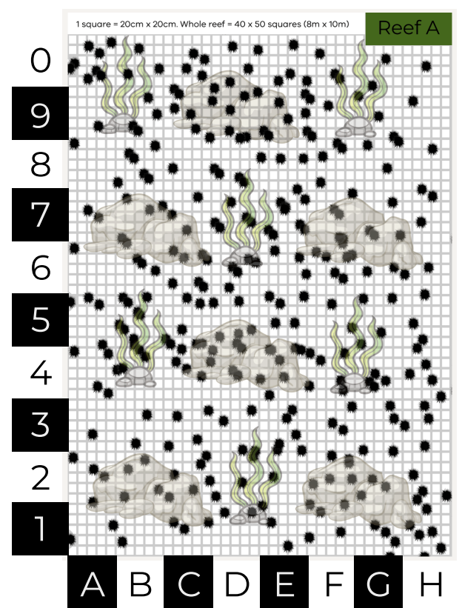
Reef A
Random Coordinate | Urchin population count
H8 | 2
D8 | 7
G7 | 4
E6 | 3
F4 | 6
5A | 4
C3 | 4
0C | 4
AVERAGE | =SUM/COUNT = 4.25
POPULATION ESTIMATE | = Avg x No. m2 4.25 x 80m2 = 340
Reef A total urchins: 306

Slide 19
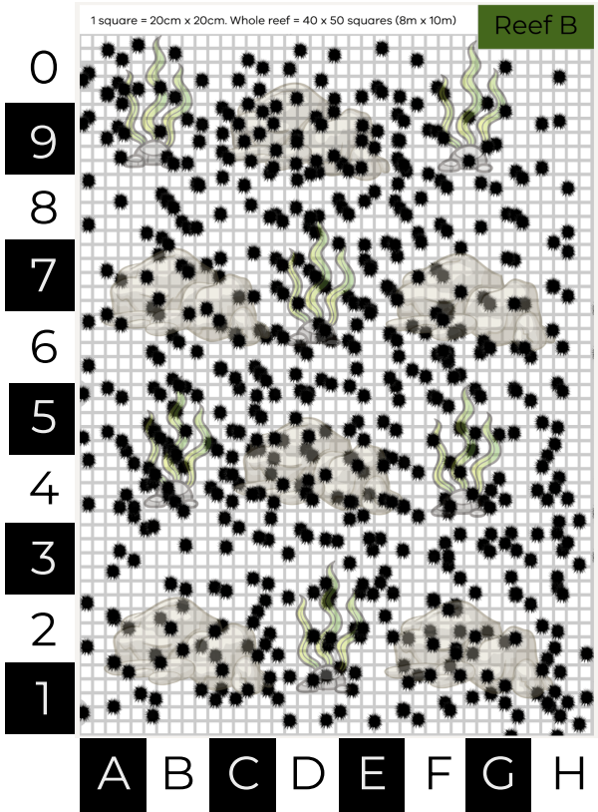
Reef B
Random Coordinate | Urchin population count
A6 | 3
F2 | 10
7B | 9
4H | 9
3E | 11
9C | 12
F5 | 5
2B | 7
AVERAGE | =SUM/COUNT = 8.25
POPULATION ESTIMATE | = Avg x No. m2 4.25 x 80m2 = 660
Reef B total urchins: 552

Slide 20
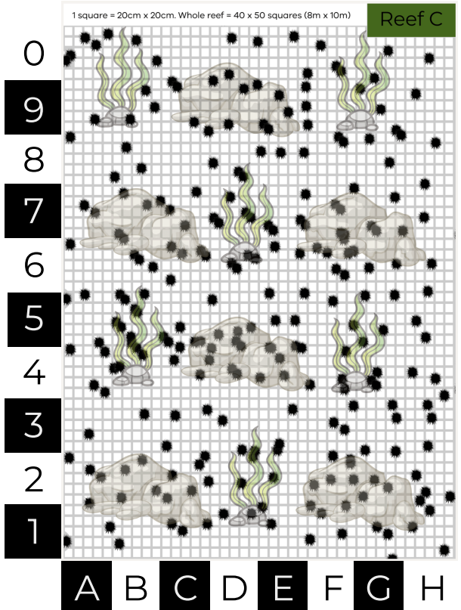
Reef C
Random Coordinate | Urchin population count
A4 | 4
B7 | 5
4D | 4
G3 | 3
0C | 0
5D | 6
1E | 2
6F | 6
AVERAGE | =SUM/COUNT = 3.75
POPULATION ESTIMATE | = Avg x No. m2 3.75 x 80m2 = 300
Reef C total urchins: 289

Slide 21
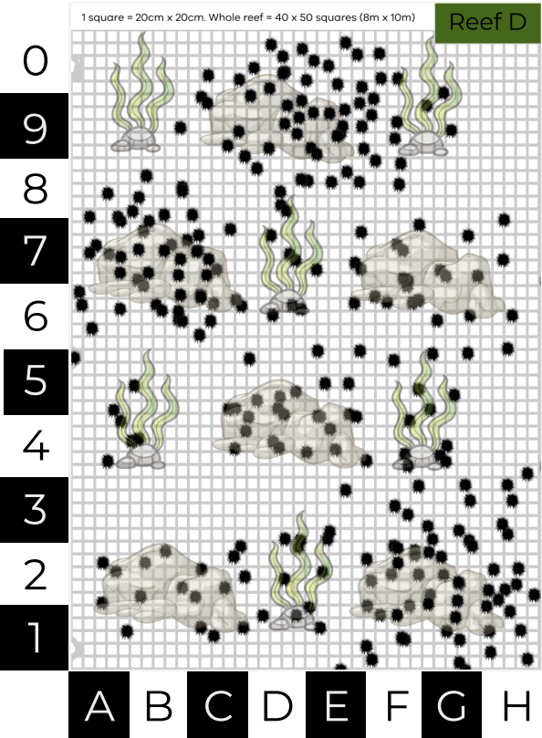
Reef D
Random Coordinate | Urchin population count
A5 | 2
3D | 1
6C | 6
A8 | 3
F9 | 6
F6 | 4
4G | 3
7F | 5
AVERAGE | =SUM/COUNT = 3.75
POPULATION ESTIMATE | = Avg x No. m2 3.75 x 80m2 = 300
Reef D total urchins: 299

Slide 22
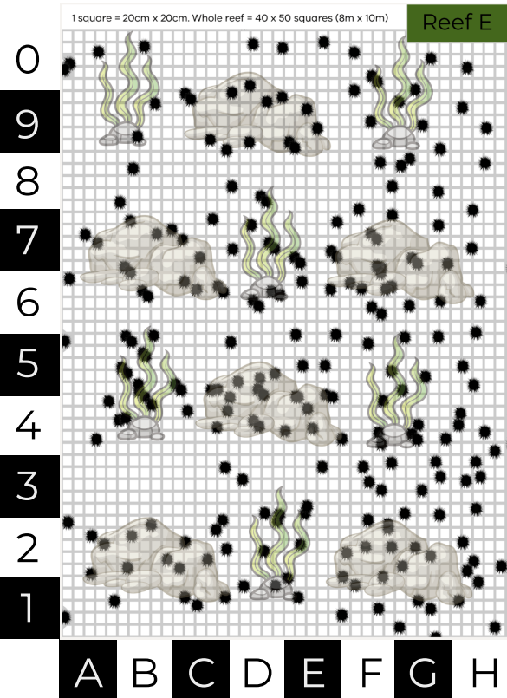
Reef E
Random Coordinate | Urchin population count
A5 | 1
F6 | 6
G0 | 2
B1 | 0
A2 | 4
4G | 4
D3 | 2
8E | 0
AVERAGE | =SUM/COUNT = 2.37
POPULATION ESTIMATE | = Avg x No. m2 2.37 x 80m2 = 190
Reef E total urchins: 297

Slide 23
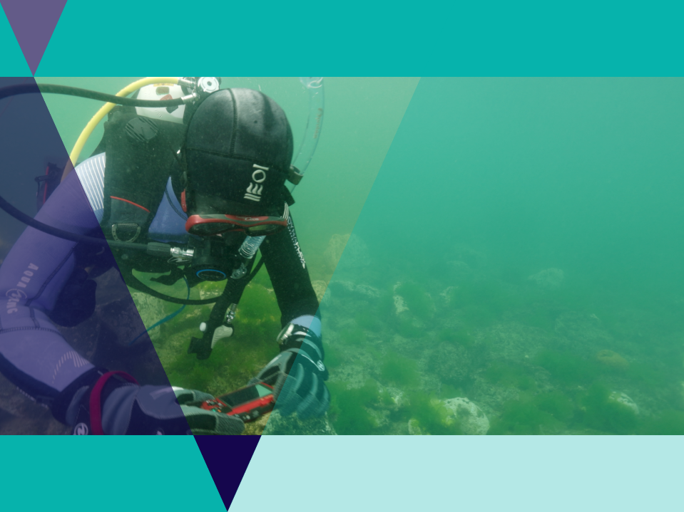
Activity reflection
How accurate were your estimates?
‘Reflect on the experimental design, how could the experiment be improved to be more accurate?

Slide 24
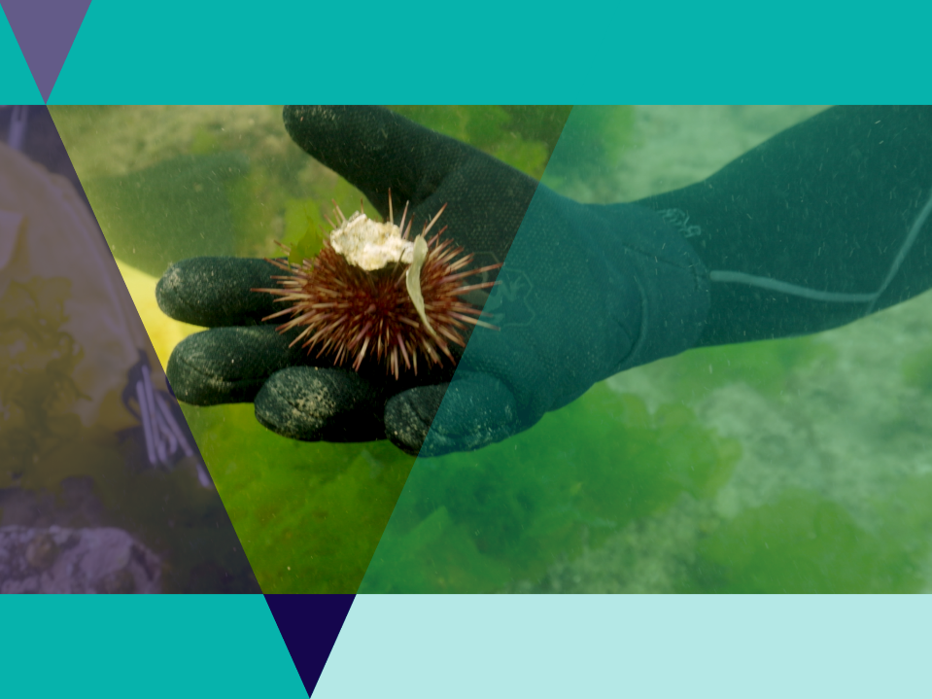
Adaptations
Adaptations are a special way that an organism is suited to survive and reproduce in an environment.
Adaptations help an organism to survive and reproduce.

Slide 25
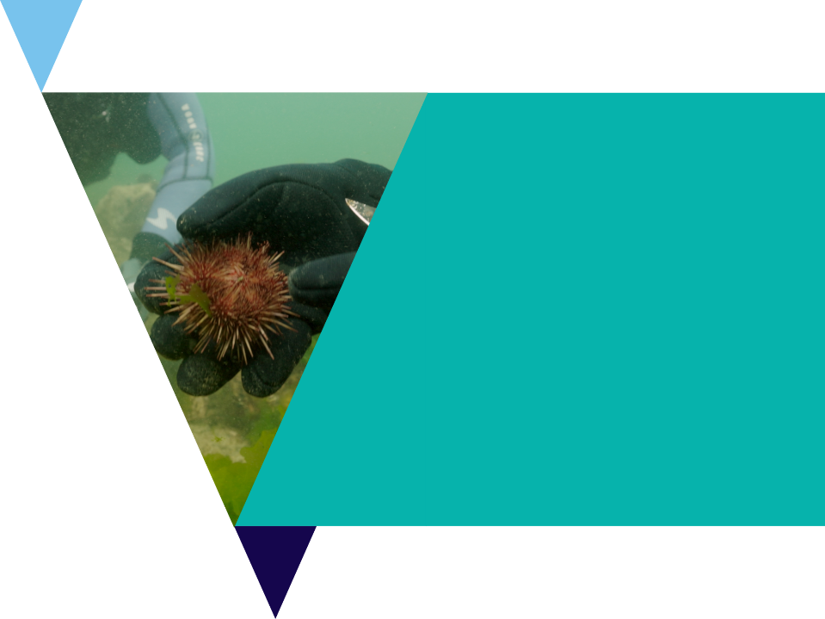
Adaptations
Scientists classify adaptations in three main categories. But some adaptations may fit multiple categories.
Behavioural: things organisms do to survive / reproduce
Physiological: a body process that helps an organism survive / reproduce.
Structural: a physical feature that helps an organism survive / reproduce.

Slide 26

Adaptations
Urchins are highly successful animals that can be found in all of the world’s oceans, to depths as deep at 5000m!
There are 950+ species worldwide.
Only an animal highly suited (adapted) to their environment could be so successful.
In this task you will investigate the various adaptations of sea urchins using the Urchin adaptations investigation worksheet.

Slide 27
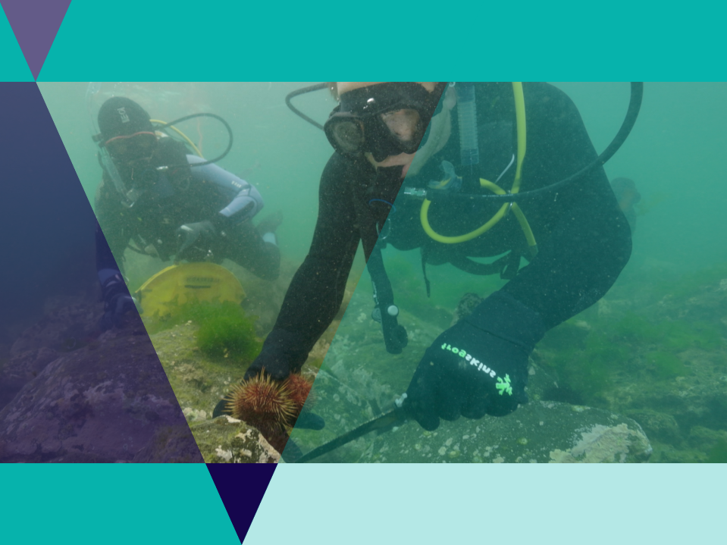
Sustainable seafood
Edible Urchins
Removing urchins from the reef may help seaweed grow back
Urchins are considered a sustainable seafood
People with a license can collect 40 urchins per person per day
Urchins must be collected below 2m deep and never from a marine sanctuary.

Slide 28
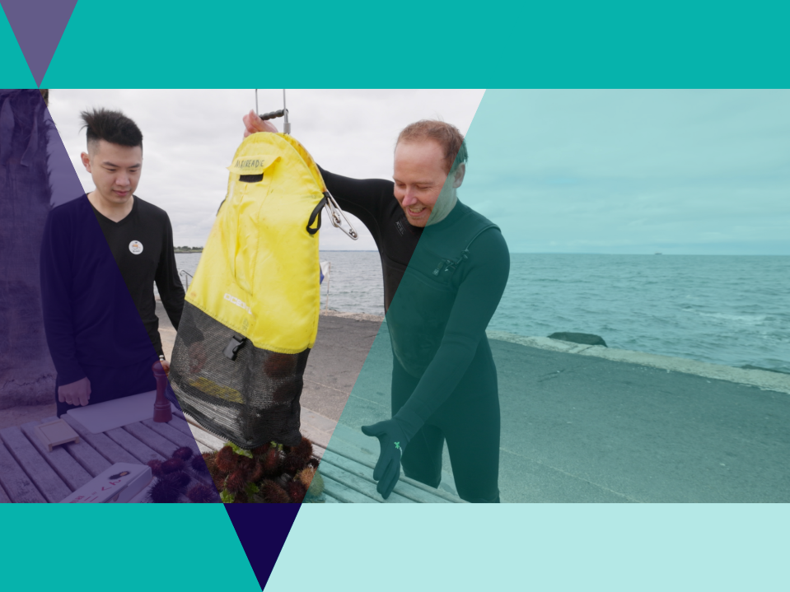
Sustainable seafood
Currently in Australia eating sea urchins is rare but there are many urchins in the local waters.
More people eating urchins may be better for the environment.
What makes other marine species sustainable?

Slide 29
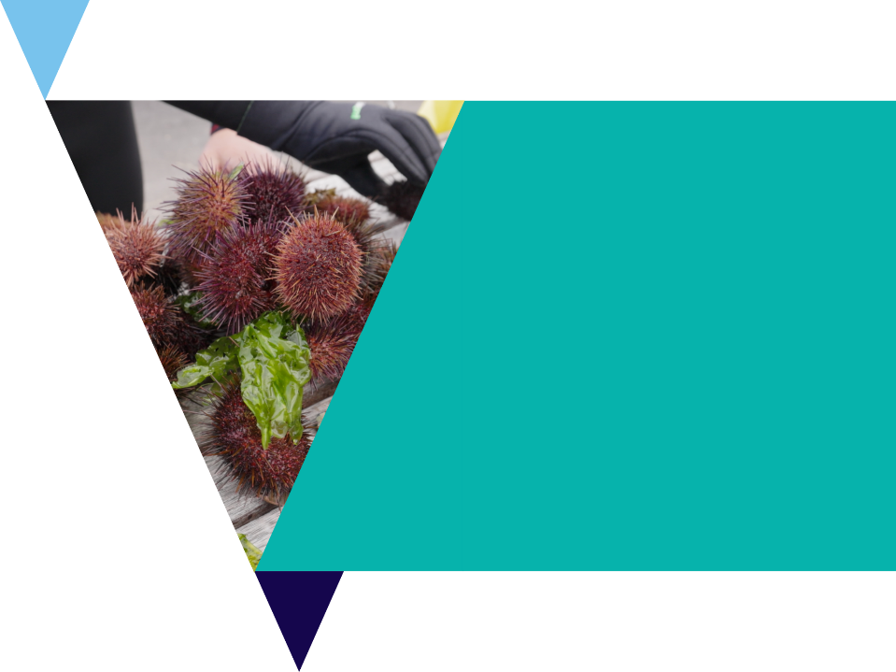
Sustainable seafood
As general rule, the lower they are on the population pyramid the more sustainable they are to harvest.
Often the smaller the prey of the organism, the more sustainable it is likely to be.
A traffic light system is often used to indicate sustainability:
  Green = sustainable
  Orange = eat less
  Red = say no

Slide 30
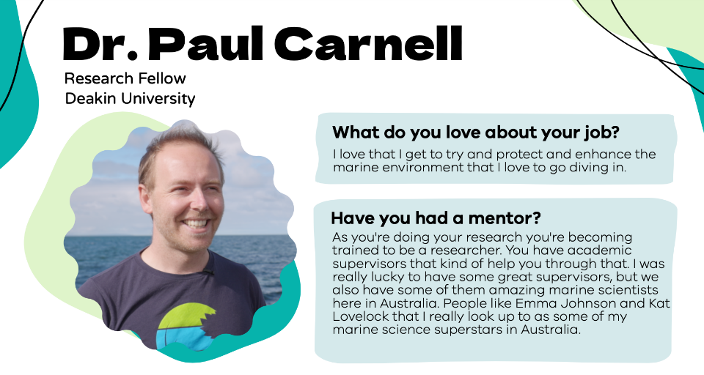
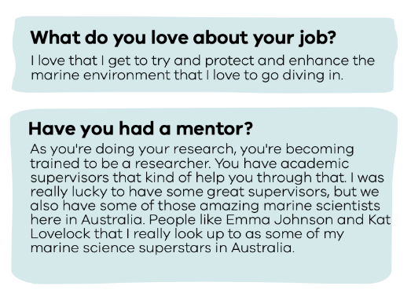

Slide 31
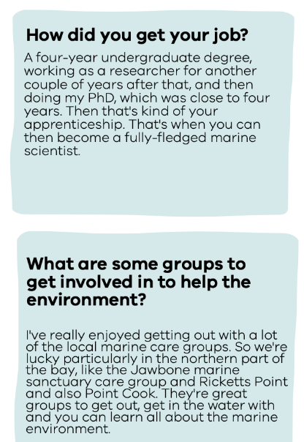


Slide 32


Slide 33

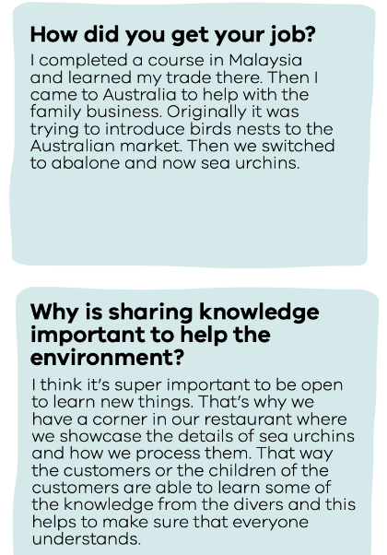
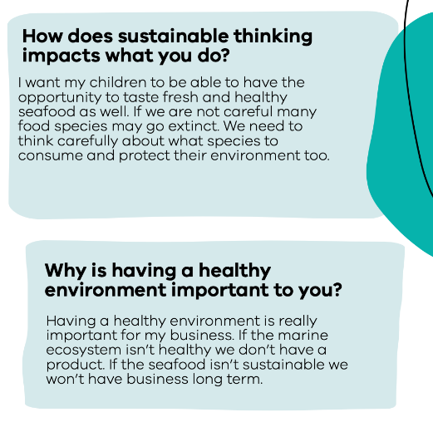

Slide 34

Review questions
It’s time to check your understanding!
Fill out the review worksheet on ecosystems
Or answer the questions in a class discussion.

